Slide 1
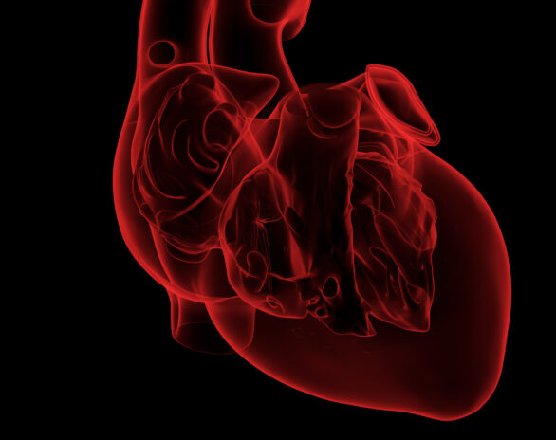
2025 ESC Guidelines for management of myocarditis and pericarditis
Suzane Cadiz
12/02/2026
Notes:
Last update 2015

Slide 2
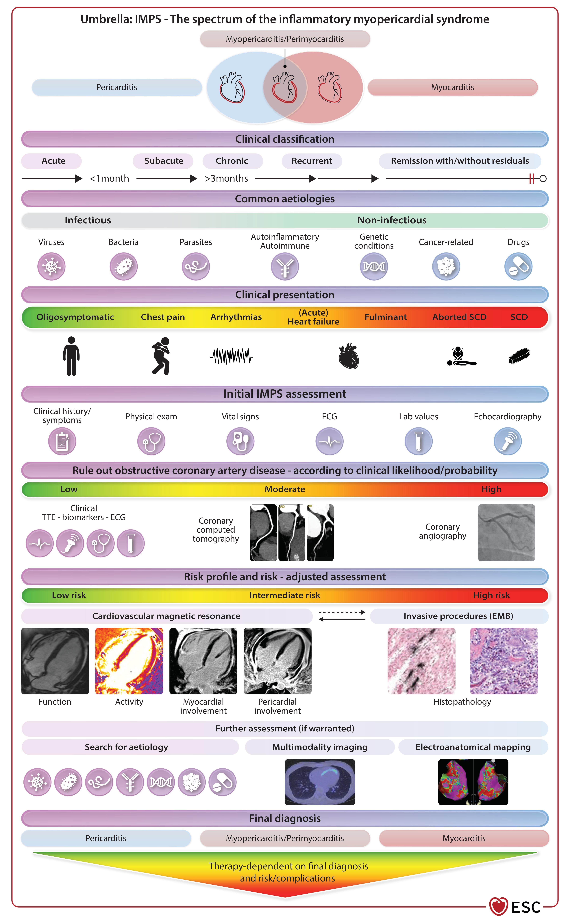
What's new in 2025?
1
First ESC myocarditis guideline
2
New umbrella term: IMPS
3
CMR-led diagnosis
Replaces the 2015 pericardial guideline and covers the whole myopericardial spectrum.
Inflammatory myopericardial syndrome, used until a final diagnosis is made.
Non-invasive diagnosis can be definite; biopsy is kept for selected patients.
ESC 2025 myocarditis & pericarditis guidelines
2
Notes:
~1 min. Six headline changes. (1) First ESC guideline for myocarditis; replaces the 2015 pericardial guideline. (2) IMPS is an entry term used until the final diagnosis is made. (3) Paradigm shift: CMR can give a definite non-invasive diagnosis, biopsy is now for selected cases. The ACC made a similar move in its 2024 consensus. (4) Genetics: overlap with desmosomal and sarcomeric cardiomyopathy, and with monogenic autoinflammatory disease in recurrent pericarditis. (5) Anti-IL-1 agents have a defined place in recurrent pericarditis. (6) Return to work and play is individualised rather than a fixed clock, and the task force recommends a multidisciplinary IMPS team for complicated cases.

Slide 3
IMPS: one spectrum, not two diseases
Isolated pericarditis
Myopericarditis
Perimyocarditis
Isolated myocarditis
Pleuritic pain, rub, raised CRP, effusion
Pericarditis-predominant: troponin rasied, no new LV dysfunction
Myocarditis-predominant: troponin raisedwith new LV dysfunction
Infarct-like pain, heart failure, arrhythmia
Acute: up to 4 weeks
Subacute: >4 weeks to 3 months
Chronic: >3 months
Complicated myocarditis
Fulminant myocarditis
Acute myocarditis plus at least one of: LVEF <50%, sustained ventricular arrhythmia, advanced heart block, heart failure, cardiogenic shock.
Acute onset with haemodynamic instability needing inotropes or mechanical circulatory support (about 3-9% of cases).
ESC 2025 myocarditis & pericarditis guidelines
3
Notes:
~1.5 min. The spectrum runs from isolated pericarditis to isolated myocarditis. Myopericarditis means pericarditis-predominant: definite pericarditis with raised troponin but no new LV dysfunction. Perimyocarditis is myocarditis-predominant: same picture but with new regional or global LV impairment on echo or CMR. Stages: acute up to 4 weeks, subacute more than 4 weeks to 3 months, chronic beyond 3 months. Complicated myocarditis is acute myocarditis plus at least one of LVEF below 50%, sustained ventricular arrhythmia, advanced heart block, heart failure or cardiogenic shock. Fulminant is acute onset with haemodynamic instability needing inotropes or mechanical support, roughly 3-9% of cases.
reflects the possible myocarditis–pericarditis overlap, aiming to increase the awareness of the spectrum of disease, and to allow timely diagnosis and better management
Guidelines for pericarditis have been published twice before, while myocarditis it is the first time it is covered in the guideline
Ranges from isolated myocarditis and isolated pericarditis with mixed forms inbetween
Introduced as they have similar aetiologies and are anatomical continguous structures with possible secondary involvement

Slide 4
Aetiology
Eur Heart J, Volume 46, Issue 40, 21 October 2025, Pages 3952–4041, https://doi.org/10.1093/eurheartj/ehaf192
Notes:
-Share mostly similar aetiologies- can be infectious or noninfectious; and these can trigger IMPS in those genetically predisoposed by inflammatory and autoimmune mechanisms
Myocarditis
-Most common infectious aetiology is presumed to be viral
-ex. Enteroviruses, adenovirus, and PArvoB19, EBX, influena, and coronavirus
-Bacterial infection with Borrelia (lyme caridits) and parasitic infections (Trypanosoma cruzi- Chagas disease) are important aetiologies in other regions
-Nonfecitous aetiologies including systemic disease, autoimmune disorders- SLE, SSc, RA, EGPA, EM, and cardiac sarcoidosis
-Inciting event- infection or exposure to durg to toxin that activates the immune response
-incidence of myocarditis caused by the infectious agents varies geographically
Pericarditis
-idiopathic or viral are the most frequent aetiology in developed countries
-TB is responsible for 70% cases in HIV patients in regions where disease is endemic
-Other systemic disease and cancer (lung, breast, lymphoma, and leukemia

Slide 5
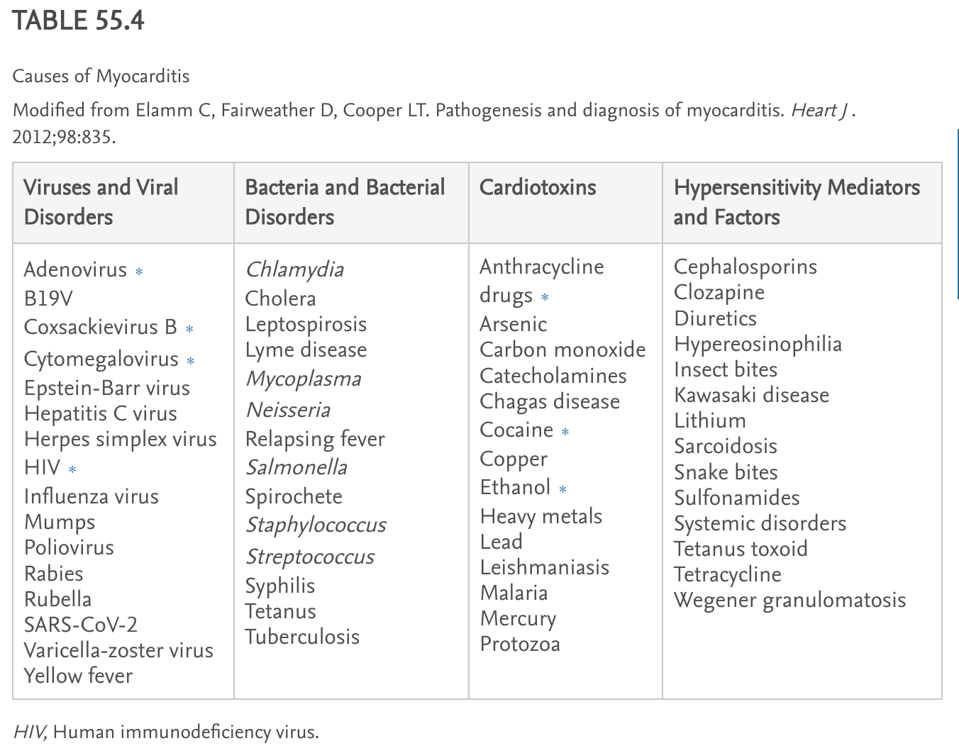
Notes:
Braunwald Heart disease

Slide 6
Diagnostic Criteria:
Myocarditis
Pericarditis
Clinical presentation
Chest pain, arrhythmia, heart failure, aborted SCD
Plus additional criteria
ECG changes (ST changes); troponin rise; abnormal strain, wall motion, reduced EF; CMR oedema and/or LGE
Definite
Clinical + CMR- or EMB-proven
Possible
Clinical + at least 1 additional criterion; CMR/EMB uncertain or unavailable
Clinical presentation
Sharp, pleuritic, positional chest pain (85-90% of cases)
Additional criteria
Friction rub; PR depression or widespread ST elevation; raised CRP; new or worsening effusion; CMR pericardial oedema/LGE
Definite
Clinical + more than 1 additional criterion
Possible
Clinical + 1 additional criterion
ESC 2025 myocarditis & pericarditis guidelines
4
Notes:
~1.5 min. The criteria mirror the 2023 endocarditis guideline: definite, possible, unlikely. Myocarditis needs a compatible clinical presentation (infarct-like pain, arrhythmia, heart failure, aborted SCD) plus additional criteria. It is definite when CMR or EMB proves it, possible when there are additional criteria but CMR/EMB is uncertain or unavailable. Pericarditis: typical pain plus more than one additional criterion is definite; one additional criterion is possible. Key teaching point: the pericardium is electrically silent, so ECG changes in a patient labelled pericarditis imply myocardial involvement. Always consider and exclude myocarditis.

Slide 7
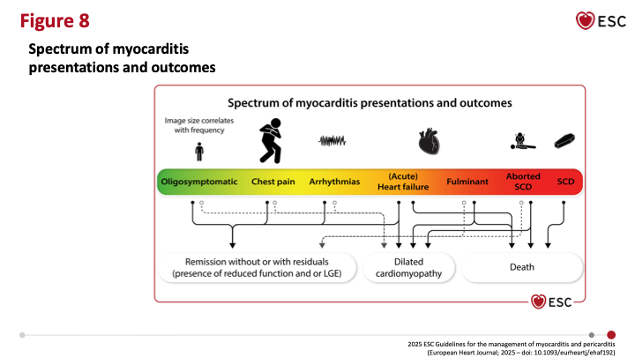
Clinical Presentation
Eur Heart J, Volume 46, Issue 40, 21 October 2025, Pages 3952–4041, https://doi.org/10.1093/eurheartj/ehaf192
Notes:
Most common symptom of myocarditis and pericarditis
The most common symptom of myocarditis and pericarditis is chest pain (sometimes with infarct-like features, especially for myocarditis, or pleuritic with respiratory changes, especially for pericarditis).
Other common presentations include dyspnoea (myocarditis with HF presentation, but it is also the most common symptom in the elderly with pericarditis)
and/or arrhythmias of different degrees (mainly ventricular for myocarditis and supraventricular and AF for pericarditis) and, less frequently, syncope. Flow charts are provided for each type to guide the diagnostic pathway (see Section 4.3).
Myocarditis is characterized by the heterogeneity of clinical manifestations
The main patterns of clinical presentation are infarct-like chest pain (most frequent symptom), arrhythmias, and HF.
Severity may range from asymptomatic/oligosymptomatic to severe life-threatening scenarios, such as severe HF or VA (potentially leading to SCD).
MYOCARDITIS
Chest pain -most common form of clinical presentation ; 75% of cases in adolescents and adults
Assoicated with increased in biomarkers (troponin) and ECG changes) (especially ST-segment elevation), which may mimic ACS, despite the absence of significant obstructive coronary artery disease (CAD).
Patients with this presentation usually report a recent or concomitant viral infection, such as a respiratory tract infection or gastroenteritis, which often precedes myocarditis by several days to weeks (2–4 weeks).
Heart Failure- clinical presentation may range from unexplained impaired ventricular function (with or without dilated LV), new onset or worsening HF (usually over 2 weeks to 3 months), to rapidly progressive refractory HF and cardiogenic shock.
Arrhythmia: Patients with AM with new, recurrent, or unexplained arrhythmias may have a wide spectrum of symptoms, ranging from palpitations to syncope or life-threatening arrhythmias causing aborted SCD.^{10,}
Scar-related VA can occur at any time during follow-up, even after inflammation resolution. However, polymorphic and irregular VA are more common during the active inflammatory phase, whereas monomorphic and regular VA are associated with healed myocarditis with residuals.⁸³ Consistently, catheter ablation of ventricular tachycardia (VT) is more effective when performed in the post-inflammatory stage of the disease rather than during AM.⁸⁴
AVB is a common feature of myocarditis related to non-viral infections (i.e. CD, LC, diphtheria),⁸⁵ and can also be an initial presentation of CS
---------
Clinical diagnosis of pericarditis requires pleuritic chest pain (or occasionally dyspnea in elderly) along with a least one of
Pericardial rub
Typical ECG findings in up to 60% (widespread ST-segment elevation and/or PR depression)
Elevated CRP 80-90%
Pericardial effusion, usually small in up to 60%

Slide 8
Triage: High-risk vs. Low-risk
Low-risk presentation
High-risk / complicated
~75%
of unselected cases are uncomplicated and usually have spontaneous remission
3-9%
present as fulminant myocarditis needing haemodynamic support
Chest pain with preserved LVEF
No wall-motion abnormality
No ventricular arrhythmia
ECG normalises
LVEF <50% or heart failure
Sustained VA or advanced AV block
Cardiogenic shock, fulminant course
Septal mid-wall LGE: worse outcomes
ESC 2025 myocarditis & pericarditis guidelines
5
Notes:
~1.5 min. Risk classification predicts outcome better than the label. About 75% of unselected myocarditis is uncomplicated: chest pain, preserved LVEF, no wall-motion abnormality, no ventricular arrhythmia, ECG normalising. Excellent long-term prognosis, with rare exceptions such as eosinophilic and giant-cell myocarditis. High-risk features: LVEF below 50% or heart failure, sustained VA or advanced AV block even with preserved EF, cardiogenic shock, and mid-wall septal LGE on CMR, which is linked to worse outcomes even with preserved EF. Fulminant disease is 3-9%. The guideline advises admission for all myocarditis, and exclusion of ACS first by angiography or CTCA depending on pre-test probability.

Slide 9
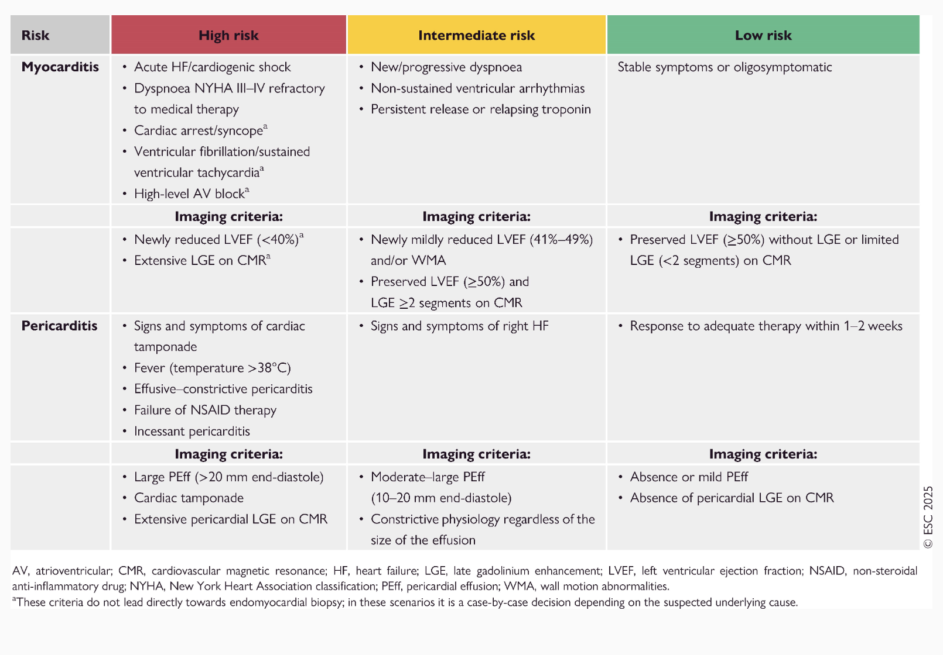
Clinical Risk Stratification
Eur Heart J, Volume 46, Issue 40, 21 October 2025, Pages 3952–4041, https://doi.org/10.1093/eurheartj/ehaf192
Notes:
-1B Hospital admission if recommended for patients with high risk peircaridtis
-1C Hospital admission is recommended for moderate to high risk myocarditis for monitoring and treatment

Slide 10
Pericarditis: admission?
Suspected pericarditis
Typical pain plus at least one additional criterion. ECG, CRP, hs-troponin, echo.
→
High-risk features: admit and search for aetiology
Fever >38°C; subacute course; moderate/large effusion or tamponade; no response to NSAIDs; myopericarditis; immunosuppression; anticoagulation; trauma
No high-risk features: outpatient care
Empirical NSAID + colchicine; no aetiology search if the response is good
20-30%
up to 50%
10-20%
recur within 18 months of a first episode
recur after a first recurrence
non-inflammatory phenotype (low CRP), harder to treat
ESC 2025 myocarditis & pericarditis guidelines
11
Notes:
~1.25 min. Triage by high-risk features. Admit and search for aetiology (TB, neoplasm, autoimmune, purulent) if any are present: fever above 38C, subacute course, moderate or large effusion or tamponade, failure to respond to NSAIDs, myopericarditis, immunosuppression, oral anticoagulation, trauma. Without these, treat as an outpatient with empirical anti-inflammatory therapy and no aetiological search if the response is good. Recurrence happens in 20-30% within 18 months and up to 50% after a first recurrence; omitting colchicine and using high-dose steroids with fast tapering are the main modifiable risks. 10-20% have a non-inflammatory phenotype with low or normal CRP, which is harder to treat. Verify the exact high-risk list against Table 16 before teaching it.

Slide 11
Work-up:
Initial work-up
Advanced
History and examination: triggers, drugs
ECG
Chest X-ray
Biomarkers
Echocardiography
Coronary angiography or CTCA if ACS possible to exclude obstructive CAD (1C)
CMR in all with clinical suspicion of myocarditis and pericarditis (1B)
EMB: high-risk; intermediate case by case (1C)
Hospital admission for high-risk pericarditis (1B) and moderate-high risk myocarditis (1C)
ESC 2025 myocarditis & pericarditis guidelines
6
Notes:
~1 min. Basic assessment is for everyone: history including triggers, drugs and family history; ECG and chest X-ray; hs-troponin, CRP/ESR, NT-proBNP, full blood count with eosinophils, renal, thyroid and liver tests; echo with strain. Advanced assessment is usually after admission: coronary anatomy, CMR, arrhythmia monitoring, biopsy in high-risk cases, genetic testing where indicated, CT for pleuropulmonary disease, diagnostic pericardiocentesis when indicated. A normal ECG does not exclude IMPS. Routine viral serology is not recommended, except HIV, HCV and suspected Borrelia, rickettsial or T. cruzi infection.

Slide 12
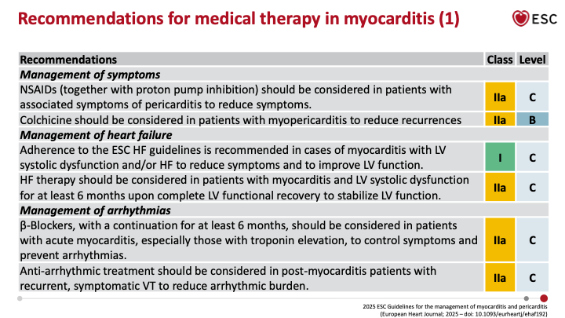
Myocarditis: management
Restriction of physical activity
Notes:
-Restriction of physical activity until symptom resolution and clinical remission with normalization of inflammatory markers
-according to presentation at least 1 month needed to reach clinical remission (but can be longer)
-Clinical remission is defined as full regression of symptoms as well as normalization of laboratory results (CRP and trop) and investigations (ECG, evidence of Peff, CMR evidence of activie inflammation)
-additional testing (eg. Exercise testing and holter monitoring) is recommended for patients with myocarditis
Recommended prolonged rest period, gradual, monitored return to work and physical activity may be helpful
I will not go into aetiology-direted tehrapy
Arrhythmias:
Beta-blockers at least 6 months in AM with high troponin, to control symptoms, and prevent arrhythmias

Slide 13
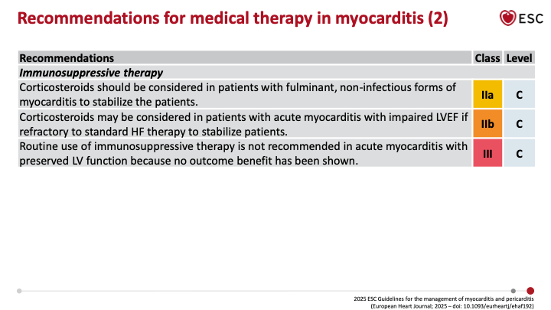

Slide 14
Pericarditis: management
1 | First line
2 | Second line
3 | Anti-IL-1
Aspirin/NSAID + colchicine (1A)
Colchicine 0.5 mg OD (<70 kg) or BD (≥70 kg)
Colchicine ≥3 months first episode, ≥6 months recurrent; stop it last
Taper NSAID by CRP and symptoms
Low-moderate dose corticosteroid-prednisone 0.2-0.5 mg/kg/day (2A)
With colchicine or triple therapy
Used of NSAIDs contraindicated
Slow taper
Anakinra or rilonacept
Failure of first line therapies and steroids with raised CRP (1A)
Allows steroid withdrawal
ESC 2025 myocarditis & pericarditis guidelines
12
Notes:
~1.5 min. Step 1: aspirin or NSAID plus colchicine, Class I Level A. Typical doses: aspirin 750-1000 mg three times daily or ibuprofen 600 mg three times daily, tapered over weeks once CRP and symptoms settle; colchicine 0.5 mg daily if under 70 kg or twice daily if 70 kg or more. Colchicine for at least 3 months after a first episode and at least 6 months for incessant or recurrent disease, and it is the last drug to stop. Step 2: low-to-moderate dose corticosteroid, for example prednisone 0.2-0.5 mg/kg/day, only when NSAIDs are contraindicated or have failed, with a slow taper; high doses with fast tapering promote recurrence. Step 3: anti-IL-1 (anakinra or rilonacept) for colchicine-resistant, steroid-dependent disease with raised CRP; rapid onset allows steroid withdrawal. Secondary sources disagree on the exact class for anti-IL-1 (I versus IIa), so check Recommendation Table 10 before quoting it. Confirm doses against Table 13. Exercise restriction applies until remission.

Slide 15
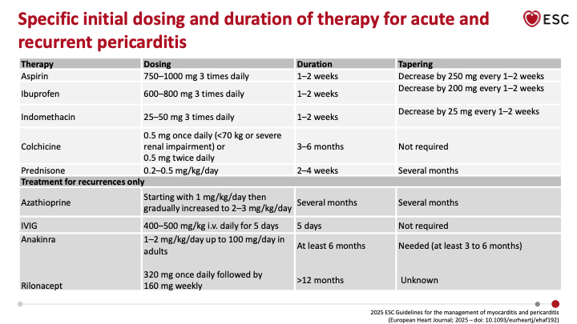

Slide 16
Follow-up & Activity
Follow-up
Activity
Every myocarditis patient, within 6 months: clinic, ECG, Holter, echo, CMR
Exercise test if no active inflammation
Complicated: long-term
Prognosis tracks baseline and 6-month LV function
Avoid exertion beyond sedentary activity until symptoms resolve and markers normalise
Individualised return to work and play: no fixed 3 or 6 month rule
Exercise test and Holter inform clearance
ESC 2025 myocarditis & pericarditis guidelines
15
Notes:
~1.25 min. Follow-up: all myocarditis patients need a structured review within 6 months of the index admission: clinical assessment, ECG, Holter, echo and CMR, with an exercise test if there is no ongoing inflammation. Uncomplicated cases: 6, 12 and 24 months; complicated cases need long-term follow-up. Prognosis tracks baseline and 6-month LV function, and the ICD decision is usually deferred to 3-6 months. Activity: the guideline moves away from fixed 3 or 6 month abstinence to an individualised return once symptoms have resolved and markers and imaging have normalised, supported by exercise testing and Holter. The ACC documents still use 3-6 months, which is a useful contrast. Pregnancy: preconception counselling in recurrent disease, NSAIDs can be considered until week 20, minimal effective steroid dose in active disease, and colchicine in selected cases. Confirm the exact return-to-play wording in Recommendation Table 26.
All follow-ups should be adapted to the clinical situation and severity
-Patients with low-risk myocarditis with chest pain presentation can be discharged when cardiac enzymes tend towards normalisation. Time to recovery in AM varies from few days to months
Relaps in 10% of cases; 5% 1 year recurrence
-Follow-up recommended in all patietns with myocarditis
-Clinical assessment
-ECG
-Holter
-exercise test
-CMR within last 6 months
-It is accepted to wait 3-6 months after acute episode of myocarditis to evalusate the need for an ICD
-In patients high risk of VA; Wearable CD should be cosiderred during follo—up as bridge to recovery
-Long term follow-up is recommended for patients with complicated myocarditis to ID a potential progression or new complications (I)
-long-term follow-up is recommended for patients with incessant or recurrent pericarditis to ID progression or new complciations (I)

Slide 17
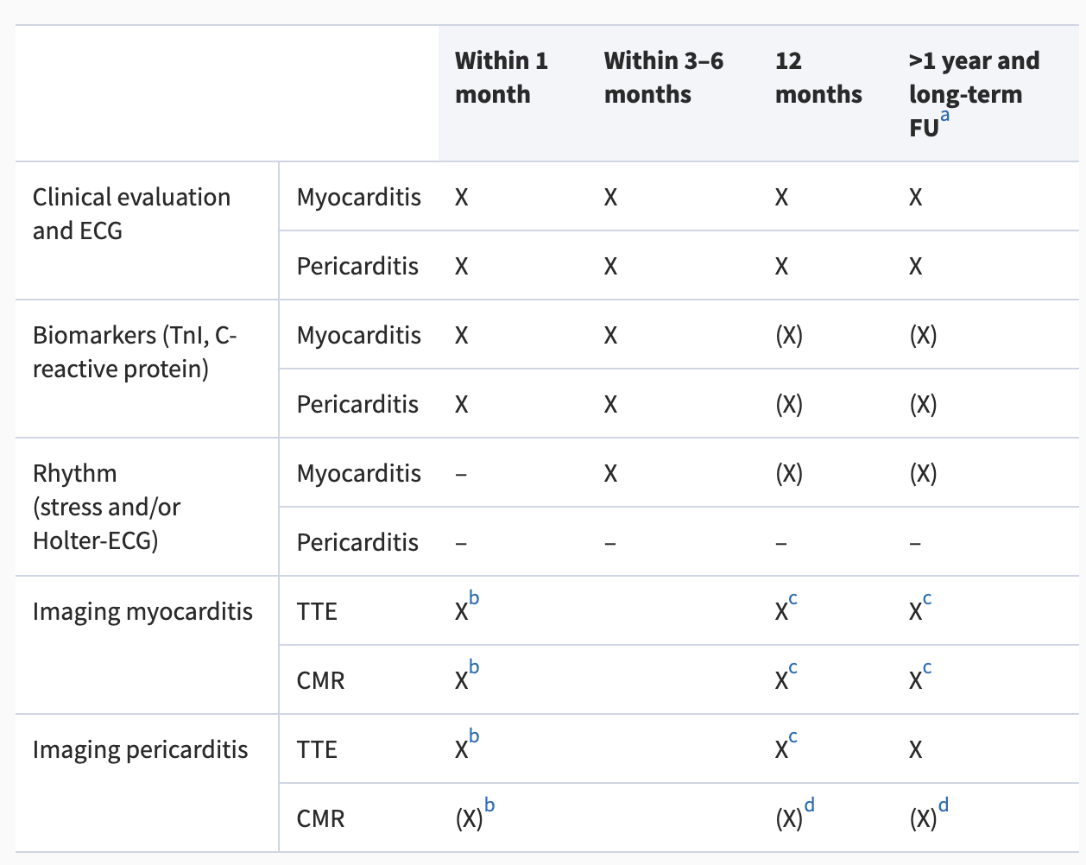
Follow-up in IMPS
Eur Heart J, Volume 46, Issue 40, 21 October 2025, Pages 3952–4041, https://doi.org/10.1093/eurheartj/ehaf192
Notes:
All follow-ups should be adapted to the clinical situation and severity
-Patients with low-risk myocarditis with chest pain presentation can be discharged when cardiac enzymes tend towards normalisation. Time to recovery in AM varies from few days to months
Relaps in 10% of cases; 5% 1 year recurrence
-Follow-up recommended in all patietns with myocarditis
-Clinical assessment
-ECG
-Holter
-exercise test
-CMR within last 6 months
-It is accepted to wait 3-6 months after acute episode of myocarditis to evalusate the need for an ICD
-In patients high risk of VA; Wearable CD should be cosiderred during follo—up as bridge to recovery
-Long term follow-up is recommended for patients with complicated myocarditis to ID a potential progression or new complications (I)
-long-term follow-up is recommended for patients with incessant or recurrent pericarditis to ID progression or new complciations (I)

Slide 18
References
Libby, P., Bonow, R. O., Mann, D. L., Tomaselli, G. F., Bhatt, D. L., & Solomon, S. D. (2022). Braunwald's heart disease: A textbook of cardiovascular medicine (12th ed.). Elsevier.
Schulz-Menger, J., Collini, V., Gröschel, J., Adler, Y., Brucato, A., et al. (2025). 2025 ESC Guidelines for the management of myocarditis and pericarditis. European Heart Journal, 46(40), 3952–4041. https://doi.org/10.1093/eurheartj/ehaf192.

Slide 19
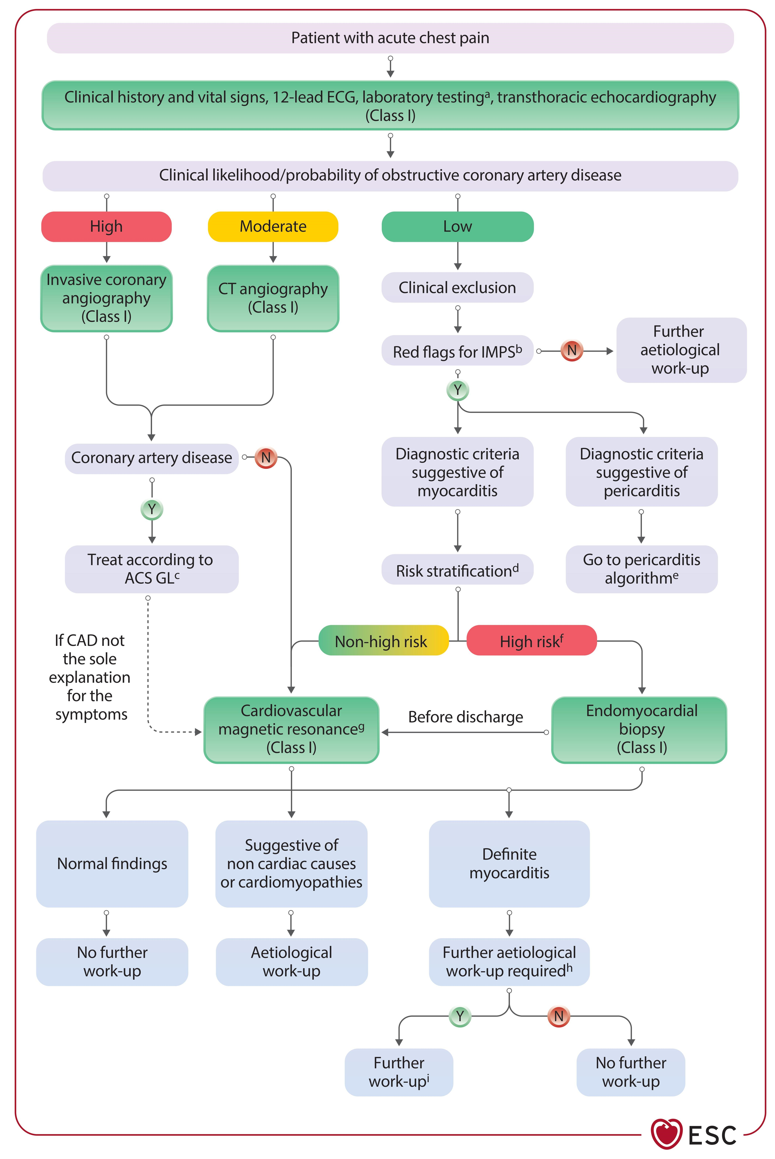
Diagnostic algorithm for acute chest pain
Eur Heart J, Volume 46, Issue 40, 21 October 2025, Pages 3952–4041, https://doi.org/10.1093/eurheartj/ehaf192
Notes:
Figure 9 Diagnostic algorithm for acute chest pain presentation.
Class 1C recommendation for coronary angiography or Coronary CT (depending on clinica likelihood) for patients with IMPs if ACS is suspected to r/o CAD

Slide 20
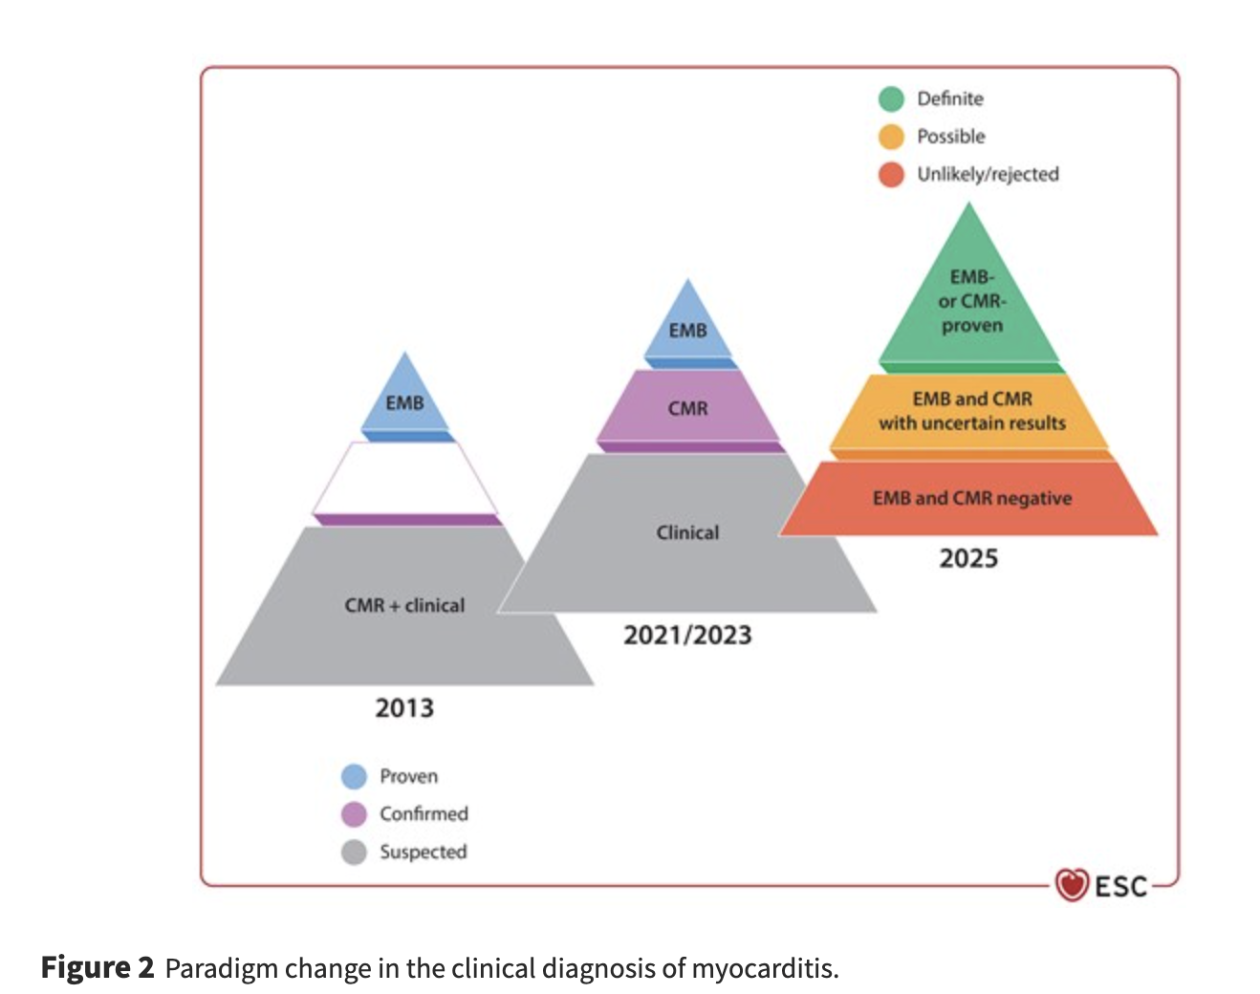
Role of CMR in Diagnosis
Notes:
The diagnostic work-up in patients with suspected IMPS should be tailored based on the severity of clinical presentation, response to medical therapy, and individual risk (Table 7). It includes medical history, clinical/physical exam, biomarkers (myocardial injury, systemic inflammation, and HF), ECG, and multimodality imaging. Endomyocardial biopsy has its place in dedicated clinical scenarios.
In the past, several consensus statements were provided, usually defining a proven myocarditis based on endomyocardial biopsy (EMB). Endomyocardial biopsy is able to detect the histological type, can identify some specific aetiologies, and can help to differentiate from non-inflammatory cardiomyopathies (CMPs).¹⁰ But nowadays multimodality imaging has become a cornerstone for the diagnosis of myocardial and pericardial inflammation and cardiovascular magnetic resonance (CMR) plays a crucial role
-1B: CMR recommended for patients with clinical suspicion of myocarditis and or pericarditis for non-invasive diagnosis of inflammatory reaction

Slide 21
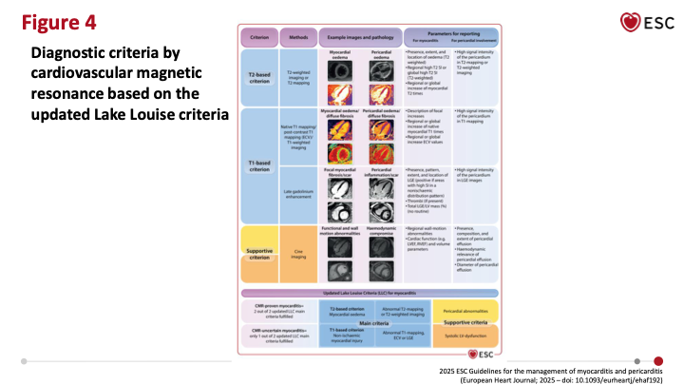
Diagnostic criteria by CMR updated Lake Louise Criteria
Notes:
Diagnostic criteria by CMR updated Lake Louise Criteria
Myocarditis: Myocardial oedema and changes due to inflammation lead to increased tissue water content that can be detected as increased signal intensities on T2-weighted imaging and/or T2 mapping; increased tissue free-water content will also lead to an increased signal in T1 mapping and extracellular volume (ECV) quantification. Myocyte necrosis and fibrosis can result in non-ischaemic (e.g. mid-wall, subepicardial, patchy) patterns of LGE, which do not typically follow a coronary artery distribution.
----
In the case of pericarditis, CMR detects thickening, oedema, and LGE of the pericardium
Cardiovascular magnetic resonance is helpful for an objective assessment of the degree of inflammatory involvement of the pericardium, either for first diagnoses or follow-up

Slide 22
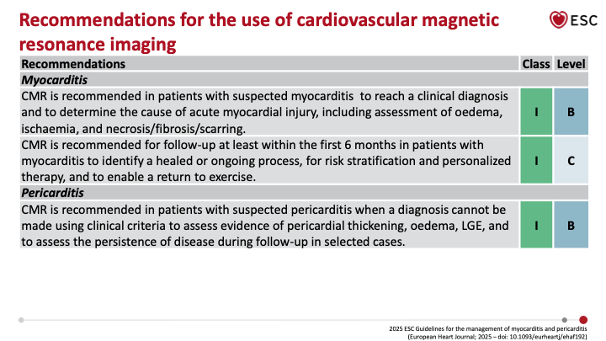

Slide 23
Management- Myocarditis
Restriction of physical activity
Notes:
-Restriction of physical activity until symptom resolution and clinical remission with normalization of inflammatory markers
-according to presentation at least 1 month needed to reach clinical remission (but can be longer)
-Clinical remission is defined as full regression of symptoms as well as normalization of laboratory results (CRP and trop) and investigations (ECG, evidence of Peff, CMR evidence of activie inflammation)
-additional testing (eg. Exercise testing and holter monitoring) is recommended for patients with myocarditis
Recommended prolonged rest period, gradual, monitored return to work and physical activity may be helpful
I will not go into aetiology-direted tehrapy
Arrhythmias:
Beta-blockers at least 6 months in AM with high troponin, to control symptoms, and prevent arrhythmias

Slide 24
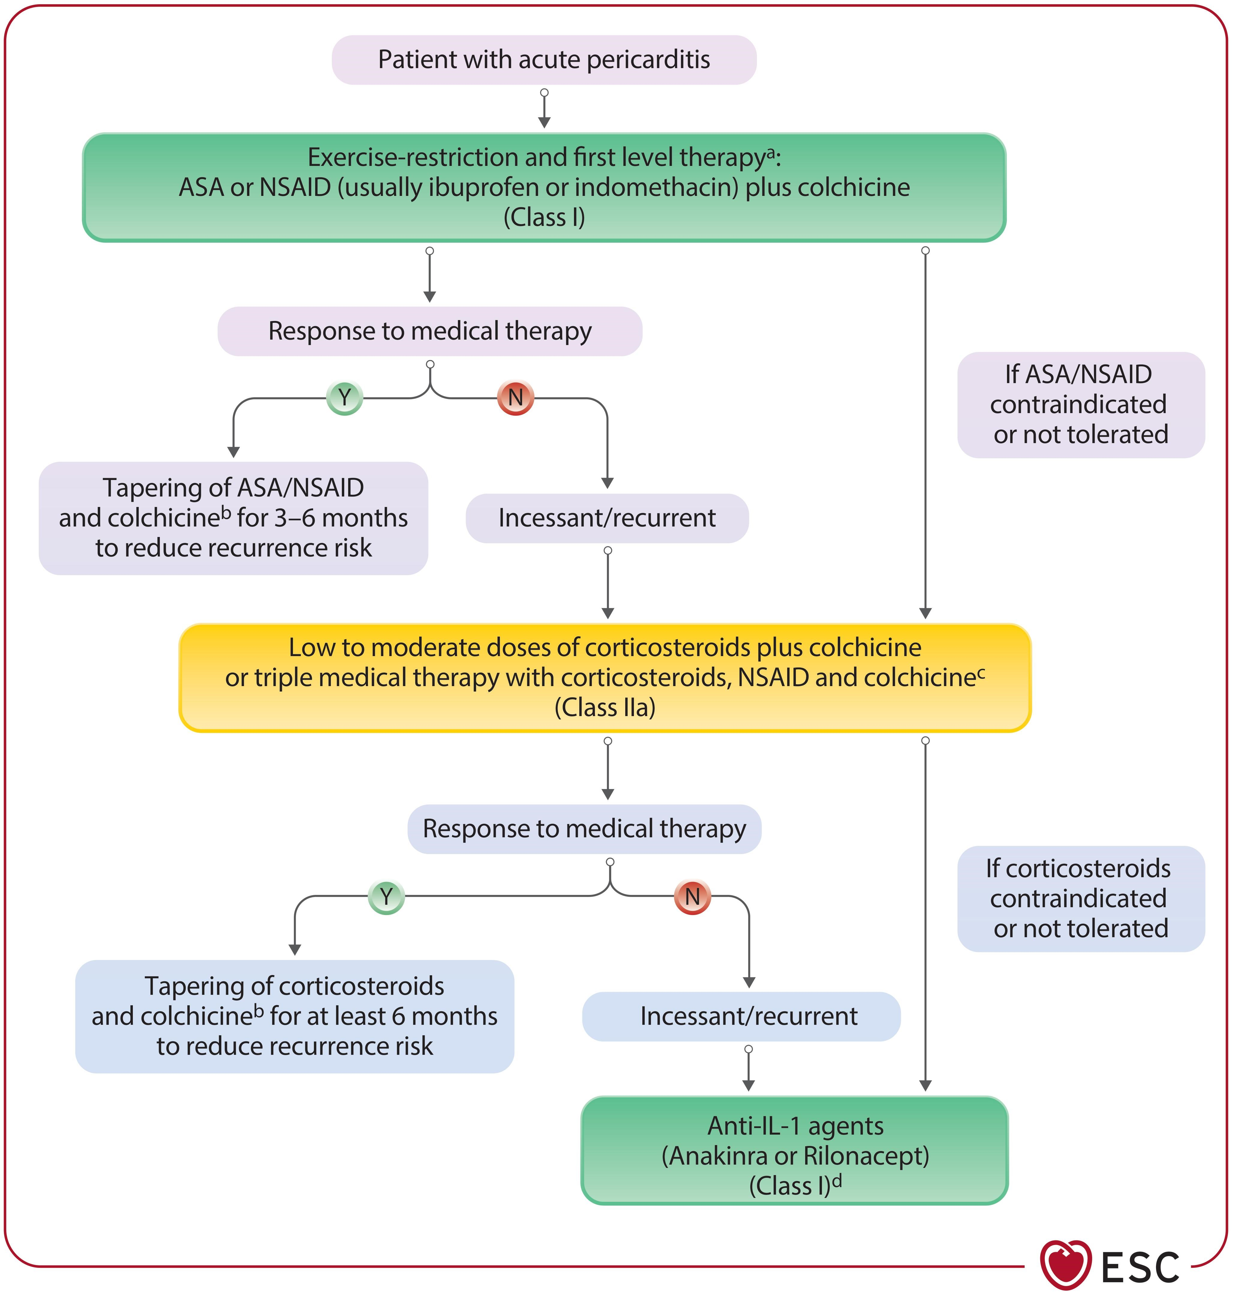
Management- Pericarditis
Eur Heart J, Volume 46, Issue 40, 21 October 2025, Pages 3952–4041, https://doi.org/10.1093/eurheartj/ehaf192
Notes:
Goals of management- symptomatic, clinical remission and prevention of complications and recurrences
Colchicine first line therapy in patients with pericarditis as adjunct/NSAID or corticosetior therpay to reduce recurrences (I)
Anti-IL1 (anakira/riloacept) for patietns with recurrent pericarditis aftetr failure of first line therapies and corticoseteriods and elvel of CRP levels to reduce recurrences and allow corticosteroid withdrawal (I)
High dose aspirin or NSAID with PPI is first line in patients with pericarditis to control symptoms and reduce recurrences (I)

Slide 26
Follow-up in IMPS
Eur Heart J, Volume 46, Issue 40, 21 October 2025, Pages 3952–4041, https://doi.org/10.1093/eurheartj/ehaf192
Notes:
All follow-ups should be adapted to the clinical situation and severity
-Patients with low-risk myocarditis with chest pain presentation can be discharged when cardiac enzymes tend towards normalisation. Time to recovery in AM varies from few days to months
Relaps in 10% of cases; 5% 1 year recurrence
-Follow-up recommended in all patietns with myocarditis
-Clinical assessment
-ECG
-Holter
-exercise test
-CMR within last 6 months
-It is accepted to wait 3-6 months after acute episode of myocarditis to evalusate the need for an ICD
-In patients high risk of VA; Wearable CD should be cosiderred during follo—up as bridge to recovery
-Long term follow-up is recommended for patients with complicated myocarditis to ID a potential progression or new complications (I)
-long-term follow-up is recommended for patients with incessant or recurrent pericarditis to ID progression or new complciations (I)

Slide 27
References
Libby, P., Bonow, R. O., Mann, D. L., Tomaselli, G. F., Bhatt, D. L., & Solomon, S. D. (2022). Braunwald's heart disease: A textbook of cardiovascular medicine (12th ed.). Elsevier.
Schulz-Menger, J., Collini, V., Gröschel, J., Adler, Y., Brucato, A., et al. (2025). 2025 ESC Guidelines for the management of myocarditis and pericarditis. European Heart Journal, 46(40), 3952–4041. https://doi.org/10.1093/eurheartj/ehaf192.

