Slide 1

Takotsubo Syndrome
Suzane Cadiz
ST4 Cardiology Registrar
Cardiology Teaching: August 20th, 2026

Slide 2
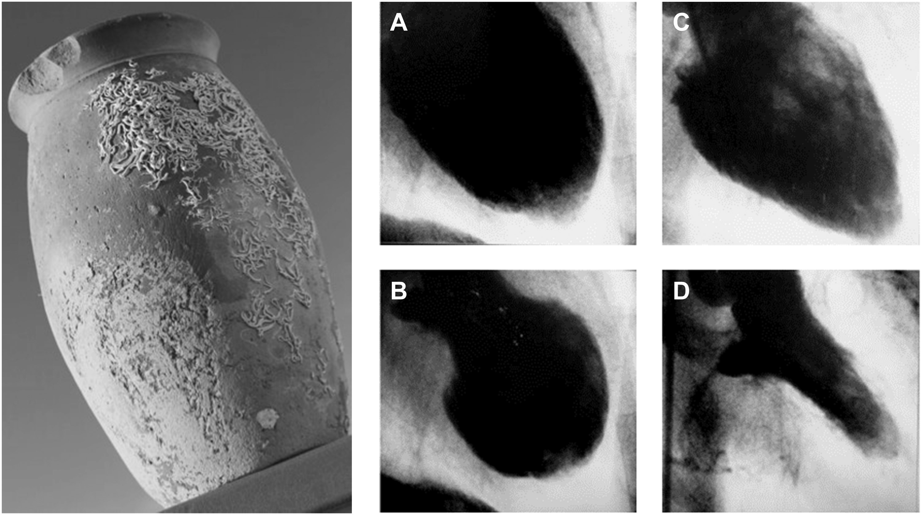
Characterized by transient regional systolic dysfunction, dilatation, and oedema involving the LV apex and/or mid-ventricle in the absence of obstructive coronary disease on coronary angiography.
Definition: Takotsubo syndrome (TTS)
Notes:
History:
-First described in Japan 1990 (Sato et al.)
-Name from the Japanese word for octopus trap, due to the shape of the LV at the end of systole (unusual appearance of the left ventricle (LV) with a narrow neck and apical ballooning during systole)
-different names in the literature including ‘broken heart syndrome’, ‘stress cardiomyopathy’, and ‘apical ballooning syndrome’.
-TTS is characterized by a temporary wall motion abnormality of the LV
https://academic.oup.com/eurheartj/article/39/22/2032 and https://academic.oup.com/eurheartj/article/39/22/2047

Slide 3
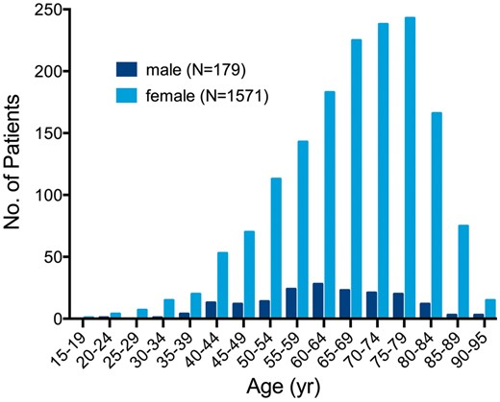
Epidemiology & Triggers
~ 1–3% of all STEMI
~5–6% of female patients presenting with suspected STEMI
~90% postmenopausal women (mean age 67-70)
Recurrence rate of TTS is estimated to be 1.8% per-patient year
Common triggers
  Bereavement
  Anxiety
  Surgery
  Acute illness
  Neurologic events.
Notes:
-Symptoms are often preceded by emotional or physical stress.
-uncommon in African–Americans and Hispanics while most of the cases reported in the United States have been Caucasians
https://academic.oup.com/eurheartj/article/39/22/2032 and https://academic.oup.com/eurheartj/article/39/22/2047

Slide 4
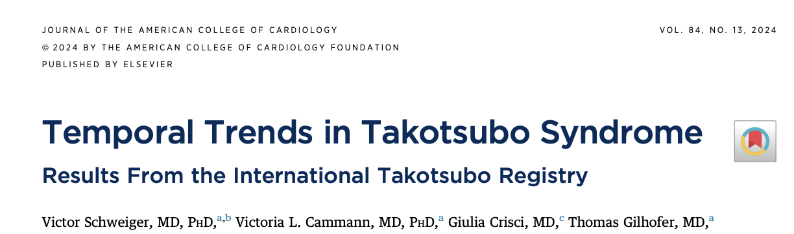
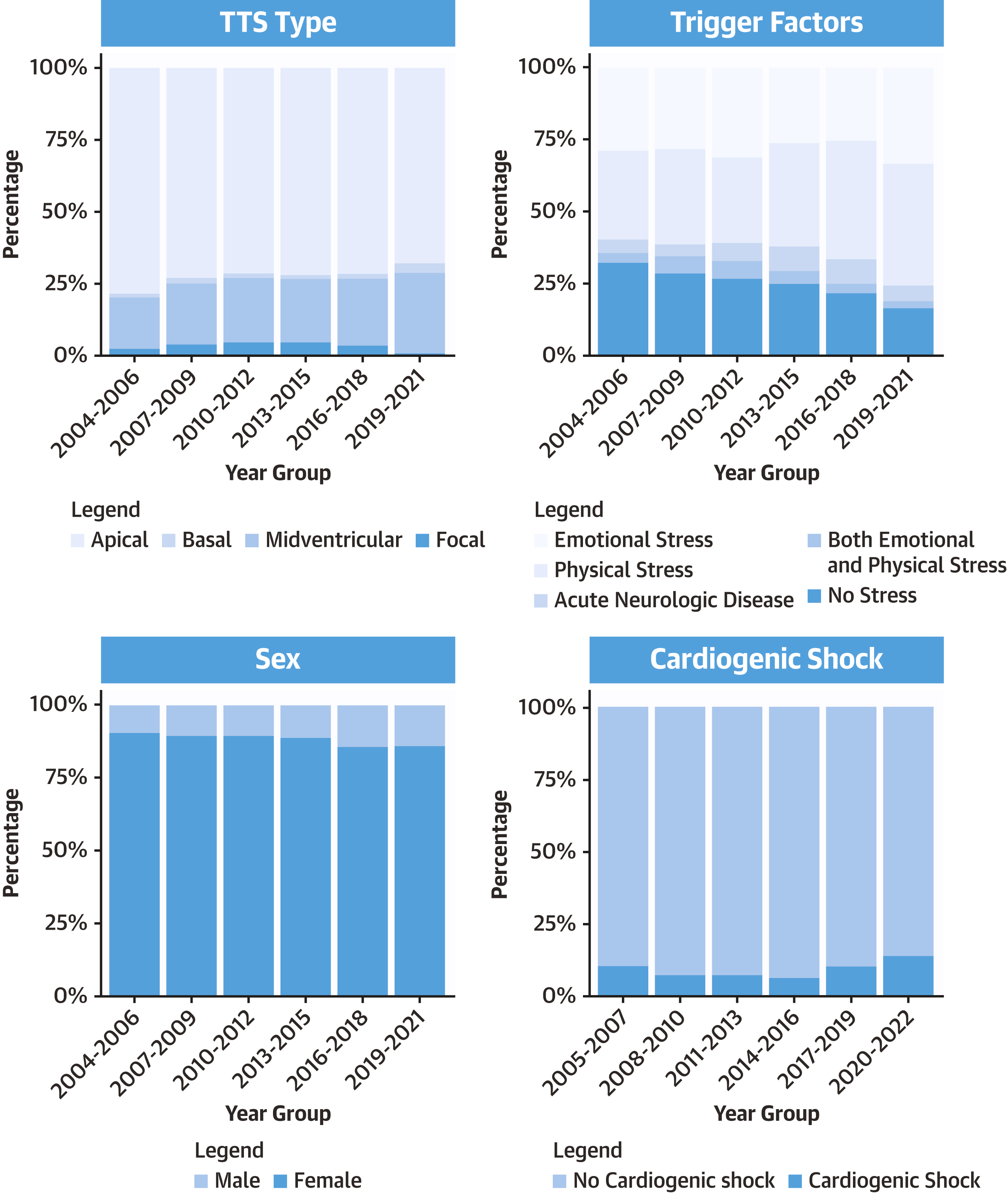
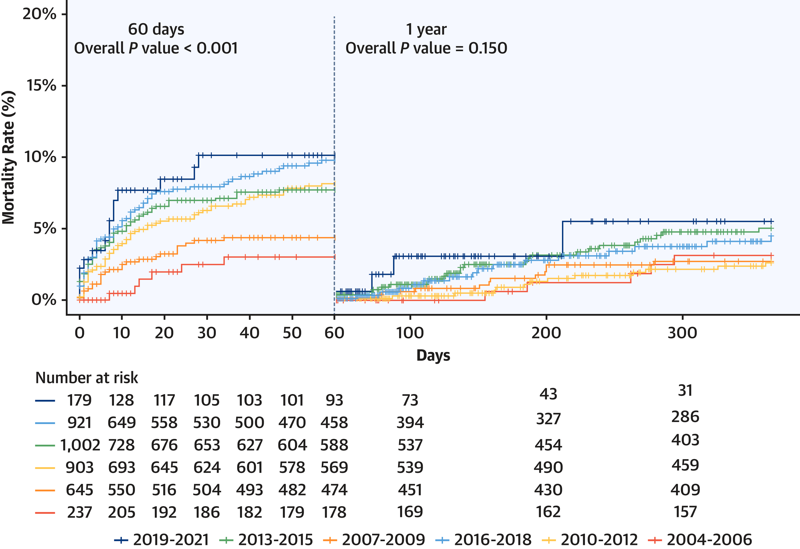
Notes:
Temporal Trends in Takotsubo Syndrome: Results From the International Takotsubo Registry
1) there has been a significant increase in the proportion of male patients diagnosed with TTS in recent years, indicating a transition in the demographic profile of the condition
2) the prevalence of apical TTS decreased, whereas midventricular TTS has become more commonly recognized
3) the prevalence of physical triggers has significantly risen over the years
4) over the course of the study, there was a significant increase in the incidence of cardiogenic shock and short-term mortality. Conversely, when patients who died within the first 60 days were excluded, the analysis revealed no significant change in long-term mortality rates.

Slide 5

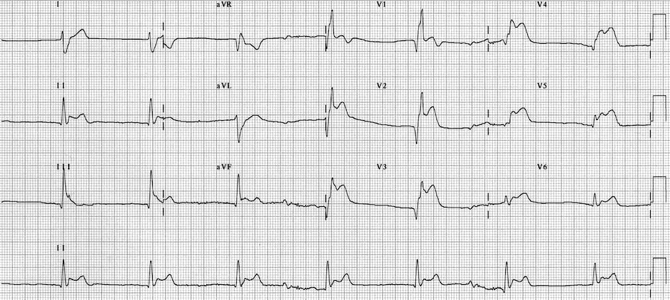
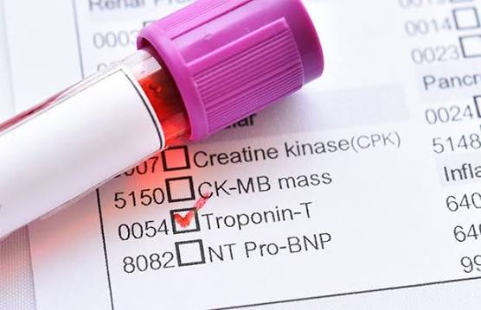
Clinical Presentation
Abrupt onset of angina-like chest pain and heart failure symptoms (dyspnea, orthopnea or syncope)
ECG changes: diffuse T wave inversion (TWI), sometimes preceded by ST-segment elevation
Mild cardiac enzyme elevation.
Notes:
Often presents like ACS
Stage 1 involves ST deviation occurring within the first few hours of symptoms onset.
Stage 2 involves progressive deep T-wave inversion and QTc prolongation, occurring within 1 to 3 days and peaking at 2 to 6 days, although when corrected for sex, the QTc is not different from male patients with acute myocardial infarction.These T-wave inversions are usually widespread over the precordial (V₁ through V₆), bipolar (I, II), and lateral limb (aVL) leads and correlate with myocardial edema, which can persist beyond ventricular contractile recovery. During these first 24 to 48 hours, torsade de pointes and other ventricular tachycardias can occur. The association of ventricular arrhythmias with prolonged QTc segment in takotsubo syndrome is well established. It Stage 3 involves gradual resolution of T-wave and QTc changes over subsequent weeks or months.³⁵
https://academic.oup.com/eurheartj/article/39/22/2032 and https://academic.oup.com/eurheartj/article/39/22/2047

Slide 6
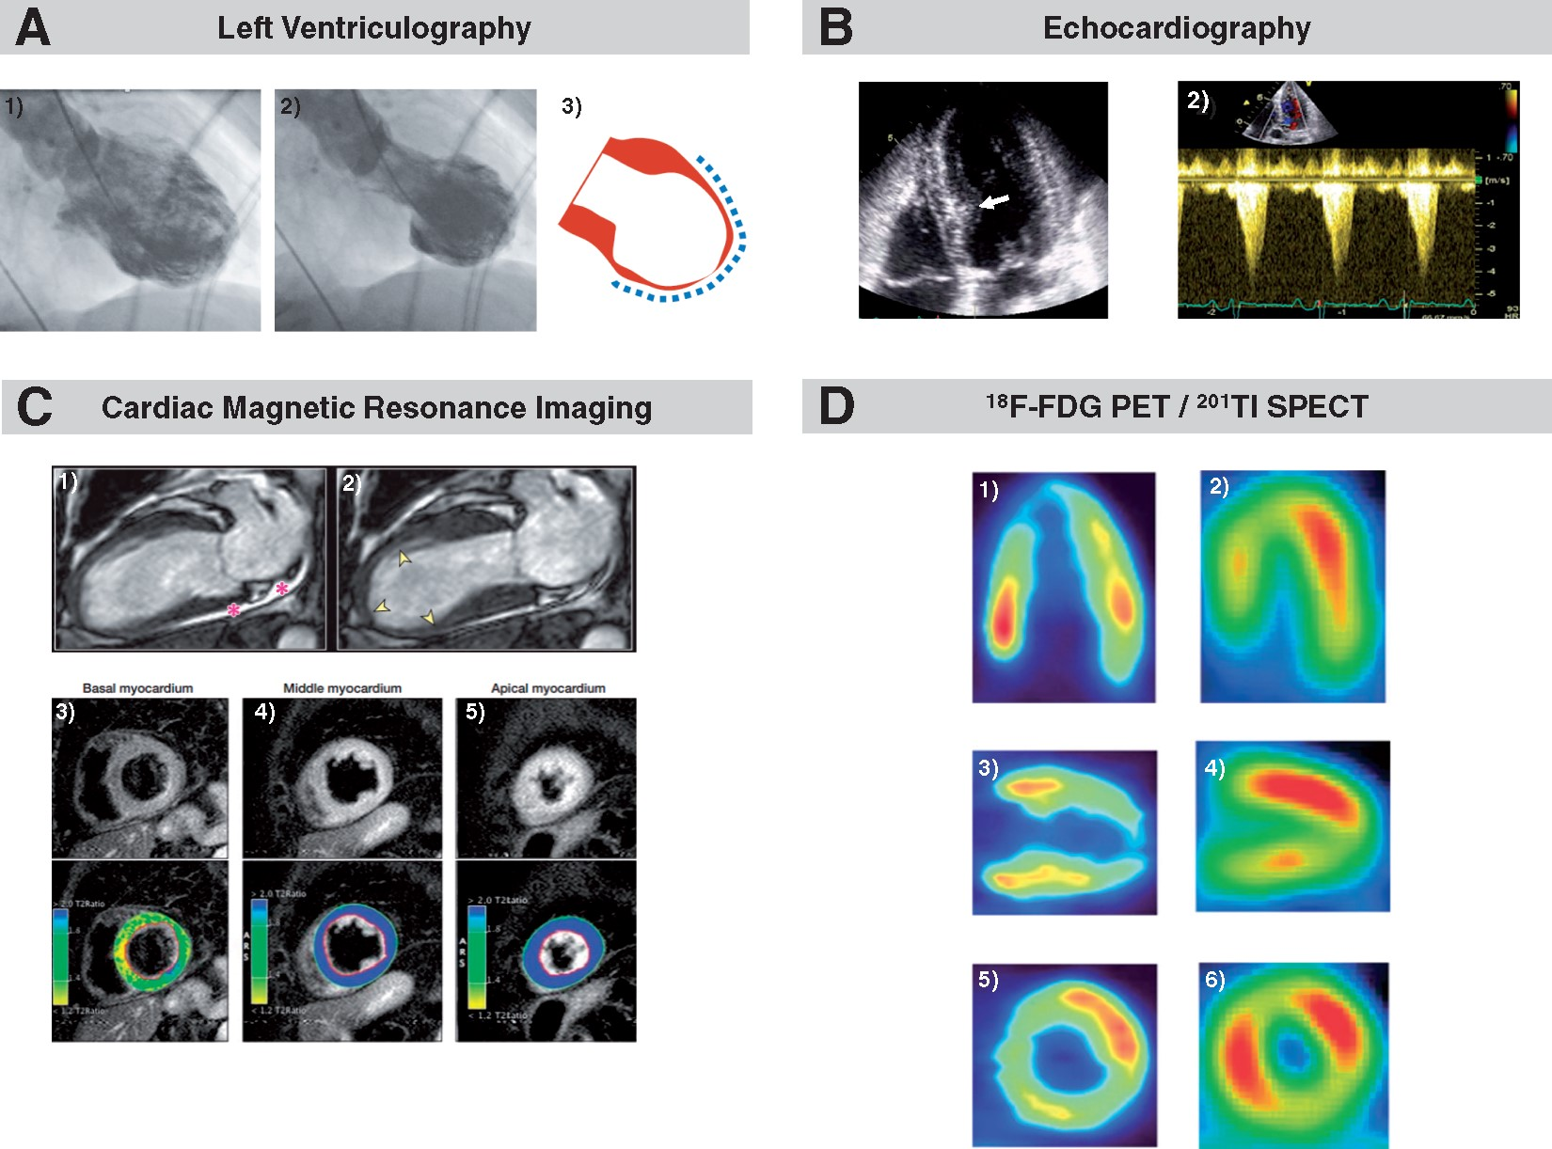
Investigations
ECG: usually demonstrating ischaemic ST-segment elevation, T-wave inversion
Troponin: raised; peak values are lower compared to ACS.
Echocardiography
  Temporary LVSD with RWMAs depending on the variant—apical, basal, or focal.
  To rule out complications (thrombus or LVOTO).
CTCA
Coronary angiography- non-bstructive coronary arteries. Concomitant CAD may be present in at least 15% of patients.
Cardiac MRI:
  absence of late gadolinium enhancement, (in AMI/myocarditis)
  Presence of complications
  RV and LV function
Ghadri et el., 2018
Notes:
ECg:
T-segment elevation- 44%
ST-depression-8%
T-wave inversion-41%
LBBB- 5%.
Troponins:
-High levels = predictor for a worse in-hospital outcome.
Echocardiography is the most used imaging tool to assess changes in LV function such as symmetric regional wall motion abnormalities (RWMAs).
Different variants can be identified with echocardiography which include:
Apical ballooning, hypo-, a-, or dyskinesia of mid-apical myocardial segments is typical, sometimes associated with hypokinetic mid-segments. The anterior or entire interventricular septum, inferior or midventricular anterolateral wall may also be involved.⁴ LV twisting on 2D speckle-tracking imaging is reduced or reversed to clockwise apical rotation and the rate of untwisting (a sensitive index of regional diastolic dysfunction) is reduced in the acute phase.
Midventricular TTS featured by hypo-, a-, or dyskinesia of midventricular segments, most often resembling a cuff.
Basal forms :This phenotype is rare and appears commonly in patients with subarachnoid haemorrhage, epinephrine-induced TTS or phaeochromocytoma.
Focal TTS mostly involving an anterolateral segment has been described- Differentiating this unusual TTS type from ACS or myocarditis requires CMR.⁴⁹
Right ventricular involvement is characterized by RV dilatation with hypo- to akinesia of the free wall and apex in its isolated form
Typically, LV contractility recovers completely in 4–8 weeks. Some segments of the LV recover earlier than others, displaying increased apical rotation, LV twisting and untwisting and recovered global longitudinal strain. Resolution of LVOTO and MR occurs in parallel with myocardial functional recovery.
-CTCA: In the presence of life-threatening comorbid conditions such as terminal malignancy, intracranial bleeding, advanced age with frailty and bleeding diathesis, invasive CAG may pose a considerable risk for complication
- The reasons for not performing CAG were not described but likely included the mentioned life-threatening comorbid conditions. In such patients, non-invasive CCTA may be an appropriate alternative to CAG. Coronary computed tomography angiography provides information on both coronary artery anatomy and regional LV contraction.
-CMR allows precise quantification of RV and LV function, assessment of additional abnormalities/complications (i.e. pericardial and/or pleural effusion, LV and RV thrombi), and characterization of myocardial tissue (i.e. oedema, inflammation, necrosis/fibrosis) Recently, specific CMR criteria for TTS diagnosis at the time of acute presentation were established which include the combination of typical RWMAs, oedema, and the absence of evidence of irreversible tissue injury [late gadolinium enhancement (LGE)].⁸²
-While LGE is usually absent and predicts complete normalization of LV function, subtle fibrosis may be present and a sign of worse outcomes. In most TTS patients, myocardial oedema is present in regions with abnormal systolic function possibly due to inflammation, increased wall stress and/or transient ischemia and indicative of the extent and severity of tissue injury. CMR is superior to echocardiography for detection of RV involvement including isolated RV TTS which may negatively impact outcome
-Importantly, absence of LGE in dysfunctional LV regions allows distinction between TTS and other conditions including ACS (subendocardial or transmural LGE corresponding to a vascular territory) and many cases of acute myocarditis (frequent, but not universal presence of epicardial or ‘patchy’ LGE)
https://academic.oup.com/eurheartj/article/39/22/2032 and https://academic.oup.com/eurheartj/article/39/22/2047

Slide 7
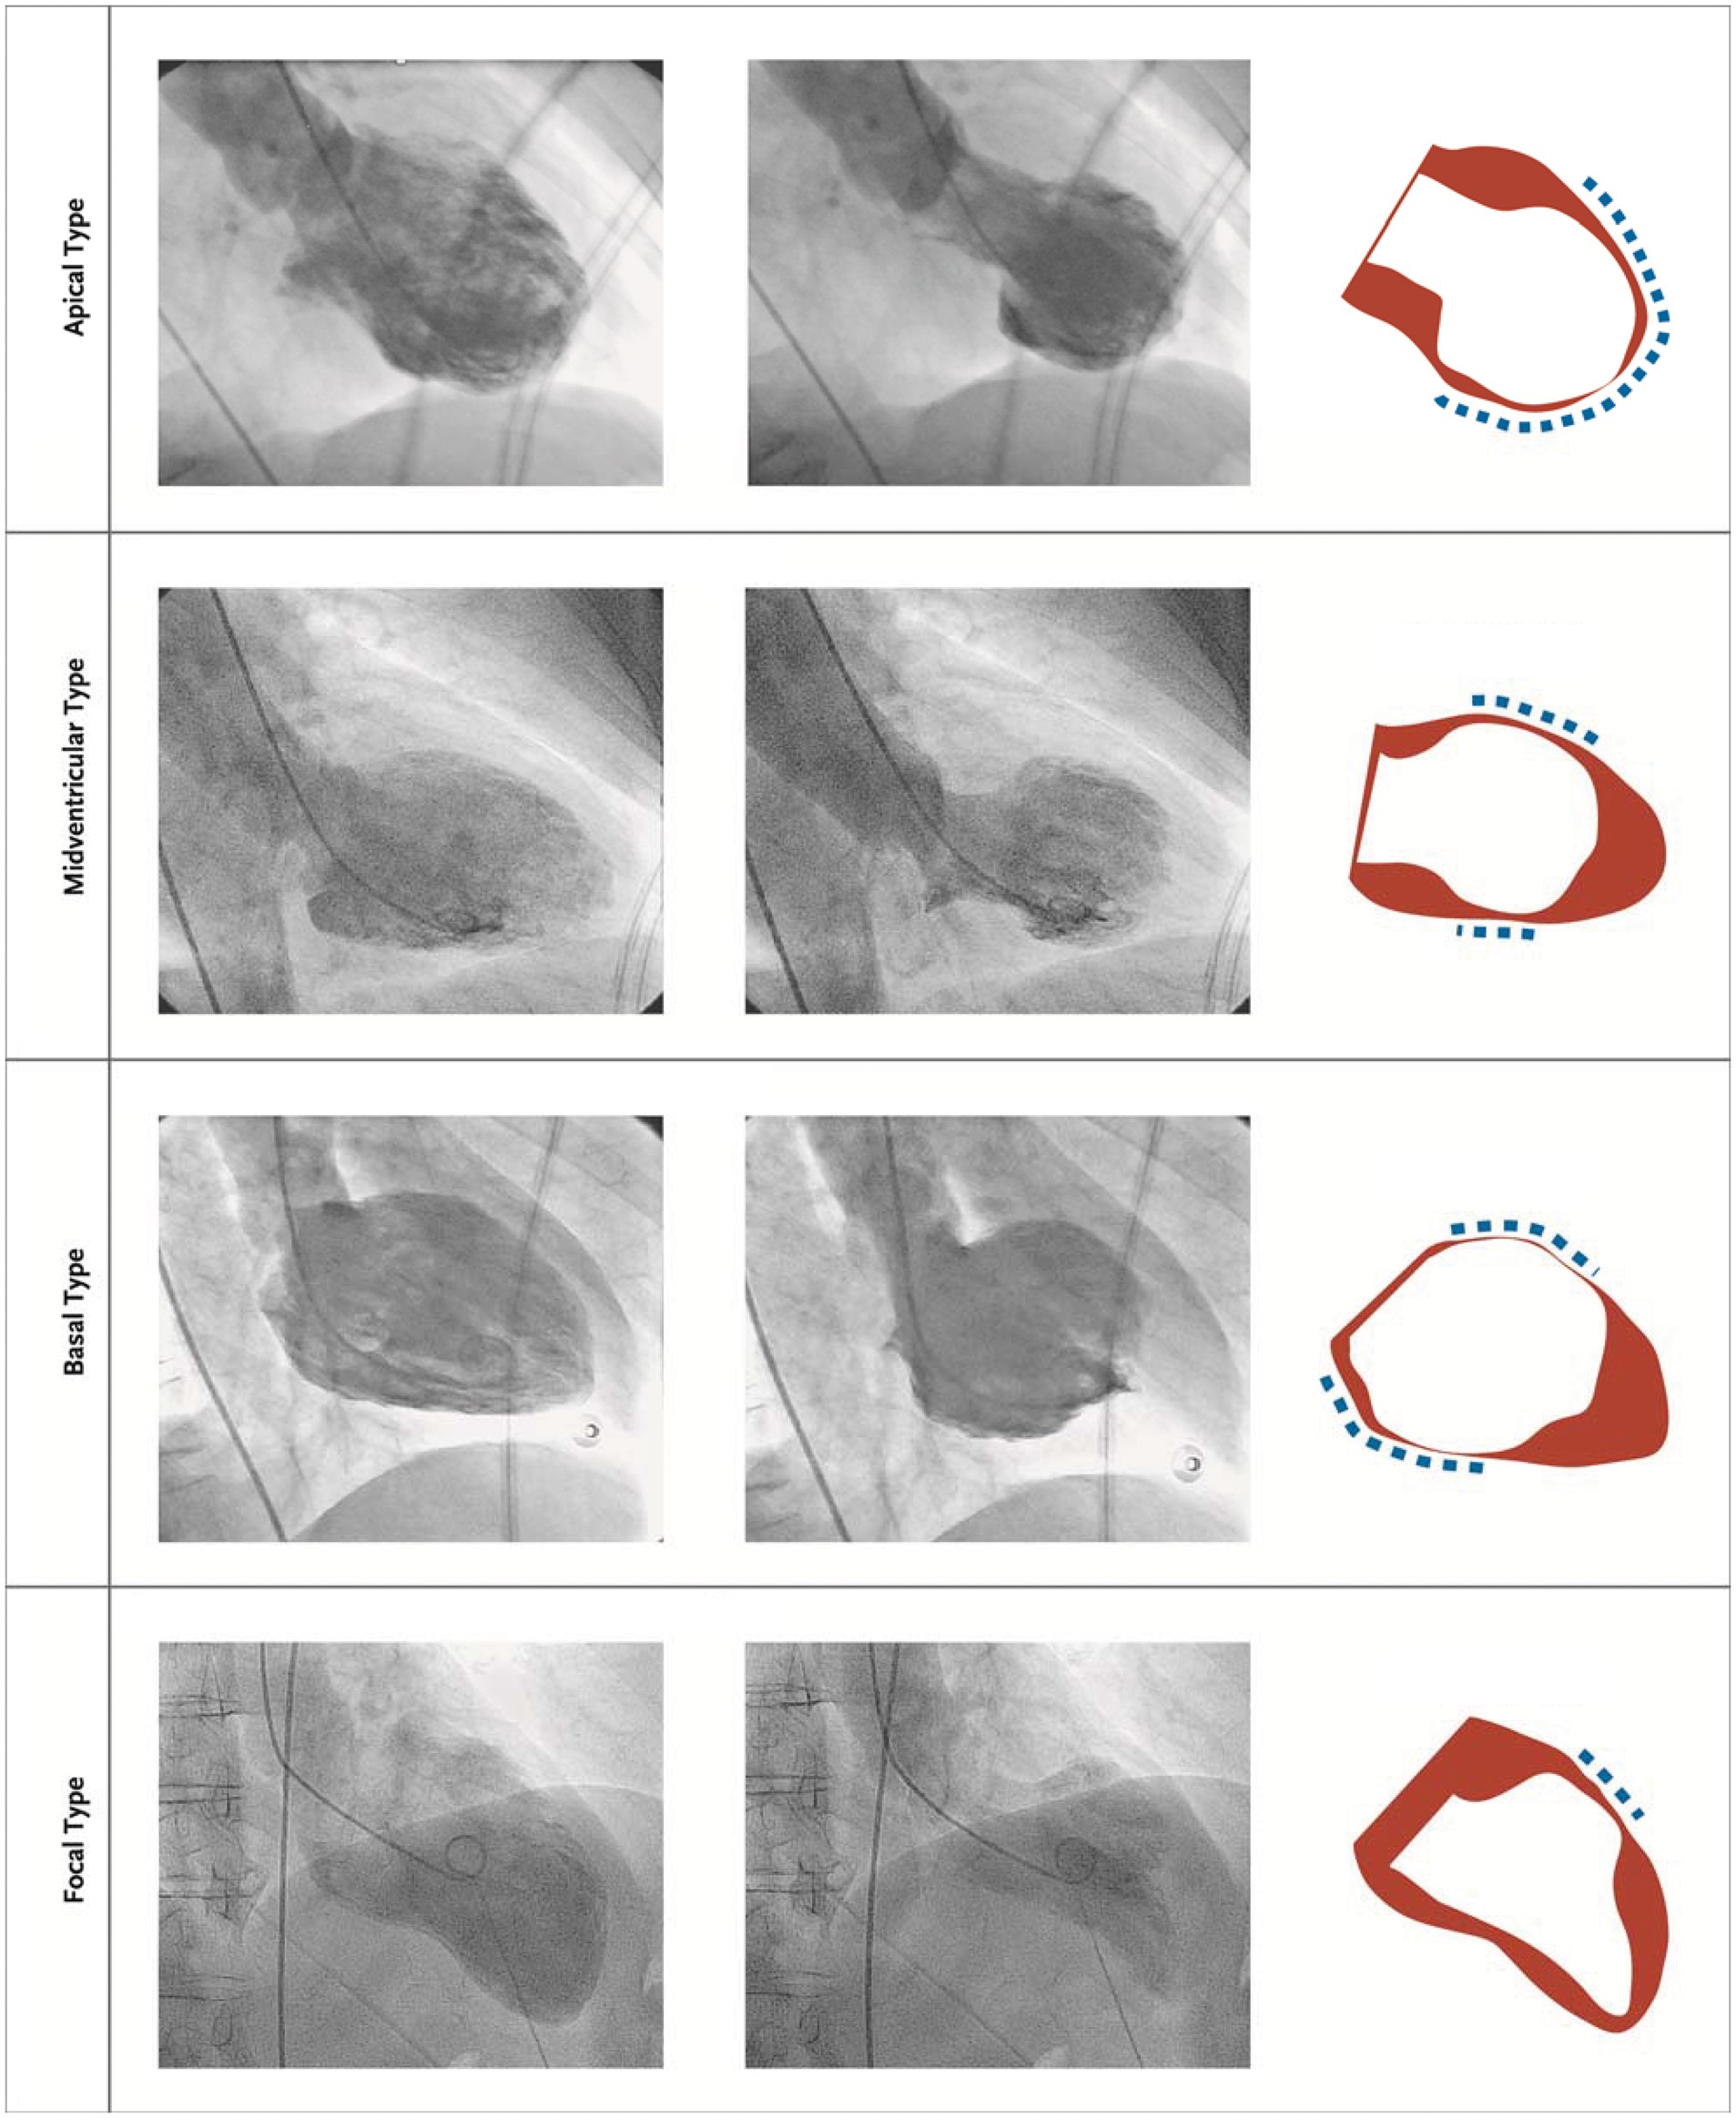
TTS: Subtypes
Apical ballooning type (81.7%)
Mid ventricular wall motion pattern (14.6%)
Basal wall motion pattern (2.2%)
Focal wall motion pattern (1.5%)
Notes:
Types:
-Several anatomical TTS variants have been described
-four major types can be differentiated based on the distribution of regional wall motion abnormalities as shown
-The most common TTS type and widely recognized form is the (i) apical ballooning type also known as the typical TTS form, which occurs in the majority of cases.
-Atypical TTS types have been increasingly recognized
(ii) midventricular
(iii) basal
(iv) focal wall motion patterns.
-Patients suffering from atypical TTS have a different clinical phenotype.
-These patients are younger, suffer more often from neurologic comorbidities, have lower brain natriuretic peptide values, a less impaired LVEF, and more frequent ST-segment depression compared to typical TTS
-In-hospital complication rate is similar between typical and atypical types, while 1-year mortality is higher in typical TTS

Slide 8
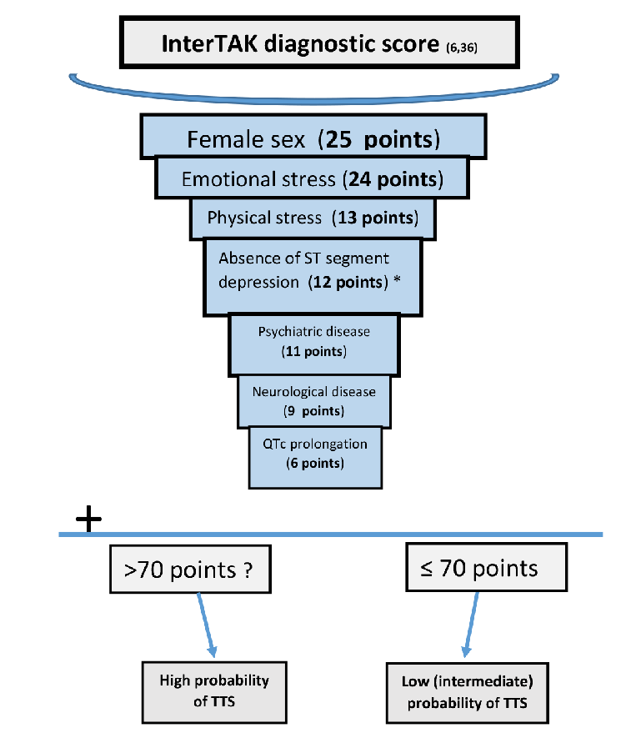
International Takotsubo Diagnostic Score-InterTAK (2018)
Notes:
-diagnosis of TTS is often challenging because its clinical phenotype may closely resemble AMI regarding ECG abnormalities and biomarkers
The InterTAK Diagnostic Score was developed by the International Takotsubo Registry to provide clinicians a model to assess the likelihood of TTS diagnosis. The criteria that make up the InterTAK Diagnostic Score are based on clinical features and ECG to predict the probability of the presence of TTS and to distinguish TTS from ACS
-Depending on the disease prevalence this means that patients with 30 score points have a predicted probability of <1%, while patients with 50 points have a probability of 18%, and patients with a score value >70 points have a probability of ∼90% of suffering from TTS
-. In patients with non ST-segment elevation the InterTAK Diagnostic Score can be considered. While an InterTAK Score ≤70 points suggests a low to intermediate probability of TTS, a score ≥70 indicates a high probability for the presence of TTS. Patients with a low probability should undergo CAG with left ventriculography, while in patients with a high score transthoracic echocardiography
https://academic.oup.com/eurheartj/article/39/22/2032 and https://academic.oup.com/eurheartj/article/39/22/2047

Slide 9
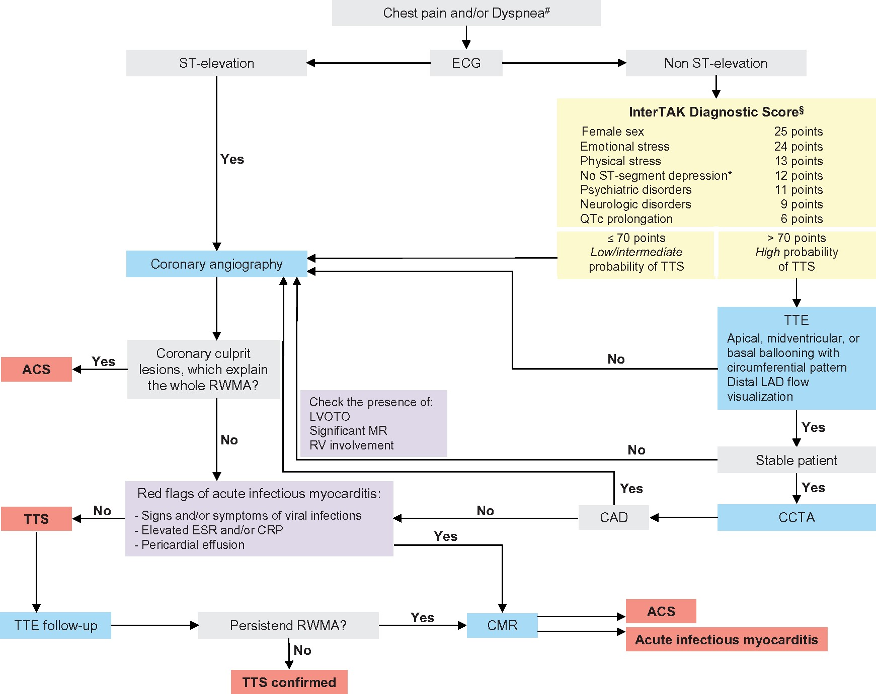
Ghadri et el., 2018
Notes:
-In stable patients with circumferential ballooning pattern coronary computed tomography angiography (CCTA) is favoured to exclude coronary artery disease (CAD).
-In unstable patients, typical complications of TTS such as left ventricular outflow tract obstruction (LVOTO) should be determined with TTE and CAG to safely rule out AMI. In patients with normal coronaries on CCTA or CAG and typical ballooning patterns without ‘red flags’ of acute infectious myocarditis TTS is the most likely diagnosis and can be confirmed after follow-up echocardiography.

Slide 10
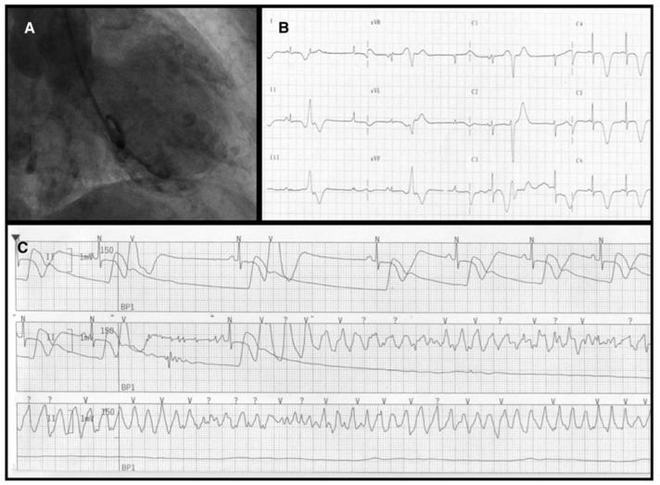
Management
Initial ACS management until diagnosis confirmed.
Management of acute complications:
  Heart failure
  Cardiogenic Shock
  Arrhythmias
    Ventricular arrhythmias: β-blocker, magnesium, direct current cardioversion
    Avoid: QT prolonging drugs
    High-degree atrioventricular block: temporary pacing
      Avoid: β-blockers, permanent devices
  Thromboembolism
    LV thrombus: Anticoagulation for at least 3 months
    Consider: Prophylactic anticoagulation in patients with left ventricular ejection fraction <30% and apical ballooning
Consider ACEI/ARB when appropriate.
Ghadri et el., 2018
Notes:
-Guidelines regarding TTS management are lacking as no prospective randomized clinical trials have been performed in this patient population. Therapeutic strategies are therefore based on clinical experience and expert consensus (evidence level C)
-ntravenous diuretic and nitrate therapies. Patients who sustain left ventricular outflow tract obstruction may benefit from sequential small doses of short-acting β-blocker therapy,⁶⁴ and small boluses of intravenous fluid, under careful monitoring in a high-dependency care environment, as well.
The management of shock is challenging in both theory and practice. Most inotropic agents can potentially aggravate systolic dysfunction because excess catecholamines may be involved in the underlying pathogenesis and pathophysiology of the condition. As such, expert consensus recommends mechanical approaches to provide hemodynamic support, such as intra-aortic balloon counterpulsation, temporary left ventricular assist devices, and extracorporeal membrane oxygenation.^{25,63} However, identification of left ventricular outflow obstruction is important because hemodynamic status may be worsened by intra-aortic balloon counterpulsation in such cases. When mechanical support is not available, low-dose levosimendan is licensed in some countries as a catecholamine-sparing positive inotrope (Table 2).^{65,66}
t is important to avoid QT segment–prolonging medications because these may worsen the likelihood of developing ventricular arrhythmias because of the high risk of further QTc prolongation.
https://academic.oup.com/eurheartj/article/39/22/2032 and https://academic.oup.com/eurheartj/article/39/22/2047

Slide 11
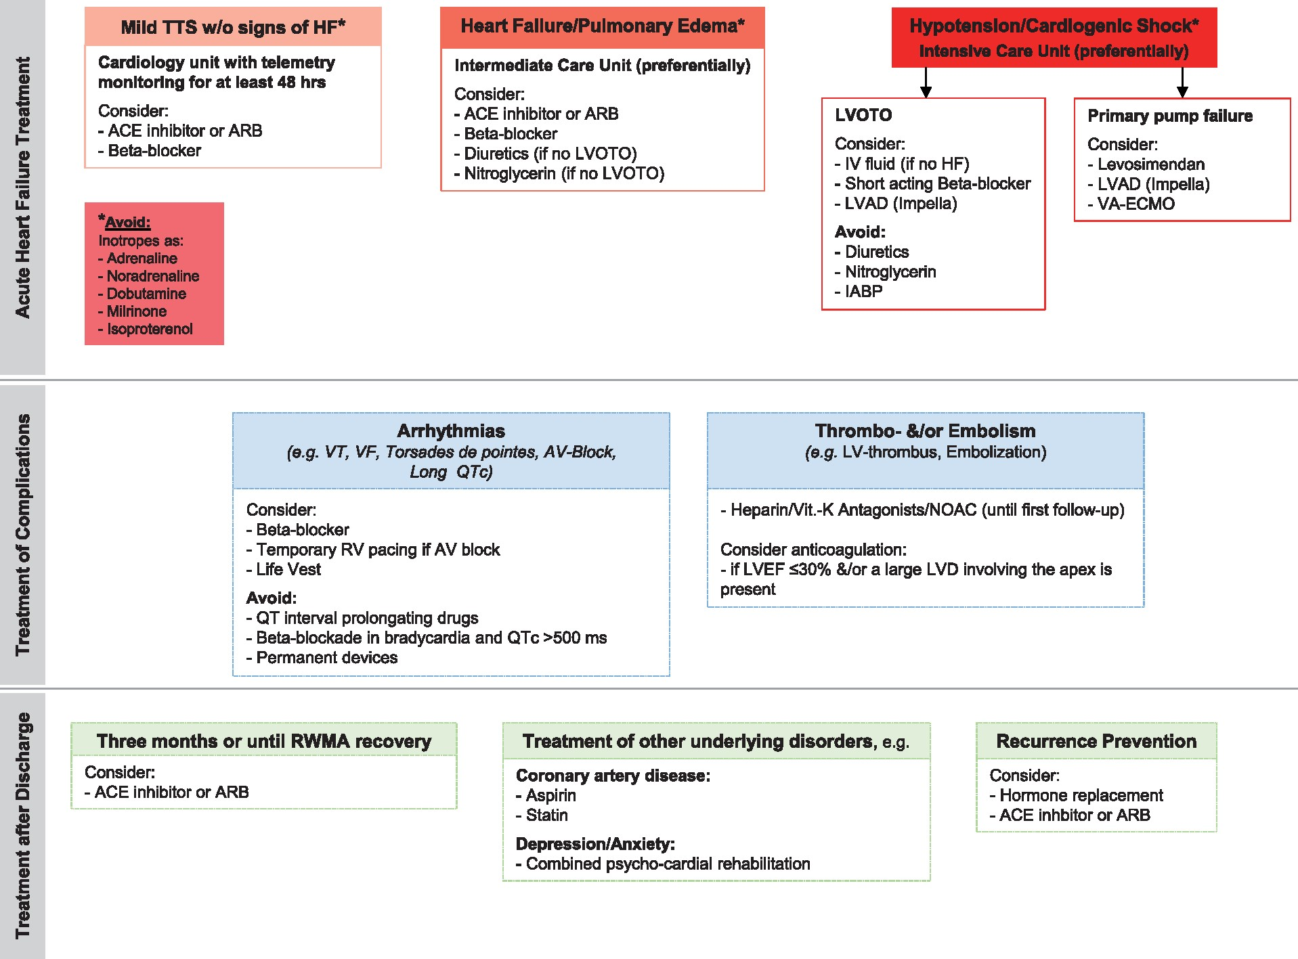
Ghadri et el., 2018
Notes:
-ACEi or ARB was associated with improved survival at 1-year follow-up
-In contrast, there was no evidence of any survival benefit for the use of beta-blockers.
-one-third of patients experienced a TTS recurrence during beta-blockade² suggesting that other receptors such as alpha-receptors, that are more prevalent in the coronary microcirculation, might be involved.
-The prevalence of recurrent TTS is relatively low, consequently conducting randomised trials of pharmacological agents to prevent recurrence is challenging. Beta-blocker therapy after hospital discharge does not appear to prevent recurrence,² , ¹⁴⁴ whereas ACEi or ARB are associated with a lower prevalence of recurrence. The significance of this observation remains uncertain and requires validation in other cohorts.
If concomitant coronary atherosclerosis is present, aspirin and statins are appropriate. As TTS mainly occurs in postmenopausal women oestrogen supplementation in those with recurrence is questionable. In an animal model oestrogen supplementation partially attenuated TTS,¹⁵² and chronic oestrogen supplementation after oophorectomy improved the condition.¹⁵³
Psychiatric disorders (e.g. depression, anxiety) are common in TTS patients² , ¹⁵⁴ and those might benefit from a combined psycho-cardiologic rehabilitation.¹⁵⁵ Whether anti-depressants or other psychiatric drugs might provide clinical benefit in such patients is controversial.
----
For TTS with complications such as cardiogenic shock, management depends on left ventricular outflow tract obstruction (LVOTO). In patients without LVOTO, inotropic agents can be used to maintain pressure, while inotropic agents are contraindicated in patients with LVOTO.
Most recover within days to weeks, but recurrence can occur.
- Left ventricular function usually normalizes over a period of days to weeks, and recurrence is rare. The same kind of reversible myocardial dysfunction is occasionally encountered in patients with intracranial haemorrhage or other acute cerebral accidents (neurogenic myocardial stunning).

Slide 12
References
Ghadri JR, Wittstein IS, Prasad A, Sharkey S, Dote K, Akashi YJ, Cammann VL, Crea F, Galiuto L, Desmet W, Yoshida T, Manfredini R, Eitel I, Kosuge M, Nef HM, Deshmukh A, Lerman A, Bossone E, Citro R, Ueyama T, Corrado D, Kurisu S, Ruschitzka F, Winchester D, Lyon AR, Omerovic E, Bax JJ, Meimoun P, Tarantini G, Rihal C, Y-Hassan S, Migliore F, Horowitz JD, Shimokawa H, Lüscher TF, Templin C. International Expert Consensus Document on Takotsubo Syndrome (Part II): Diagnostic Workup, Outcome, and Management. Eur Heart J. 2018 Jun 7;39(22):2047-2062. doi: 10.1093/eurheartj/ehy077. PMID: 29850820; PMCID: PMC5991205.
Kato K, Di Vece D, Kitagawa M, Yamamoto K, Miyakoda K, Aoki S, Goto H, Kitahara H, Kobayashi Y, Templin C. Clinical characteristics and outcomes in takotsubo syndrome -Review of insights from the InterTAK Registry. J Cardiol. 2025 Apr;85(4):263-267. doi: 10.1016/j.jjcc.2025.01.009. Epub 2025 Jan 30. PMID: 39892867.
Lyon AR, Citro R, Schneider B, Morel O, Ghadri JR, Templin C, Omerovic E. Pathophysiology of Takotsubo Syndrome: JACC State-of-the-Art Review. J Am Coll Cardiol. 2021 Feb 23;77(7):902-921. doi: 10.1016/j.jacc.2020.10.060. PMID: 33602474.
Sattar Y, Siew KSW, Connerney M, Ullah W, Alraies MC. Management of Takotsubo Syndrome: A Comprehensive Review. Cureus. 2020 Jan 3;12(1):e6556. doi: 10.7759/cureus.6556. PMID: 32042529; PMCID: PMC6996473.
Schweiger V, Cammann VL, Crisci G, Gilhofer T, Schlenker R, Niederseer D, Chen S, Ebrahimi R, Wenzl F, Würdinger M, Citro R, Vecchione C, Gili S, Neuhaus M, Franke J, Meder B, Jaguszewski M, Noutsias M, Knorr M, Jansen T, D'Ascenzo F, Dichtl W, von Lewinski D, Burgdorf C, Kherad B, Tschöpe C, Sarcon A, Shinbane J, Rajan L, Michels G, Pfister R, Cuneo A, Jacobshagen C, Karakas M, Koenig W, Pott A, Meyer P, Roffi M, Banning A, Wolfrum M, Cuculi F, Kobza R, Fischer TA, Vasankari T, Airaksinen KEJ, Napp LC, Dworakowski R, MacCarthy P, Kaiser C, Osswald S, Galiuto L, Chan C, Bridgman P, Beug D, Delmas C, Lairez O, Gilyarova E, Shilova A, Gilyarov M, El-Battrawy I, Akin I, Poledniková K, Toušek P, Winchester DE, Massoomi M, Galuszka J, Ukena C, Poglajen G, Carrilho-Ferreira P, Hauck C, Paolini C, Bilato C, Kobayashi Y, Kato K, Ishibashi I, Himi T, Din J, Al-Shammari A, Prasad A, Rihal CS, Liu K, Schulze PC, Bianco M, Jörg L, Rickli H, Pestana G, Nguyen TH, Böhm M, Maier LS, Pinto FJ, Widimský P, Felix SB, Braun-Dullaeus RC, Rottbauer W, Hasenfuß G, Pieske BM, Schunkert H, Budnik M, Opolski G, Thiele H, Bauersachs J, Horowitz JD, Di Mario C, Kong W, Dalakoti M, Imori Y, Münzel T, Liberale L, Montecucco F, Bax JJ, Crea F, Ruschitzka F, Lüscher TF, Ghadri JR, Bossone E, Templin C, Di Vece D. Temporal Trends in Takotsubo Syndrome: Results From the International Takotsubo Registry. J Am Coll Cardiol. 2024 Sep 24;84(13):1178-1189. doi: 10.1016/j.jacc.2024.05.076. Epub 2024 Sep 1. PMID: 39217551.
Singh T, Khan H, Gamble DT, Scally C, Newby DE, Dawson D. Takotsubo Syndrome: Pathophysiology, Emerging Concepts, and Clinical Implications. Circulation. 2022 Mar 29;145(13):1002-1019. doi: 10.1161/CIRCULATIONAHA.121.055854. Epub 2022 Mar 28. Erratum in: Circulation. 2022 May 17;145(20):e1053. doi: 10.1161/CIR.0000000000001075. PMID: 35344411; PMCID: PMC7612566.

Slide 13
Thank-you!

Slide 14
Pathophysiology
The pathophysiology of the Takotsubo form of acute heart failure is incompletely understood.
•
Excessive release of cardiac neuronal and systemic catecholamines contributes to acute myocardial dysfunction in patients with Takotsubo syndrome, but impaired microvascular perfusion, myocardial inflammation, and electrophysiological derangements contribute to its clinical manifestations.
•
Takotsubo stunning, which involves both catecholaminergic and ischemic mechanisms, is the pathophysiological framework underlying this syndrome, which is critical to the development of effective diagnostic and therapeutic strategies.
Notes:
Serum catecholamine levels in TTS are significantly higher than patients with myocardial infarction and heart failure, and remain elevated for a longer
Conditions that are known to cause catecholamine excess – such aspheochromocytoma and subarachnoid haemorrhage (via sympathetic stimulation) –are associated with TTS
coronary vasospasm has been noted during invasive angiography in patients with TTS.
-Plaque rupture: It has been suggested that transient ischaemia induced by plaque rupture followed by rapid lysis may cause myocardial stunning in patients with apparent non-obstructed CAD at angiography (very unlikely as patients with TTS exhibit wall motion abnormalities extending beyond single coronary vascular territories)
https://academic.oup.com/eurheartj/article/39/22/2032 and https://academic.oup.com/eurheartj/article/39/22/2047

