Slide 1
Spontaneous Coronary Artery Dissection
Dr Shankar Iyer ST5 Cardiology

Slide 2
SCAD
Epicardial coronary artery dissection that is not associated with atherosclerosis or trauma and not iatrogenic.
Intramural hematoma or intimal disruption rather than atherosclerotic plaque rupture or intraluminal thrombus.
First described in 1931.
Associations: Female sex, pregnancy, physical and emotional stress triggers; concurrent systemic arteriopathies, particularly fibromuscular dysplasia
High rates of recurrence

Slide 3
Can be misdiagnosed, underdiagnosed and managed as atherosclerotic ACS, which may harm patients with SCAD.
PCI associated with lower technical success and higher complications.

Slide 4
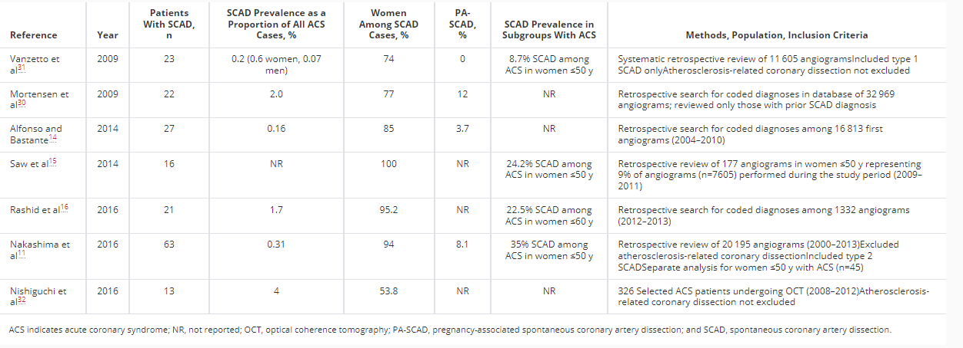

Slide 5
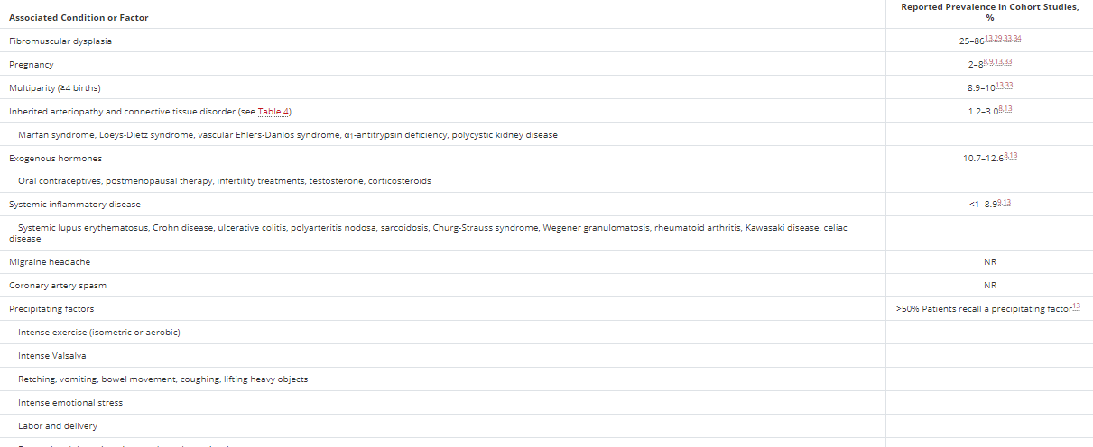

Slide 6
Arteries affected
LAD most commonly affected - 32%–46% of cases.
Circumflex /ramus /OM in 15% to 45%
Right coronary artery 10% to 39%
LM in up to 4% of cases.
Mid to distal segments mostly affected; proximal only <10% of cases
Multivessel SCAD occurs in 9% to 23% of cases.

Slide 7
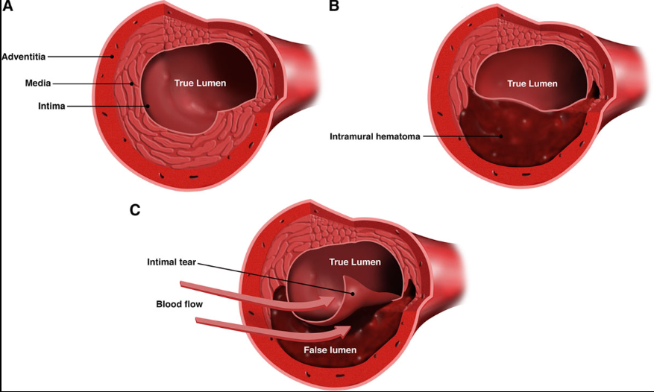
Histopathology

Slide 8
Mechanisms
1) Intimal tear which allows blood from the true lumen to enter and generate a false lumen.
2) Primary event is a spontaneous hemorrhage arising from the vasa vasorum within the vessel wall causing hematoma and then causing intima tear due to pressure.
3) In PA SCAD due to hormonal changes affecting vessel wall.
Associations - black race, chronic hypertension, lipid abnormalities, chronic depression, migraines, advanced maternal age, and treatment for infertility. Poorer prognosis than non PA SCAD.

Slide 9
FMD
FMD is a nonatherosclerotic, noninflammatory vascular disease that can affect any arterial bed and can manifest as arterial stenosis, aneurysm, tortuosity, or dissection.
Multifocal FMD - alternating stenosis and dilatation resulting in a string-of-beads pattern
Focal FMD appears angiographically as a single concentric or tubular narrowing; <10% of cases of FMD

Slide 10
Clinical presentation
ACS and increased levels of cardiac enzymes.
2-5% Cardiogenic shock
26% to 87% of patients with SCAD present with STEMI, and 13% to 69% present with NSTEMI.
Ventricular arrhythmias or sudden cardiac death account for SCAD presentation in 3% to 11% of reported series

Slide 11
Diagnosis
High rates of misdiagnosis due to demographics, absence of risk factors.
Angiogram first line diagnostic imaging.
Limitation - 2-dimensional lumenography and does not specifically image the arterial wall.
IVUS and OCT – aid diagnosis but additional risks, costs and availability issues.

Slide 12
Coronary angiography
Pattern recognition on coronary angiography essential.
Multiple radiolucent lumens and extraluminal contrast staining – only small subset of pts.
SAW angiographic classification:
Type 1 - classic appearance of multiple radiolucent lumens or arterial wall contrast staining of dissected arteries, followed by type 1 in 29.1%
Type 2 - Diffuse stenosis varying severity and length (usually >20 mm) 67.5%
- Variant 2A diffuse arterial narrowing bordered by normal segments proximal and distal to the IMH.
- Variant 2B diffuse narrowing that extends to the distal tip of the artery.
Type 3 is focal or tubular stenosis, usually <20 mm in length, that mimics atherosclerosis. 3.4%

Slide 13
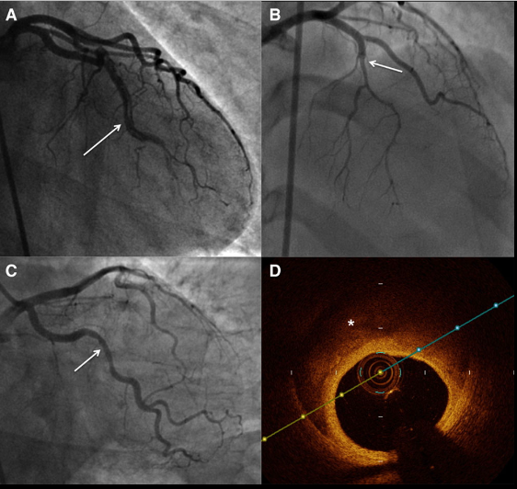

Slide 14
Intracoronary imaging
IVUS can detect intimal tear, false lumen, IMH, and intraluminal thrombi
Although its resolution may not be adequate
OCT uses light waves to image the arterial wall.
Superior to IVUS for delineating the lumen-intimal interface and is better for visualizing intimal tears, false lumen, IMH, and intraluminal thrombi

Slide 15
Risks of imaging
Extending the coronary dissection with wire or imaging catheter
Guide-catheter iatrogenic dissection
Catheter-induced occlusion of true lumen
Hydraulic extension with contrast injection for OCT.
Should be pursued only when angio diagnosis is uncertain (eg, type 3 or unclear lesions) and when the vessel diameter is large enough for intracoronary imaging.
Limit to the proximal segment of dissection only, no need to image the entire dissection.

Slide 16
CCTA
No studies done in acute SCAD as patients present acutely as ACS.
Useful for noninvasive follow-up of patients with SCAD, particularly dissections in proximal or large-caliber coronary arteries

Slide 17
Management
Conservative management - Angiographic “healing” of SCAD lesions in the majority of patients (70%–97%) in weeks to months after a conservatively managed index episode.

Slide 18
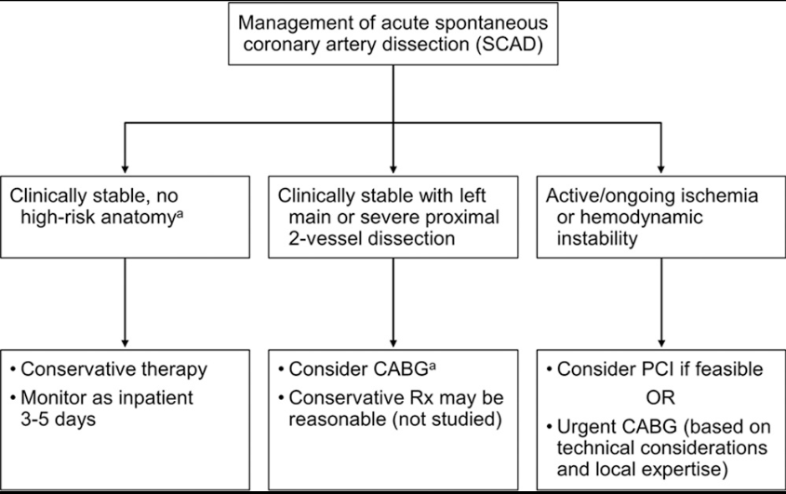
Management

Slide 19
PCI
increased risk of complications
Susceptible to iatrogenic dissections and extension of dissections with PCI.
Guidewire entering false lumen.
SCAD affects distal segments, which may be too small or too distal for stent implantation.
Mayo Clinic series of 189 patients showed PCI technical failure in 53% of the patients initially managed with PCI

Slide 20
PCI strategies
Long drug-eluting stents covering in excess of 5 to 10 mm on both proximal and distal edges of the IMH
Direct stenting without balloon predilation to avoid additional risks of extension of the IMH
Balloon angioplasty alone to restore coronary flow without stenting
Cutting balloon fenestration of the IMH to allow decompression of the false lumen blood pool into the true lumen (undersized balloon)
Multistent approach by sealing distal and proximal ends first with stents, before stenting the middle, to minimize IMH propagation
Use of bioresorbable stents to provide a temporary scaffold because complete resorption of struts occurs within 2 years

Slide 21
CABG
CABG treatment strategy for SCAD in patients with left main stem or proximal dissections,
After technical failure of attempted PCI
complication of attempted PCI
ischemia is refractory despite attempted conservative therapy.

Slide 22
Medical therapy
DIssezioni Spontanee COronariche (DISCO) multicentre international registry
In this European registry, most patients with SCAD undergoing initial conservative management received DAPT. 1-year follow-up, DAPT, as compared with SAPT, was independently associated with a higher rate of adverse cardiovascular events
Most experts recommend aspirin use for at least 1 year who receive medical treatment, in the absence of contraindications.
β-Blockers and ACEi/ARB in LV dysfunction or arrhythmias and for management of hypertension.

Slide 23
References
Spontaneous Coronary Artery Dissection: Current State of the Science: A Scientific Statement From the American Heart Association

Slide 24
Thank you

