Slide 1
Infective Endocarditis in the elderly
Debjit Chatterjee
MD DM FRCP CCDS MSc
Consultant Cardiologist
Medway Maritime Hospital

Slide 2
Infective Endocarditis
A disease caused by a microbial infection involving the endothelial lining of intracardiac structures such as the heart valves.
A major public health challenge
High morbidity and mortality
In 2019, the estimated incidence of IE was 13.8 cases per 100 000
Incidence is increasing
Needs high index of clinical suspicion in susceptible patients and treatment needs multidisciplinary team involvement ( Endocarditis team)
Notes:
Increase in population at risk, change in guidelines for antibiotic prophylaxis, routine echo in e faecalis , staph aureus, CT/MRI

Slide 3
Epidemiology
The online NHS for England Hospital Episode Statistics (HES) reported 10,097 finished consultant episodes for acute and subacute endocarditis during 2019-20 compared with 3969 during 2009-10.
Mean age was 59.25 ± 18.03 years (46.3% ≥ 65 years and 12.0% ≥ 80 years) Euro Endo registry
In developing countries rheumatic valve disease is still the most frequent predisposing factor
In developed countries degenerative valve disease, prosthetic valves and CIED
25% of cases were associated with recent healthcare exposure.

Slide 4
Pathogenesis
a complex series of host-pathogen interactions conspire in the development of IE lesions, including the integrity of the vascular endothelium, the host immune system, hemostatic mechanisms, cardiac anatomical characteristics, microbial properties, and the peripheral events that cause the bacteremia.
There are substantial experimental data to suggest that host endothelial damage is the key predisposing insult, with subsequent platelet and fibrin deposition and creation of a receptive milieu for bacterial colonization during episodes of transient bacteremia.
Hurst’s The Heart 14th edition

Slide 5
IE types and classification
Acute /Subacute
NVE/PVE/Device related endocarditis
Left sided / Right sided

Slide 6
Aetiology
Staphylococcus aureus
Viridans group streptococci
Streptococcus gallolyticus (formerly Streptococcus bovis)
Oral streptococci (Streptococcus mitis, sanguinis, anginosus, salivarius, downei, and mutans)
Coagulase-negative staphylococci
Enterococci
Culture-negative Haemophilus species, Aggregatibacter, Cardiobacterium hominis, Eikenella corrodens, and Kingella species (HACEK)
Fungi
Haemophilus parainfluenzae
Coxiella burnetii
Brucella species.
Rare causative organisms Trophyerma whipplei, Malassezia furfur, Serratia species, Rothia, and Klebsiella species

Slide 7
Aetiology PVE
Early ( between 2-12 months after surgery) the vast majority of causative organisms are nosocomially acquired, with a predominance of staphylococci, notably coagulase-negative species (Staphylococcus epidermidis). Gram-negative bacilli, diphtheroids, and fungal species, although uncommon causes of IE overall, have a predilection to cause PVE during this early period.
Late PVE after 12 months generally resembles NVE

Slide 8
Euro Endo registry (1)
Prospective cohort of 3116 adult patients (2470 from Europe, 646 from non-ESC countries), admitted to 156 hospitals in 40 countries between January 2016 and March 2018 with a diagnosis of IE based on ESC 2015 diagnostic criteria.
Infective endocarditis was native (NVE) in 1764 (56.6%) patients, prosthetic (PVIE) in 939 (30.1%), and device-related (CDRIE) in 308 (9.9%). Infective endocarditis was community-acquired in 2046 (65.66%) patients
Microorganisms involved were staphylococci in 1085 (44.1%) patients, oral streptococci in 304 (12.3%), enterococci in 390 (15.8%), and Streptococcus gallolyticus in 162 (6.6%). Coxiella burnetii IE was observed in 26 (0.8%) patients.

Slide 9
Euro Endo Registry (2)
Mean age was 59.25 ± 18.03 years (46.3% ≥ 65 years and 12.0% ≥ 80 years)
Infective endocarditis was healthcare associated in 1027 (32.96%) patients (nosocomial in 60.8% of them, non-nosocomial in 39.2%), community-acquired in 2046 (65.66%) patients, and undetermined in 1.38% of patients,
The most frequent preceding non-cardiac interventions performed within the last 6 months were dental procedure (7.9%), gastrointestinal intervention (3.4%), colonoscopy (3.3%), and urogenital intervention (2.8%). The location of IE was aortic in 49.5% patients, mitral in 42.0%, tricuspid in 11.4%, and pulmonary in 2.4%. Infective endocarditis affected two or more valves in 556 (18.2%) patients.

Slide 10
Euro Endo registry (3)
Embolic events were the most frequent complication, observed in 20.6% of patients, followed by acute renal failure (17.7%) and heart failure (14.1%).
cardiac surgery was indicated in 2160 (69.3%) patients, but finally performed in only 1596 (73.9%) of them. In-hospital death occurred in 532 (17.1%) patients and was more frequent in PVIE.
Independent predictors of mortality were Charlson index, creatinine > 2 mg/dL, congestive heart failure, vegetation length > 10 mm, cerebral complications, abscess, and failure to undertake surgery when indicated.

Slide 12
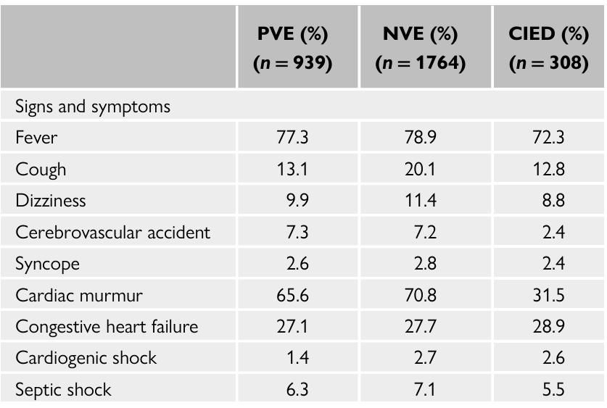
Symptoms and signs of infective endocarditis in the EURO-ENDO registry

Slide 13
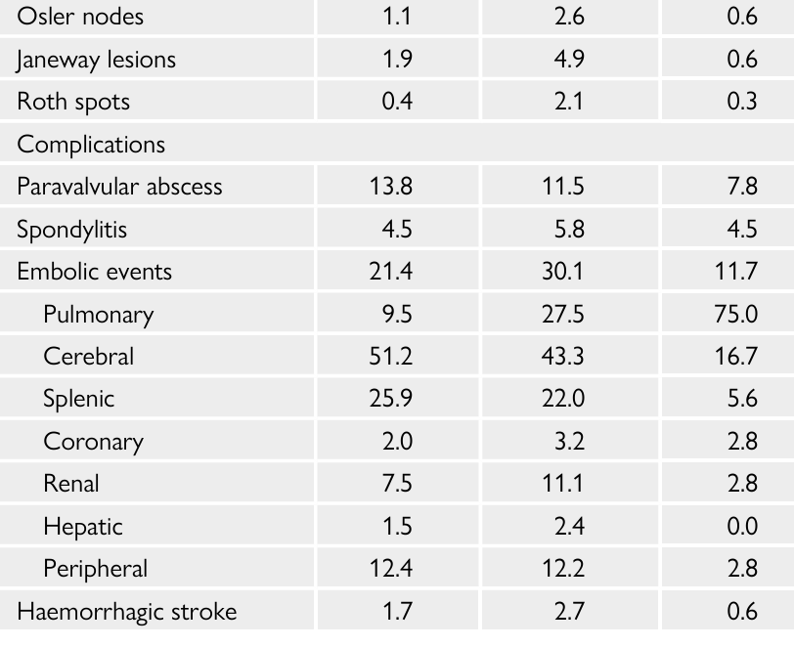
Symptoms and signs of infective endocarditis in the EURO-ENDO registry

Slide 14
Investigations
3 sets of blood culture
FBC, CRP, renal and liver function, Rheumatoid factor
Urine
Troponin usually raised and is associated with poor prognosis
Echocardiography TTE, TOE
ECG conduction abnormality
Other imaging modalities CT, MRI, FDG PET/CT, WBC SPECT

Slide 15
CT-- CTA is good for detecting valvular complications like abscess, pseudoaneurysm and fistulae
Whole body/brain CT for distant lesions and systemic complications
MRI brain for cerebral complications,, spinal involvement
18F FDG PET/CT and WBC SPECT for suspected PVE and CIED related endocarditis

Slide 24
Treatment
Antibiotic—type and duration will depend upon the organism , NVE/PVE ------available at microguide on Trust intranet
Supportive treatment
Treatment of complications
Surgery
Multidisciplinary approach ( Endocarditis Team)
The importance of an Endocarditis Team in the diagnosis, management, and clinical outcomes of patients with IE has been demonstrated in several observational studies

Slide 29
Indications for surgery
Heart Failure with
Cardiogenic shock/pulmonary oedema/haemodynamic compromise
Uncontrolled infection
Local complications
Persistently positive blood culture
Resistant bacteria or fungi
PVE caused by Staph aureus or non-HACEK gm –ve bacilli
High risk of embolism
Vegetation > 10 mm

Slide 30
Complications
Acute heart failure
Systemic and pulmonary embolism
Acute kidney injury
Valvular dehiscence, rupture, fistula
Mycotic aneurysm , splenic abscess

Slide 31
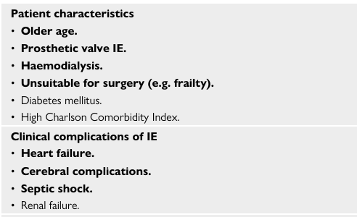
Prognostic marker (1)
©ESC2023
Notes:
The in-hospital mortality rate of patients with IE has remained largely unchanged over the past two decades, ranging from 15% to 30%

Slide 32
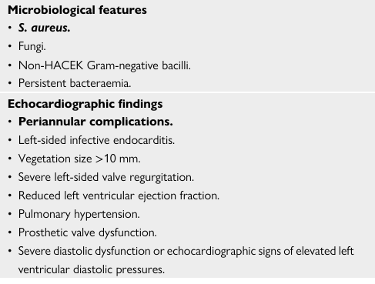
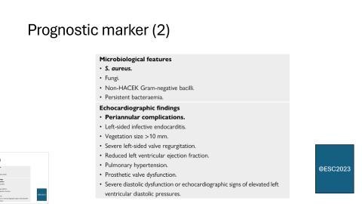
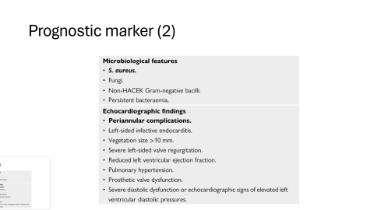
Prognostic marker (2)
©ESC2023

Slide 35
IE in elderly (1)
Incidence of IE is increasing in the elderly population.
Enterococci and S. aureus are reported to be the most frequent aetiological agent
Higher presence of intracardiac prosthetic devices (CIED and valvular prosthesis/repair including TAVI devices)
Increased incidence of healthcare-associated IE episodes are ob served.
lower risk of embolic episodes has been observed in this subgroup

Slide 36
IE in elderly (2)
Atypical presentation---a heightened index of suspicion is required to diagnose
Presence of degenerative, calcific valve disease, usually aortic, can decrease the specificity of echocardiographic imaging for the lesions of IE.

Slide 37
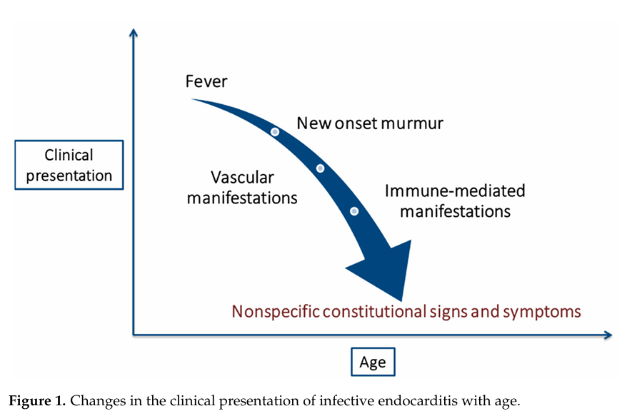
From Carlos Bea et al Cardiovasc. Dev. Dis. 2022, 9, 192. https://doi.org/10.3390/jcdd9060192

Slide 38
IE in Elderly (3)
Old age, co- morbidities, and previous non-cardiac and cardiac procedures lead to surgical hesitancy by referring physicians, surgeons, and patients themselves.
surgery was far less frequently performed when indicated (35% vs. 68%) in patients >80 vs. 80 years after. (Euro Endo registry)
Age was not demonstrated to be an independent predictor of mortality
Functional and nutritional status are important predictors of outcomes. When considering cardiac surgery in elderly patients, functional and nutritional status, and their associated risks, should be accurately explored through a comprehensive assessment by geriatricians.
Notes:
These findings suggest that performance of surgery in well-selected elderly patients is under utilized and may increase their chance of survival.

Slide 39
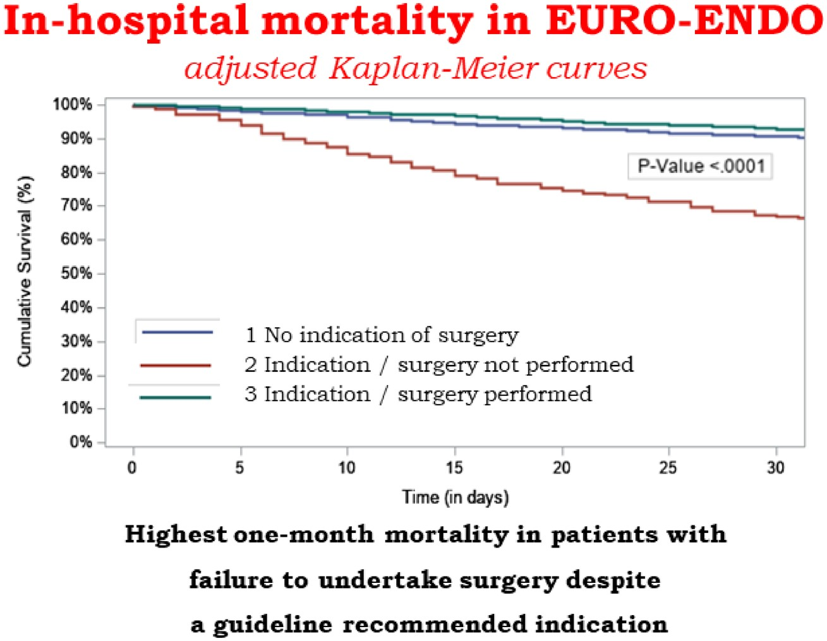


Notes:
Unless provided in the caption above, the following copyright applies to the content of this slide: Published on behalf of the European Society of Cardiology. All rights reserved. © The Author(s) 2019. For permissions, please email: journals.permissions@oup.com.This article is published and distributed under the terms of the Oxford University Press, Standard Journals Publication Model (https://academic.oup.com/journals/pages/open_access/funder_policies/chorus/standard_publication_model)

Slide 40
Case 1
78-year-old man
Presented to GP with SOB, cough and leg swelling for few months
h/o dental surgery 18 months ago
BNP 566, new AF
Was referred for an outpatient echo which showed possible vegetation on mitral valve
Admitted from the echo department
Subsequent TOE ( see the following video) vegetations on both leaflets of mitral valve and moderate to severe MR, blood culture Enterococcus faecalis
Treated with antibiotic for 4 weeks, discussed at endocarditis MDT
Discharged with a plan for outpatient review by cardiac surgeons for mitral valve surgery

Slide 41
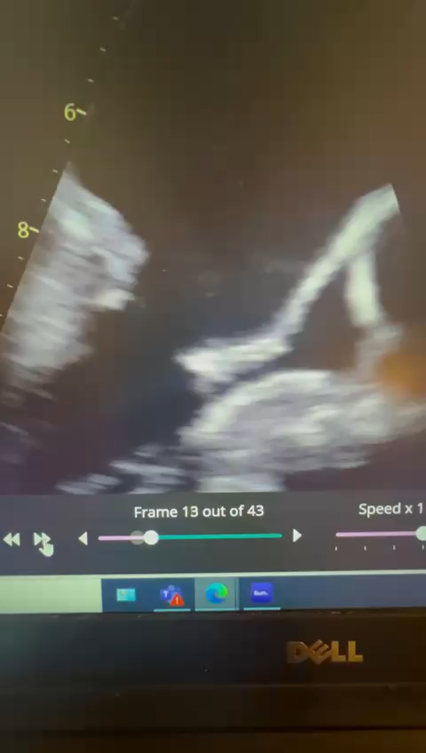
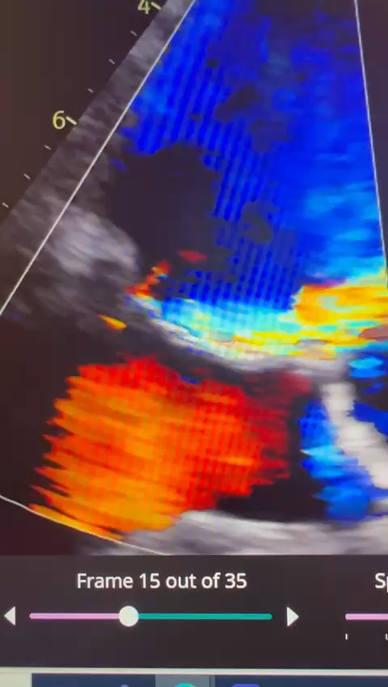

Slide 42
Case 2
53-year-old-man, PWID
Admitted with 1 week history of malaise, poor appetite, abdominal pain
In septic shock in ED on presentation
CT thorax multiple areas of focal consolidation
Blood culture Staph aureus
TTE as below very large vegetation on tricuspid valve , mild TR, discussed at MDT
Treated with antibiotics , transferred to heart valve centre for debulking of tricuspid valve vegetation

Slide 43
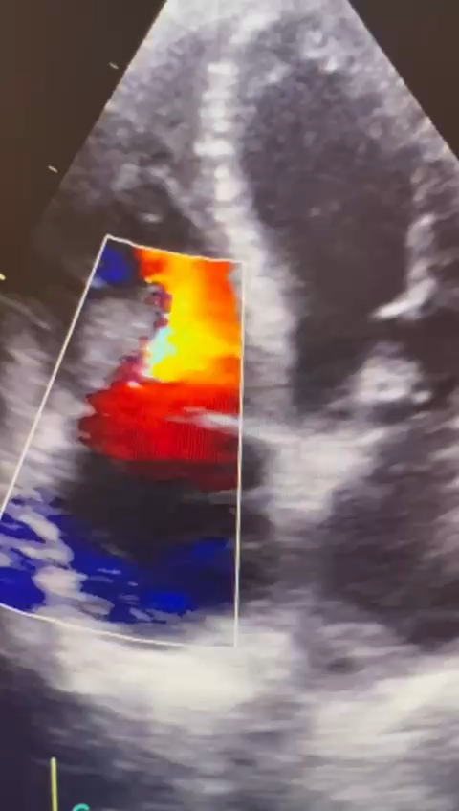
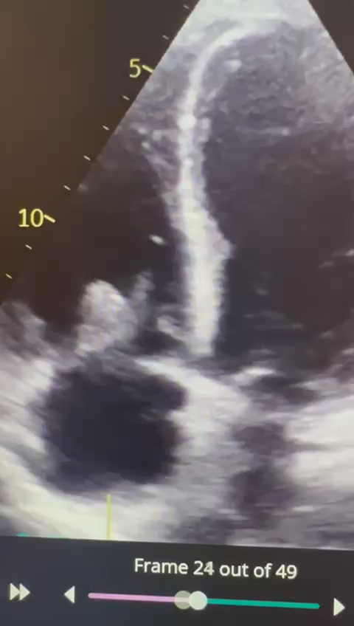

Slide 44
Thank You…

