Slide 1
Cardiology Journal Club
Presented by Saad Muhammad

Slide 2
Sirolimus- vs Paclitaxel-Coated Balloon for the Treatment of Coronary In-Stent Restenosis (SIBLINT-ISR Trial)
Liu et al, JACC: Cardiovascular Interventions, 2025
Notes:
Sirolimus inhibits T-lymphocyte activation and proliferation in response to antigenic and cytokine stimulation and inhibits antibody production. Its mechanism differs from other immunosuppressants. Sirolimus binds to FKBP-12, an intracellular protein, to form an immunosuppressive complex which inhibits the regulatory kinase, mTOR (mechanistic target of rapamycin). This inhibition suppresses cytokine mediated T-cell proliferation, halting progression from the G1 to the S phase of the cell cycle. It inhibits acute rejection of allografts and prolongs graft survival.
The 2024 ESC Guidelines for the management of chronic coronary syndromes favor paclitaxel DES implantation over DCB angioplasty for in-stent restenosis but acknowledge that there is no difference in clinical endpoints at 10-year follow-up between the two methods [77].

Slide 3
Background
In-stent restenosis (ISR) rate for 1st generation drug eluting stents (DES) = ~13-16% (Dangas et al., 2010)
Drug-coated balloons (DCBs) may be more suitable for certain patients than re-stenting
Most evidence base is with paclitaxel-coated balloons (PCBs)
Knowledge gap: Few head-to-head RCTs of SCB vs PCB for ISR
Notes:
Sirolimus-coated balloons (SCBs) are newer and thought to have better anti-ISR properties
Study aim: To test whether a novel SCB is noninferior to an established PCB for the treatment of ISR.

Slide 4
Study Design
Prospective multicentre assessor-blinded non-inferiority RCT
16 PCI centres in China
Randomization: 1:1 SCB vs PCB after adequate lesion preparation
Sample size: 258 patients (285 lesions); >80% statistical power
Primary endpoint: 9-month angiographic late lumen loss (LLL)
Secondary endpoints: restenosis, target lesion failure (TLF), PoCE at 12 months
Notes:
Pooled analysis of 6186 patients from six major clinical trials assessed frequency and predictors of restenosis among BMS. The frequency of clinical restenosis was defined as target lesion or target vessel revascularization (TVR) beyond 30 days, death, or myocardial infarction in the target vessel territory [3]. At one year, target lesion revascularization (TLR) was performed in 12 percent and TVR in 14.1 percent. These values were more than two-thirds higher than those at six months (6.9 and 8 percent). Clinically relevant restenosis occurred in only about one-half of patients with angiographic restenosis (defined as ≥50 percent diameter stenosis). This was mostly a matter of degree, since 50 to 70 percent angiographic stenosis is unlikely to cause symptoms. The incidence of TLR was much higher with more than 70 percent diameter stenosis (73 versus 26 percent for less than 60 percent diameter stenosis).
Clinical restenosis with BMS is a relatively early event, most often becoming clinically evident within the first 6 to 12 months after the procedure [4]. After one year, recurrent ischemia is more likely to be due to new or progressive disease at another site rather than restenosis.

Slide 5
Inclusion/Exclusion
Eligible: age ≥18, ISR lesions (≥70% stenosis or ≥50% with ischemia), RVD 2.5–4.0 mm, lesion length ≤34 mm
Excluded: MI <1 week, EF <35%, left main, very complex ISR, severe calcification/tortuosity, thrombus
Notes:
Rvd – reference vessel diameter

Slide 6
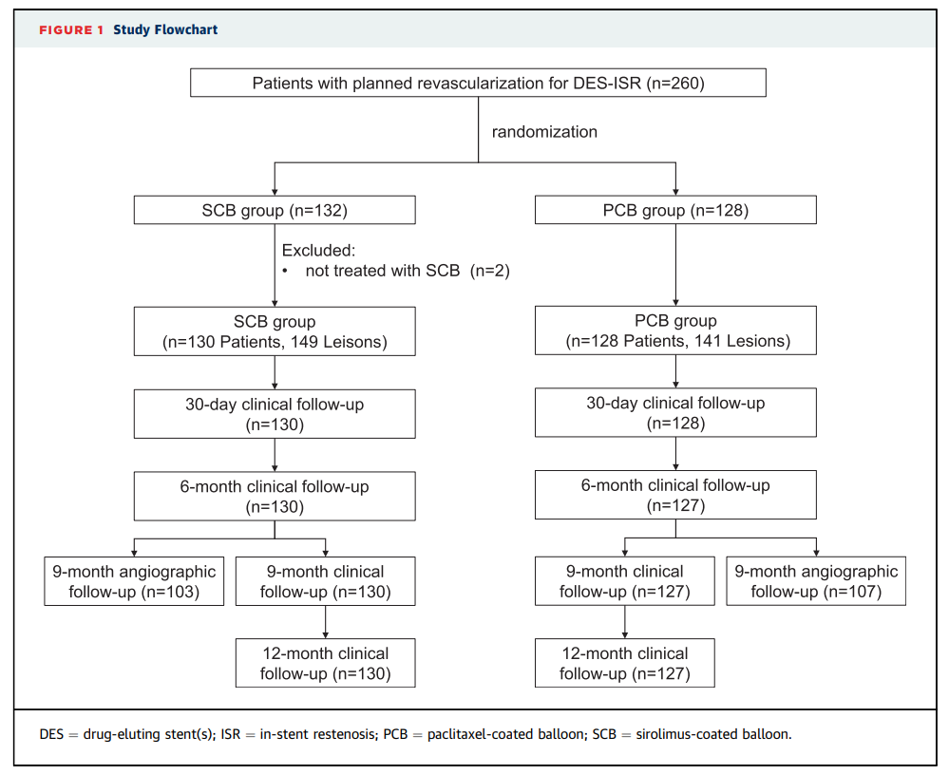

Slide 7
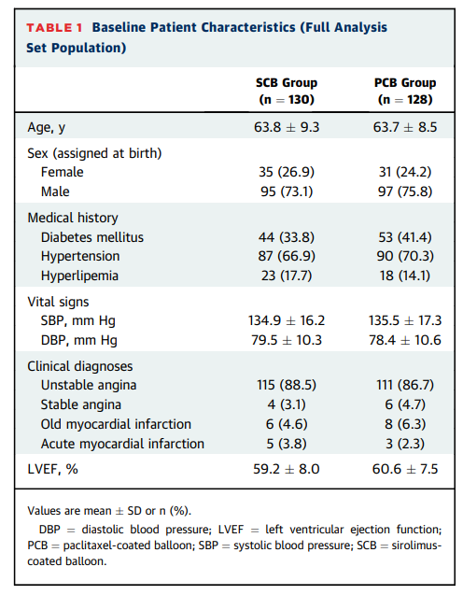

Slide 8
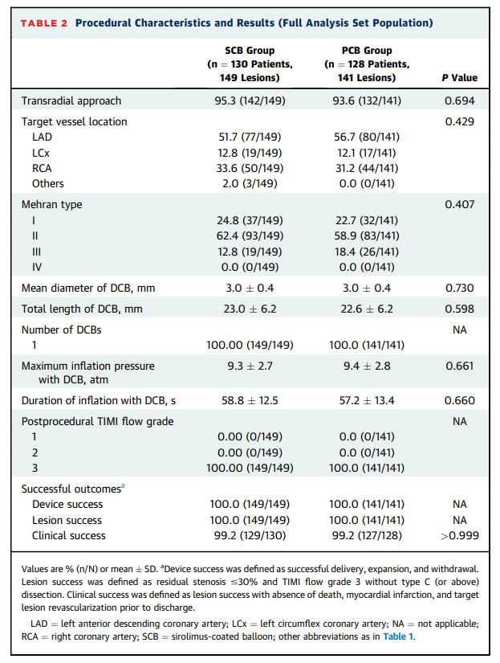
Notes:
- Pattern I describes a focal (<10 mm in length) lesion and was found in 42 percent of patients. Subsequent target lesion revascularization (TLR) was performed in 19 percent of patients.
- Pattern II describes ISR >10 mm within the stent and was present in 21 percent of patients; 35 percent required TLR.
- Pattern III describes ISR >10 mm extending outside the stent; TLR performed in 50 percent of patients.
- Pattern IV describes a totally occluded stent, which was found in 7 percent of patients; 83 percent underwent TLR.

Slide 9
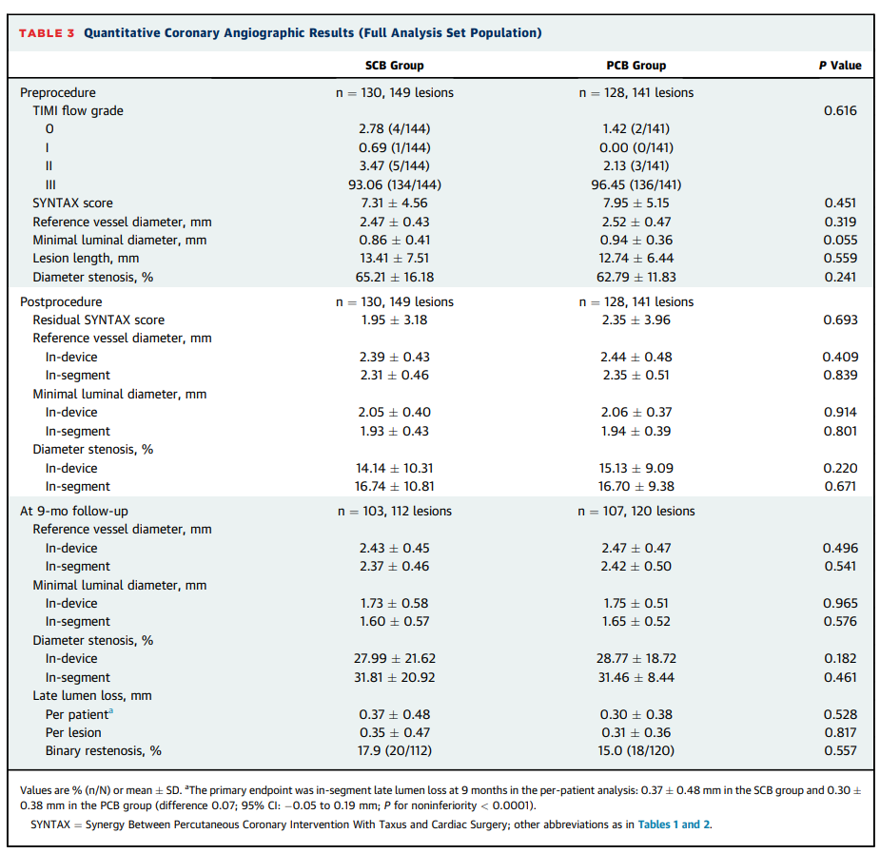
Notes:
Restenosis develops gradually, so flow is often preserved at rest despite severe stenosis. These lesions are still functionally significant under stress and need treatment

Slide 10
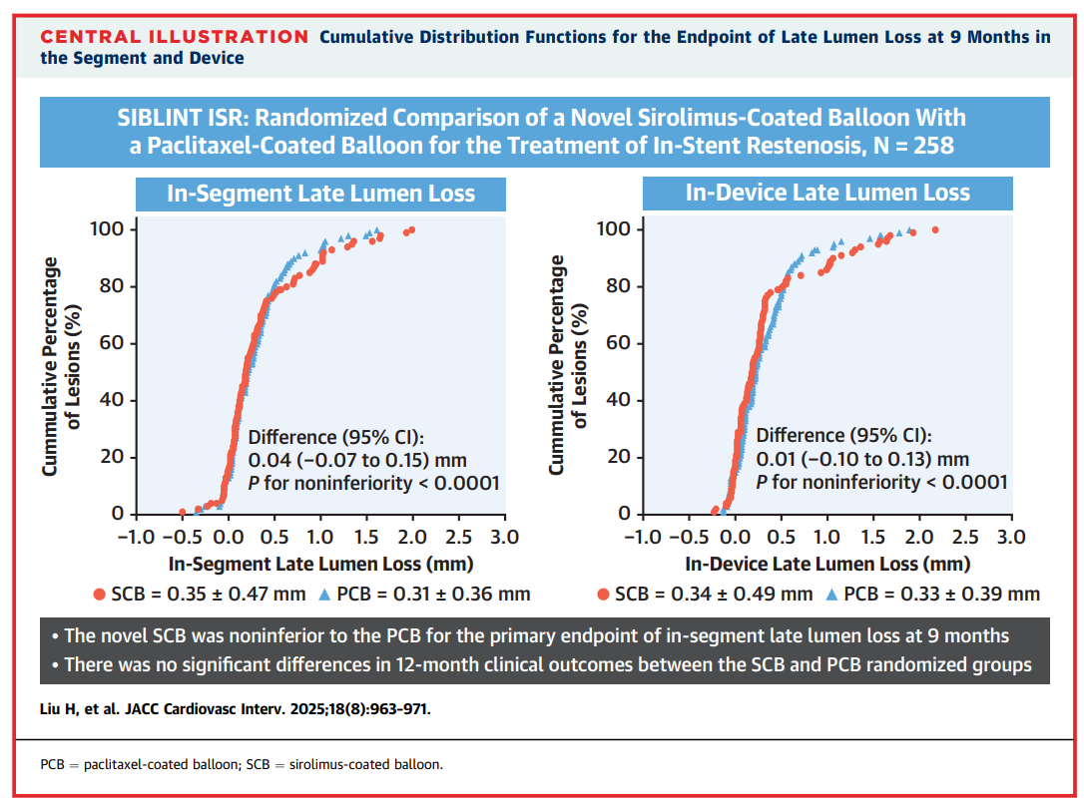
Notes:
Was the margin clinically justified?
The authors anchored their sample size to historical paclitaxel-DCB LLL (~0.46 ± 0.51 mm at 9 months) and then chose an absolute NI margin of 0.20 mm. They explicitly acknowledge that the observed paclitaxel-DCB LLL in this trial was lower than anticipated, which effectively makes 0.20 mm a looser margin than planned relative to the active control’s performance.
Good NI practice (ICH E10; CONSORT NI) expects a clinical rationale that the margin preserves a substantial fraction of the active control’s effect and is clinically acceptable to lose. That argument is not made explicitly in clinical terms here (i.e., how many mm of LLL “loss” translates to acceptable trade-offs in TLR/TVR). European Medicines Agency (EMA)Oxford Academic
How big is 0.20 mm in context?
Active-control effect size: Paclitaxel-DCB has reduced LLL meaningfully versus plain balloon in prior ISR RCTs (and performed ~0.46 mm in PEPCAD China ISR vs 0.55 mm with PES). If the clinically valuable “effect to preserve” is on the order of a few tenths of a millimetre, allowing 0.20 mm could erode a large proportion of that benefit. JACCPubMed
Surrogate endpoint issue: LLL is a surrogate, and its relationship to hard events (TLR, TLF) isn’t linear. Without an explicit mapping (e.g., “each 0.10 mm LLL difference predicts X% TLR”), it’s hard to claim 0.20 mm is clinically innocuous.
Is 0.20 mm typical vs other head-to-head DCB trials?
Contemporary sirolimus-vs-paclitaxel DCB trials have used margins in this ballpark or tighter:
• BIO-ASCEND ISR planned 0.195 mm. PubMed
• RESTORE ISR concluded NI if the upper 95% CI for LLL difference was < 0.17 mm (i.e., a 0.17 mm margin). PubMed
• Some planning docs (e.g., OPEN-ISR) have used 0.25 mm (looser). Eurointervention
⇒ So 0.20 mm is not outlandish, but it’s on the liberal side relative to some peers—especially if the comparator performs better than expected.
What changed after seeing the data?
Because the paclitaxel-DCB arm had lower-than-expected LLL, the fixed 0.20 mm absolute margin effectively became more permissive. The authors themselves note this concern in the discussion. You can point out that data-drift against the planning assumption is a classic way NI boundaries become easier to meet post hoc—even when the plan was reasonable ex ante.
Bottom line to present at JC:
Strength: The margin was pre-specified, aligned with ranges used in some DCB trials, and operationally clear.
Limitations: (i) No explicit clinical justification tying 0.20 mm to an acceptable loss in events; (ii) given the better-than-expected comparator LLL, 0.20 mm may not preserve a meaningful fraction of the active control’s effect; (iii) surrogate endpoint makes clinical acceptability of 0.20 mm uncertain.
Your take: “Reasonable ex-ante, but arguably too liberal ex-post once we saw the control’s performance; a ≤ 0.17–0.195 mm margin (as used elsewhere) might have been more conservative.”

Slide 11
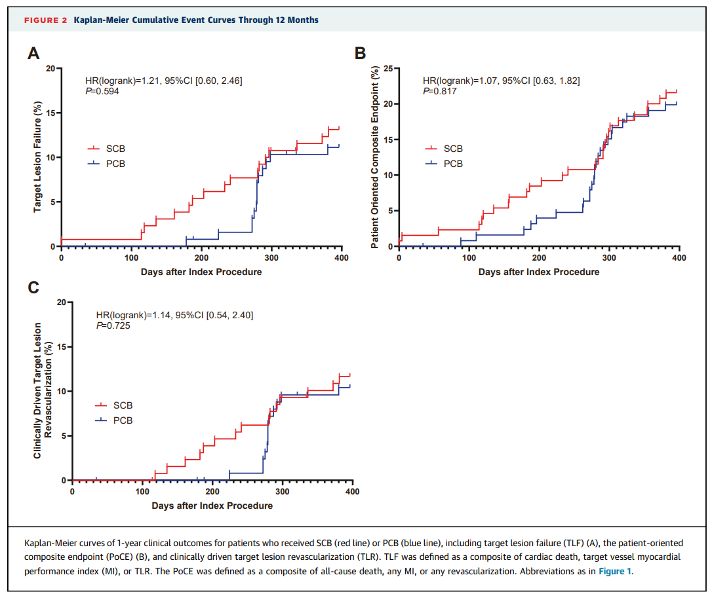
Notes:
The absolute event rates are low (10–20%)
The 95% CIs are wide (e.g., HR 1.21 but CI 0.60–2.46)
F/u duration is 12 months
SR lesions in this trial were relatively simple (mostly Mehran I/II).
KM curves might look different in higher-risk ISR subsets (diffuse, left main, diabetics)
Suggestive that the trial is underpowered for clinical endpoints — consistent with the fact that it was designed for angiographic noninferiority, not clinical superiority
Interpretation: absence of difference ≠ equivalence for clinical outcomes.
Most events were TLR-driven, so the curves reflect restenosis rather than hard outcomes like MI or death

Slide 12
Strengths/Limitations
Strengths:
Multi-centre, randomised, assessor-blinded
Adequately powered for angiographic endpoint
Limitations:
Powered for angiographic, not clinical endpoints
Chinese population only
Mostly simple ISR (Mehran I/II)
Limited duration of follow-up (12 month clinical f/u)
Industry-funded (B. Braun)
Notes:
Should SCBs replace PCBs in ISR management?
Do angiographic endpoints (LLL) matter as much as clinical outcomes?
What about complex ISR lesions (Mehran III/IV, left main)?
How might this trial affect UK practice?
What further research is needed?
Operators were not blinded however all angiographic measurements were performed at a blinded independent core lab and clinical events adjudicated by a blinded committee
PCB available in UK with £512-636 cost per device
SCB not currently available in UK

Slide 13
Would you use SCBs over PCBs?
Notes:
Should SCBs replace PCBs in ISR management if efficacy is similar but safety profile of sirolimus is potentially more favoruable?
How much weight should we give angiographic endpoints (LLL) versus hard clinical endpoints?
What about longer-term outcomes (>12 months)?
Would the results be the same in more complex ISR (Mehran III/IV, left main, multivessel)?
How might this influence practice in the UK, where PCBs are more widely used and SCBs are just emerging?
Do we need larger multinational RCTs, or is this evidence enough to shift guidelines?

Slide 14
Thinking Points
Should SCBs replace PCBs in ISR management if efficacy is similar but safety profile of sirolimus is potentially more favourable?
How much weight should we give angiographic endpoints (LLL) versus hard clinical endpoints?
What about longer-term outcomes (>12 months)?
Would the results be the same in more complex ISR (Mehran III/IV, left main, multi-vessel)?
How might this influence practice in the UK, where PCBs are more widely used and SCBs are just emerging?
Do we need larger multinational RCTs, or is this evidence enough to shift guidelines?

