Slide 1

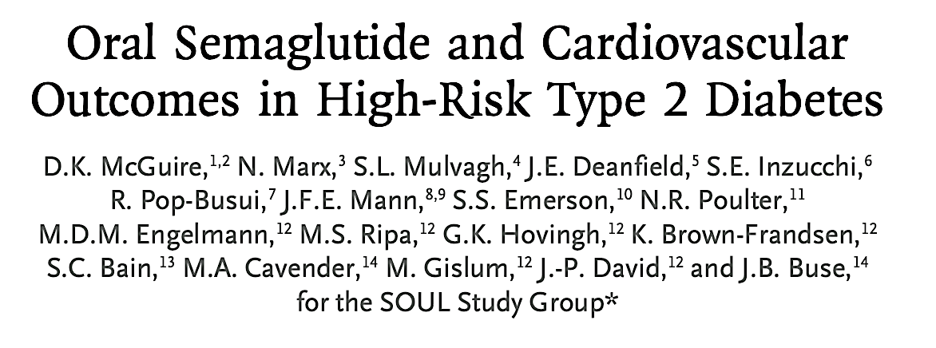


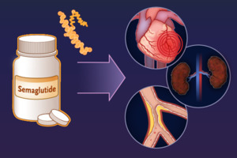
Cardiology Journal Club
Published 29 May 2025
14 August 2025 Dr Y Padayachee

Slide 2

Rationale
SUSTAIN-6 trial: injectable semaglutide weekly showed significant CV benefit in T2D with high CV risk.
PIONEER-6 trial: Oral semaglutide daily confirmed CV safety but was short in duration and underpowered for superiority.
Gap in literature addressed: Cardiovascular efficacy of oral semaglutide.
Notes:
PIONEER 4 trial. It was a randomized, double-blind, double-dummy, phase 3a trial comparing oral semaglutide to subcutaneous liraglutide (not semaglutide) and placebo over 52 weeks in patients with type 2 diabetes.
It showed that oral semaglutide was non-inferior to subcutaneous liraglutide in lowering HbA1c, and even superior in reducing body weight.
Safety profiles between the two routes were similar.
SUSTAIN 6 however demonstrated a statistically significant 26% risk reduction with s.c. semaglutide compared with placebo for the primary endpoint (time from randomisation to first occurrence of a major adverse cardiovascular event (MACE) consisting of: CV death, non-fatal myocardial infarction (MI) or nonfatal stroke).
PIONEER 6 demonstrated CV safety with a favourable point estimate.
Clinical pharmacology and clinical efficacy data indicate that the action of semaglutide is the same whether administrated via a subcutaneous injection or orally in a tablet. Hence, once semaglutide has entered systemic circulation, the properties and actions of the molecule are similar and independent of the route of administration. Accordingly it is hypothesised that oral semaglutide in the dose of 14 mg OD can reduce CV risk.
Only CV safety, not efficacy, has been established for oral semaglutide in people with T2D and high risk of CVD through the PIONEER 6 trial

Slide 3
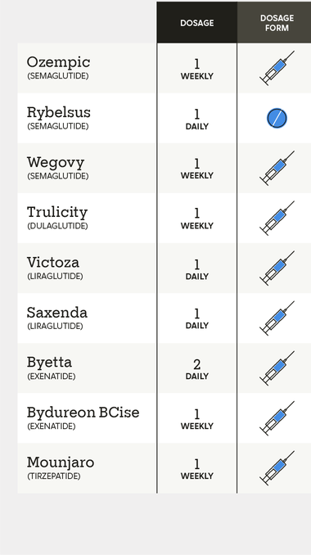
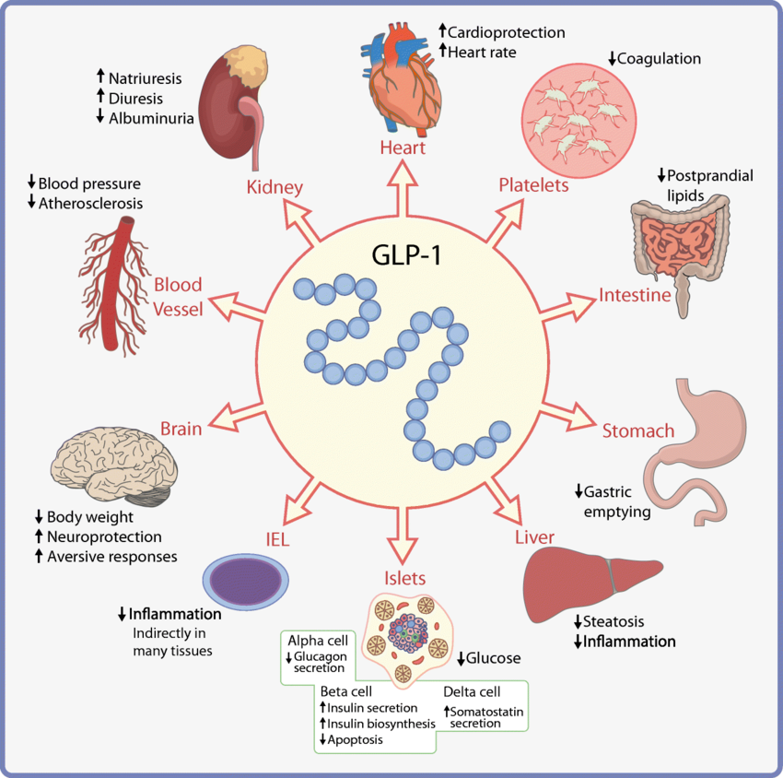
Pharmacology of Semaglutide
Glucagon-like peptide-1 (GLP-1) receptor agonist
Common side effects: burping; cholelithiasis; constipation; diarrhoea; fatigue; gastrointestinal discomfort; nausea; vomiting; impaired renal function secondary to dehydration ; hypoglycaemia
Rarer: pancreatitis, diabetic retinopathy, pancreatic cancer, medullary thyroid cancer
Notes:
Mechanism of action:
Semaglutide is a next-generation glucagon-like peptide-1 (GLP-1) analogue with a high degree of homology to human GLP-1.6 For oral administration, semaglutide has been co-formulated with an absorption enhancer (SNAC, 300 mg) in a tablet formulation
binds to and activates GLP-1 receptors, primarily in the pancreas, gastrointestinal tract, and brain
enhances insulin release in response to elevated blood glucose levels, helping to lower blood sugar.
reduces the release of glucagon,] further contributing to glucose control.
Delayed gastric emptying
Regulates appetite
Lipid Benefits, and Anti-Inflammatory Effects
improve the function of adipose tissue by reducing inflammation
https://www.sciencedirect.com/science/article/pii/S0002934325000592

Slide 4
Recommendations for semaglutide in the UK
NICE adults ≥ 18 years old:
If triple therapy with metformin and 2 other oral drugs is not effective, not tolerated, or contraindicated
consider triple therapy by switching one drug for a GLP-1 agonist for adults with type 2 diabetes who have a body mass index (BMI) of 35 kg/m² or higher
BMI 30 to 34.9 and meet criteria for referral to specialist overweight and obesity management services

Slide 5
Objectives
Primary: To demonstrate oral semaglutide lowers the risk of major adverse cardiovascular events (MACE) compared to placebo, both added to standard of care in patients with T2DM and established CVD and/or CKD.
Secondary: To compare the effects of oral semaglutide versus placebo, in patients with T2D and at high risk of CV events with regards to:
CKD
CV events
Peripheral artery disease (PAD)
Glycaemic control and body weight
Safety
Notes:
The goal of the phase 3b trial was to assess the cardiovascular efficacy of oral semaglutide, a GLP-1 receptor agonist, and to determine the risk of major adverse cardiovascular events (MACE) in patients with type 2 diabetes mellitus (T2DM) and atherosclerotic cardiovascular disease (ASCVD), chronic kidney disease (CKD), or both.

Slide 6
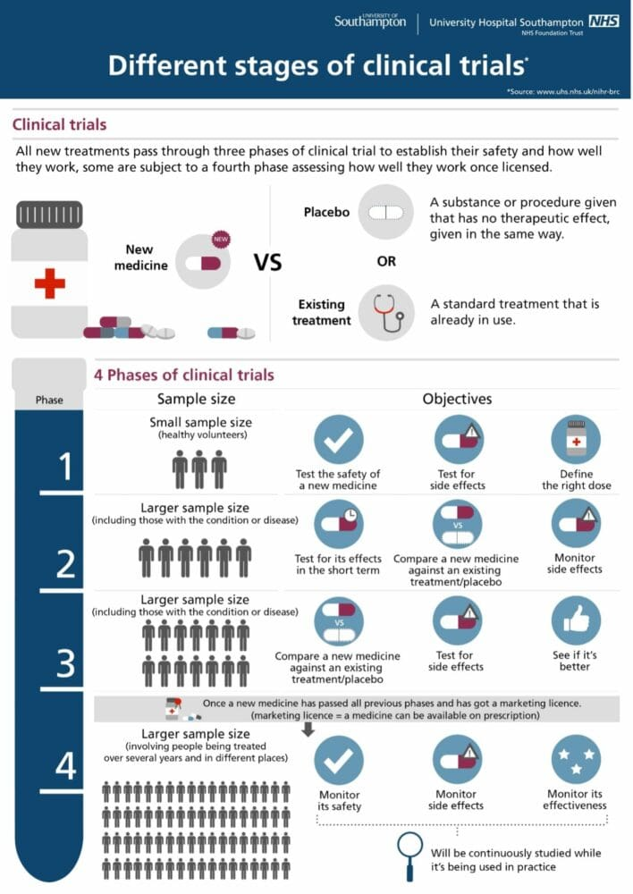
Study Design
International & multi-centre
Double-blind
Parallel group
Randomised
Placebo-controlled
Event-driven
Superiority phase 3b trial
Notes:
Double blind: neither the participants nor the researchers know who is receiving the actual treatment (or intervention) and who is receiving the placebo or control.
Randomised: participants are randomly assigned to different treatment groups
completion of the trial or analysis is triggered by the occurrence of a predetermined number of specific clinical events rather than a fixed study duration or sample size.
"event-driven" aspect of the SOUL trial refers to the trial's design, where it continues until a predetermined number of primary endpoint events (major adverse cardiovascular events, or MACE) have occurred, rather than running for a fixed duration. This approach helps ensure sufficient statistical power to detect meaningful differences between the treatment groups.
Phase 3a trials are typically conducted before regulatory approval to gather more data on safety and efficacy, while Phase 3b trials are conducted after approval to further explore the treatment's use, often in different populations or for longer durations.

Slide 7

Trial design
3 mg*
7 mg*
14 mg oral semaglutide OD*
Follow-up
Screening
3 mg*
7 mg*
14 mg placebo OD*
Week
-3
Week 0
Week 4
Week 8
5 weeks
Treatment period (Event driven, ≥ 1225 first EAC confirmed MACE)
End of treatment visit
Follow-up visit
Screening
*= in addition to SOC
Randomisation 1:1
Notes:
4 years and 1.5 months), Duration of follow-up: median 49.5 months
Endpoint Adjudication Committee
The 5-week follow up is chosen due to the half-life of oral semaglutide and is considered appropriate for end of systemic exposure.
Three doses of oral semaglutide have been investigated in the phase 3a development programme: 3 mg, 7 mg and 14 mg. The selected doses are based on the data derived from the NN9924-3790 dose-finding trial. For further details regarding the results obtained in the phase 2 dose-finding trial (NN9924-3790), please refer to the current edition of the IB for oral administration of semaglutide (NN9924), or any updates thereto.
Participants were instructed to take the semaglutide or placebo tablet in the morning, in a fasting state, with up to 120 ml of water and to wait at least 30 minutes before taking food, drink, or other oral medications.
Premature permanent discontinuation of oral semaglutide or placebo occurred in 1309 participants (27.1%)in the oral semaglutide group and in 1373 participants (28.5%) in the placebo group (Fig. S3B).

Slide 8
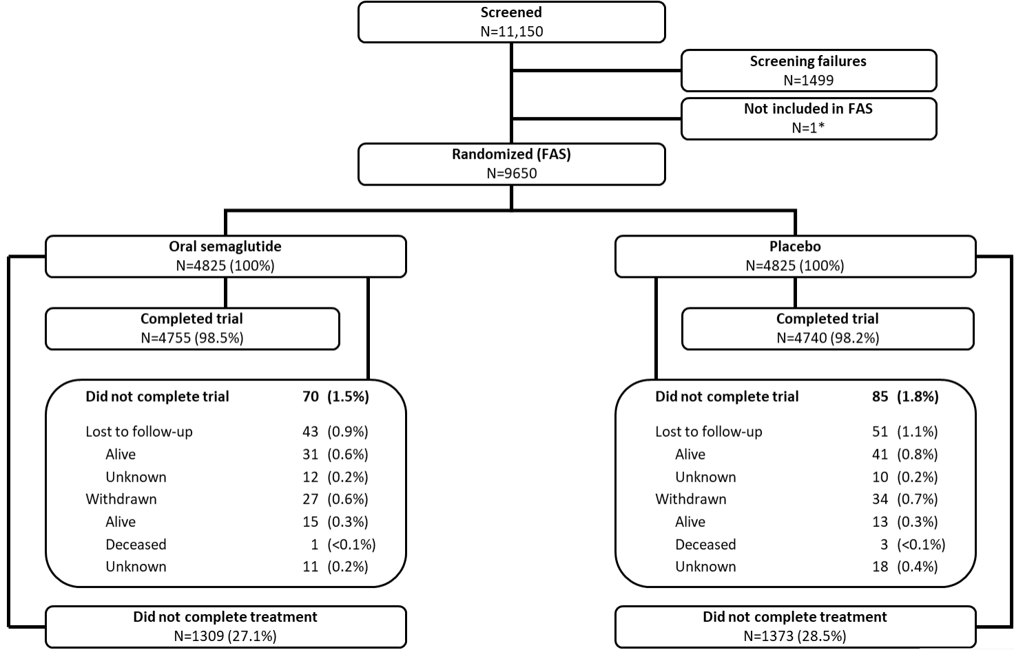
Disposition of participants
Median follow up 49.5 months
98.4% completed trial between both groups.
Standard of care: glucose-lowering and cardiovascular risk reducing therapies according to local guidelines
FAS= full analysis set
444 sites in 33 countries
Notes:
June 2019 to March 2021 9650 patients randomised
FAS= full analysis set
SOC= glucose-lowering and cardiovascular risk reducing therapies according to local guidelines
Participants were instructed to take the semaglutide or placebo tablet in the morning, in a fasting state, with up to 120 ml of water and to wait at least 30 minutes before taking food, drink, or other oral medications. Trial visits occurred at 4,
8, and 13 weeks after randomization and approximately every 13 weeks thereafter.

Slide 9
Inclusion criteria
Age ≥50 years
Diagnosed with T2DM with HBA1C 6.5-10%
With at least one of the following:
Coronary artery disease
Cerebrovascular disease
Symptomatic peripheral artery disease (PAD)
CKD: eGFR < 60 mL/min/1.73 m2 (latest result available not >6months old)
Notes:
Coronary artery disease (prior MI OR prior coronary revascularisation OR ≥50% stenosis in coronary artery documented by cardiac catheterisation or CTCA OR Coronary heart disease with ischaemia documented by stress test with any imaging modality)
Cerebrovascular disease (Prior stroke OR Prior carotid artery revascularisation procedure OR ≥50% stenosis in carotid artery documented by X-ray angiography OR magnetic resonance angiography, CTA or Doppler ultrasound)
Symptomatic peripheral artery disease (PAD) defined as at least 1 of the following:
i) Intermittent claudication with an Ankle-brachial index (ABI) < 0.85 at rest ii. Intermittent claudication with a ≥50% stenosis in peripheral artery (excluding carotid) documented by X-ray angiography, magnetic resonance angiography, computerized tomography angiography or Doppler ultrasound iii. Prior peripheral artery (excluding carotid) revascularization procedure iv. Lower extremity amputation at or above ankle due to atherosclerotic disease (excluding e.g. trauma or osteomyelitis)
CKD: eGFR < 60 mL/min/1.73 m2
A patient is said to have chronic kidney disease (CKD) if they have abnormalities of kidney function or structure present for more than 3 months.
The definition of CKD includes all individuals with markers of kidney damage (see below*) or those with an eGFR of less than 60 ml/min/1.73m² on at least 2 occasions 90 days apart (with or without markers of kidney damage).
*Markers of kidney disease may include: albuminuria (ACR > 3 mg/mmol), haematuria (of presumed or confirmed renal origin), electrolyte abnormalities due to tubular disorders, renal histological abnormalities, structural abnormalities detected by imaging (e.g. polycystic kidneys, reflux nephropathy) or a history of kidney transplantation.

Slide 10
Exclusion criteria
• Any of the following: MI, stroke, hospitalisation for UA or TIA within the past 60 days prior to the day of screening
Planned coronary, carotid or peripheral artery revascularisation known on the day of screening
Heart failure presently classified as being in New York Heart Association Class IV
Treatment with any glucagon-like peptide-1 receptor agonist within 30 days before screening

Slide 11
Statistical considerations
Event-driven trial, ≈ sample of 9642 participants would provide the trial with 90% power to detect a 17% lower risk of a primary outcome event
Efficacy analyses were performed in the intention-to-treat population, which included all the individual participants who had undergone randomization, regardless of or changes to background medications(reduced selection and attrition bias)
Data analysis conducted by sponsor and analyses of primary and confirmatory secondary outcomes independently verified
Notes:
Data analysis was conducted by the
sponsor, and the analyses of the primary and
confirmatory secondary outcomes were indepen-
dently verified by Statogen Consulting.

Slide 12
Outcomes
Primary: MACE (a three-point composite of death from cardiovascular causes, nonfatal myocardial infarction, or nonfatal stroke), assessed in an analysis of the time from randomization to the first event.
Confirmatory secondary outcomes: three time-to-first-event outcomes tested in hierarchical order → Major kidney disease events, death from cardiovascular causes; and major adverse limb events (MALE)
Supportive secondary outcomes:
Time-to-first-event outcomes i.e: heart failure events, death from any cause, fatal or nonfatal myocardial infarction, fatal or nonfatal stroke, and severe hypoglycemic episodes.
Measures of metabolism and inflammation → change from baseline to week 104 for each of these measures was a prespecified secondary outcome.
Adverse events and serious adverse events
Notes:
it combines three specific events into a single outcome measure:
Cardiovascular death – death caused by heart-related issues (e.g., heart attack, fatal arrhythmia, sudden cardiac death, heart failure, stroke-related death).
Nonfatal myocardial infarction (MI) – a heart attack that the patient survives.
Nonfatal stroke – a stroke (ischemic or hemorrhagic) that the patient survives.
If superiority is confirmed for the primary endpoint the below confirmatory secondary endpoints will be controlled for multiplicity through a hierarchical testing strategy
5-component composite CKD endpoint is analysed using a Cox proportional hazards model as for the primary endpoint
e eGFR components, a persistent outcome in eGFR is defined as having two consecutive central laboratory assessments at least 4 weeks apart meeting the criteria. W

Slide 13
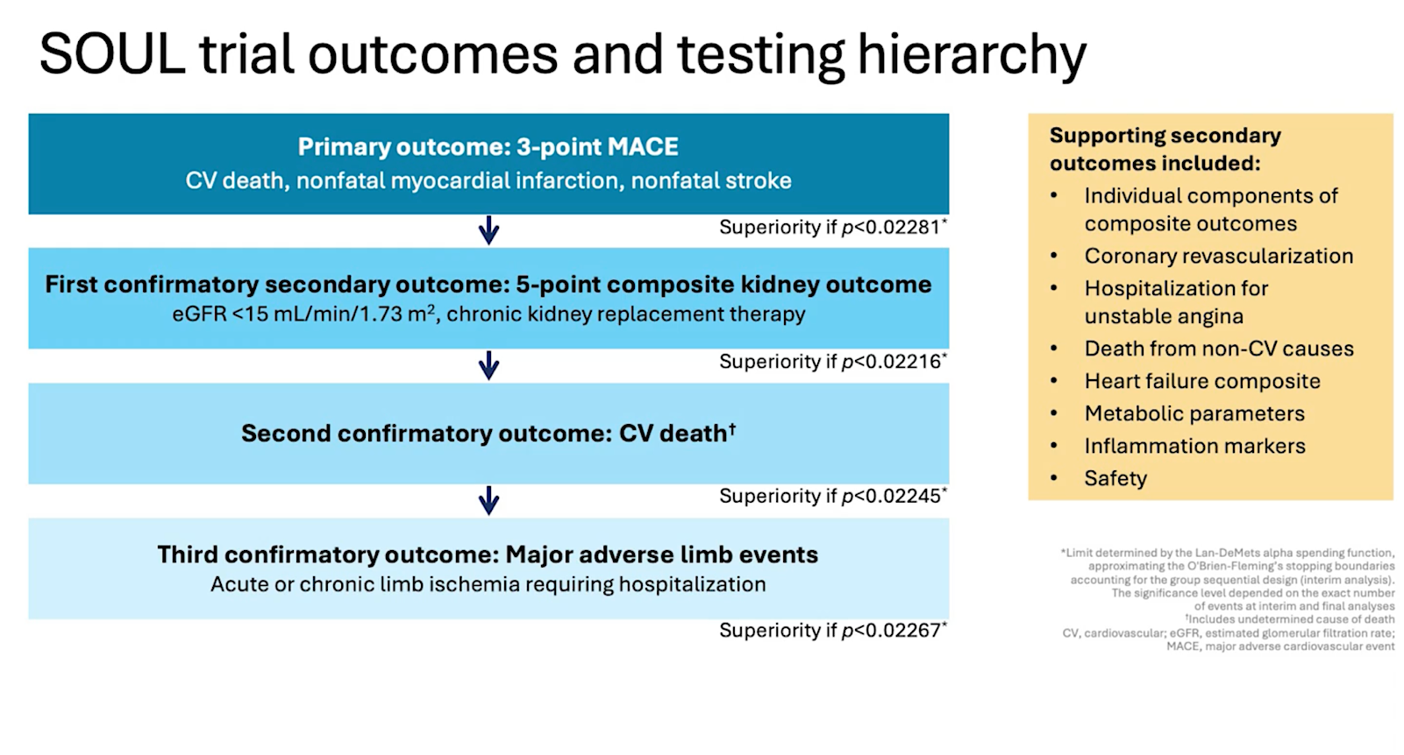
Outcomes
Notes:
Exploratory: any statistical significance is considered hypothesis generating
This diagram shows the SOUL trial’s hierarchical (sequential) testing strategy, which is designed to control the risk of false positives when multiple endpoints are being tested.
Here’s how it works step-by-step:
1. The problem: multiple outcomes increase false-positive risk
If you test many endpoints at the same time, the chance of finding a “statistically significant” result by random chance increases (inflated family-wise error rate).
Hierarchical testing solves this by pre-specifying an order of testing and only moving to the next outcome if the previous one reaches significance.
2. What this diagram shows
The trial’s primary outcome is 3-point MACE (major adverse cardiovascular events: CV death, nonfatal MI, nonfatal stroke).
If the primary outcome is statistically significant at its specific adjusted threshold (p < 0.02281), then you’re allowed to formally test the first confirmatory secondary outcome.
This process repeats down the list.
3. The flow in this diagram
Primary outcome: 3-point MACE
Test at p < 0.02281.
If significant → proceed to #2; if not → all subsequent confirmatory outcomes are considered exploratory only.
First confirmatory secondary: 5-point composite kidney outcome
eGFR < 15 or chronic kidney replacement therapy.
Test at p < 0.02216.
If significant → proceed to #3.
Second confirmatory: CV death
Test at p < 0.02245.
If significant → proceed to #4.
Third confirmatory: Major adverse limb events
Acute/chronic limb ischemia requiring hospitalization.
Test at p < 0.02267.
4. Why this helps
Controls type I error: The overall chance of a false-positive across all outcomes is preserved at the intended alpha (usually 0.05) because testing is sequential and pre-planned.
Maintains statistical integrity: It avoids the need for heavy corrections (like Bonferroni) for all outcomes, which can make the trial underpowered.
Prioritizes clinical relevance: Outcomes most important to the trial’s main question are tested first, ensuring the trial’s conclusions hinge on the most critical endpoints.
In short: The diagram shows that SOUL will only claim formal statistical significance for kidney outcomes, CV death, or limb events if the earlier outcomes in the chain meet their significance thresholds. This preserves the reliability of findings while allowing multiple clinically relevant endpoints to be examined.

Slide 14
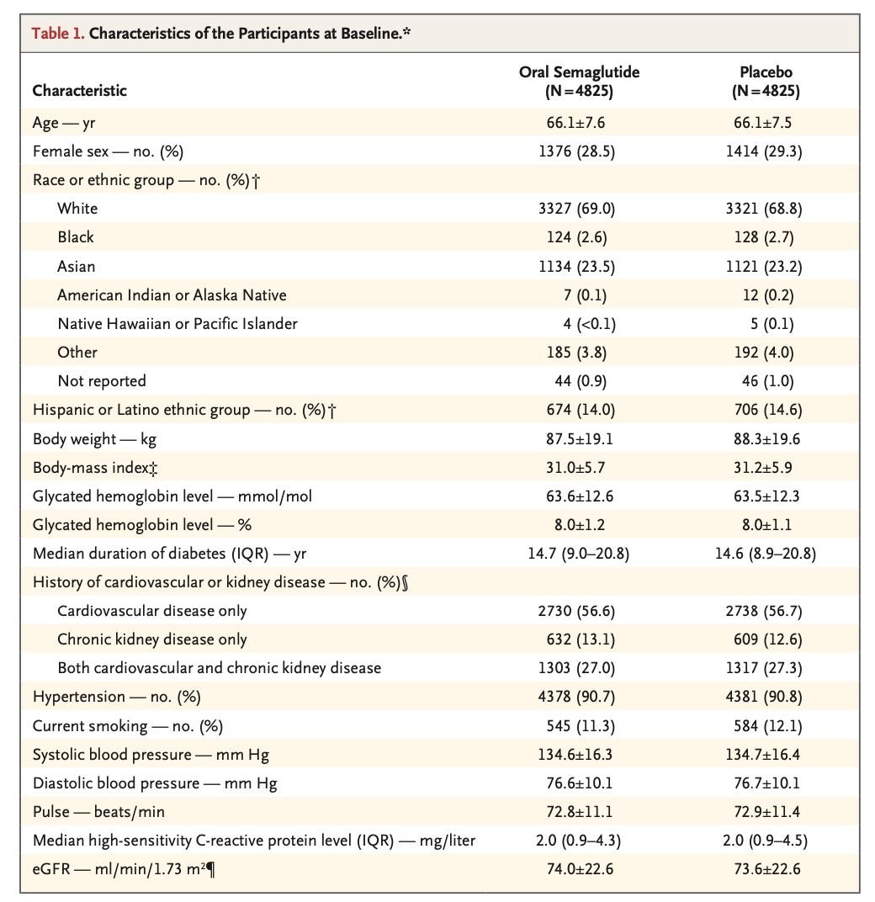
Results: participant characteristics
Notes:
At baseline, participants were predominantly male (71.1%), white (68.9%), with a mean age of 66.1 years.
Key characteristics also included a mean diabetes duration of 15.4 years, a body mass index (BMI) of 31.1 kg/m², and a glycated hemoglobin (HbA1c) level of 63.5 mmol/mol (8.0%). A large proportion had existing cardiovascular conditions, with 70.7% having CAD, 42.3% CKD, 21.1% cerebrovascular disease, and 15.7% symptomatic peripheral artery disease (PAD)

Slide 15
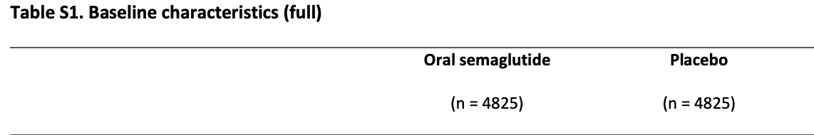
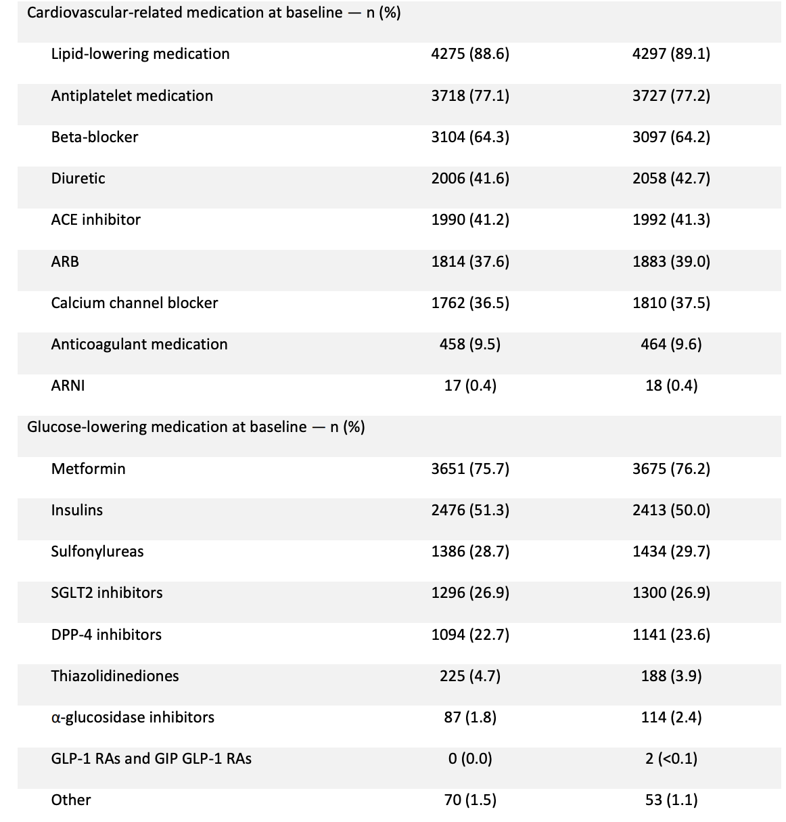
Results:
Supplementary baseline medications

Slide 16
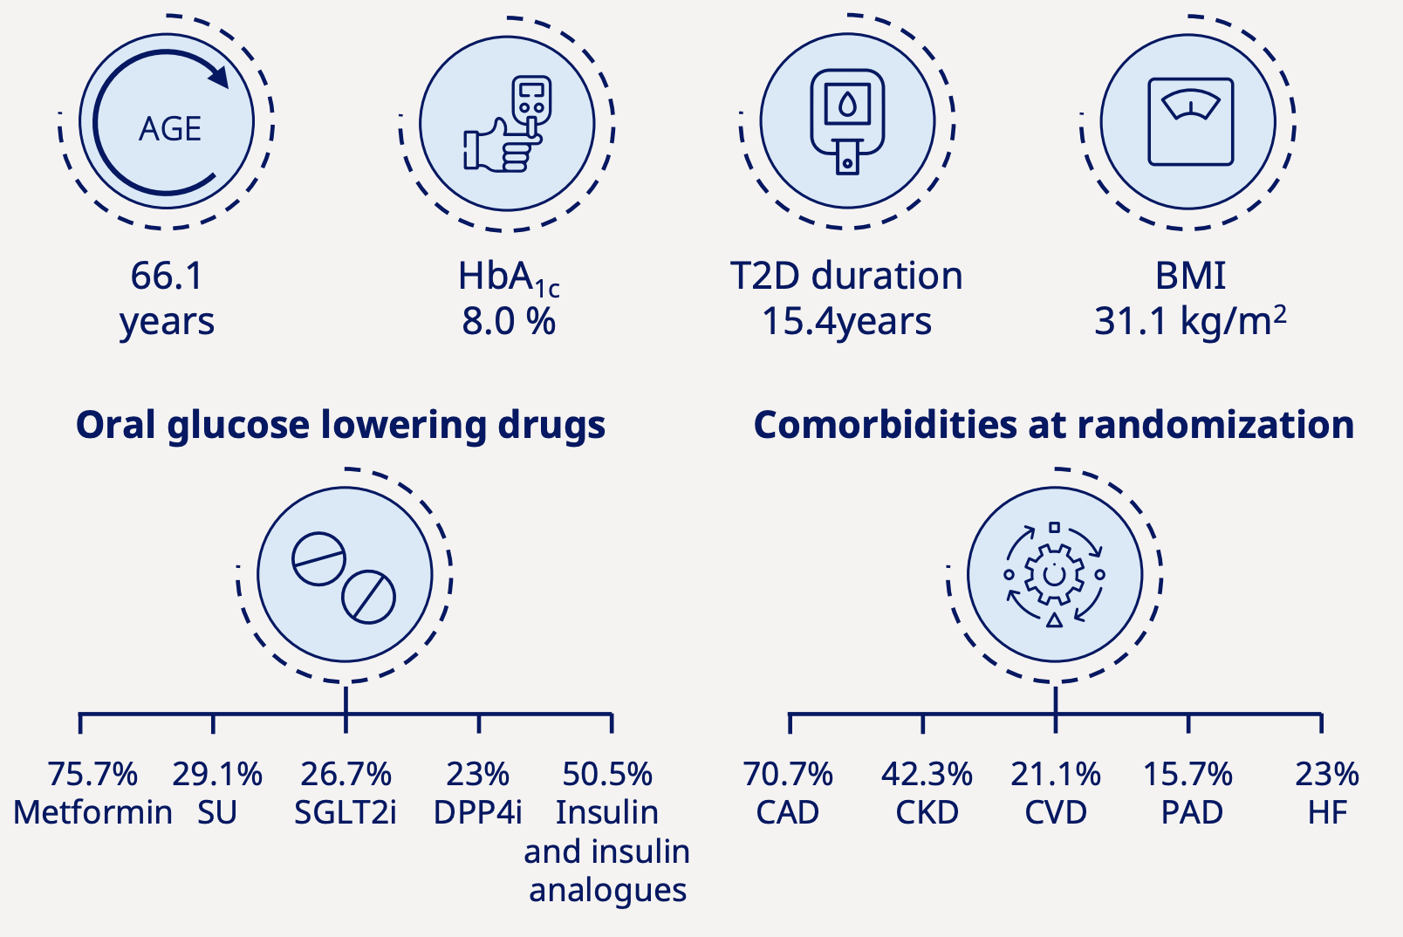
Baseline characteristics summary
Notes:
June 2019 to March 2021 9650 patients randomised

Slide 17
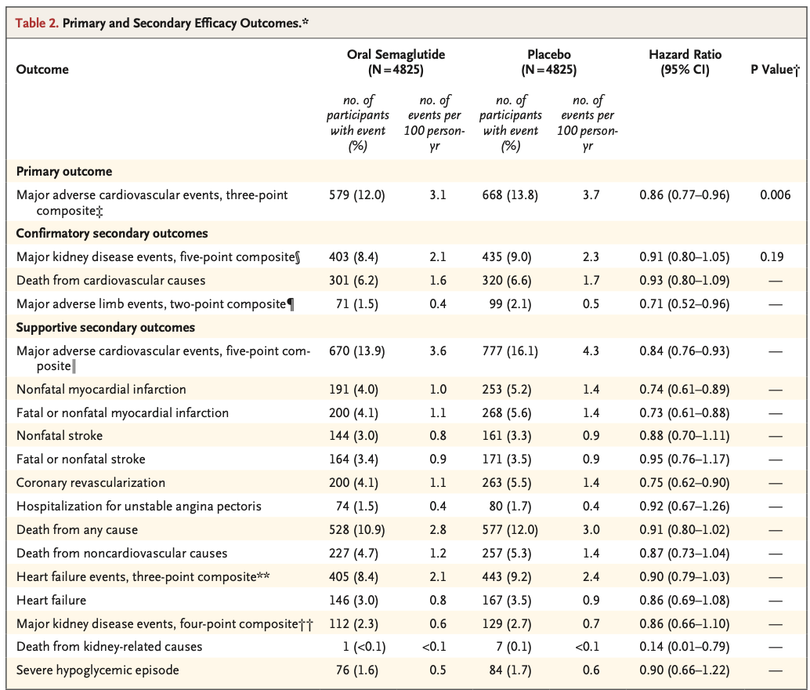
Results
MACE: death from cardiovascular causes, nonfatal myocardial infarction, or nonfatal stroke
✔️Statistically significant reduction in MACE
Kidney: ❌ Not statistically significant
Remaining two
confirmatory secondary outcomes in the hierarchy not tested for significance→ exploratory thus only point estimates and 95% CI reported
exploratory
Notes:
The results for all three confirmatory secondary outcomes were directionally consistent with the results for the primary outcome, but a significant effect was not observed for the first outcome in the hierarchy (major kidney disease events),
and thus statistical testing was stopped at the second step.
Primary Outcome (Major adverse cardiovascular events, three-point composite—death from cardiovascular causes, nonfatal myocardial infarction, or nonfatal stroke):
Oral Semaglutide significantly reduced the risk of major adverse cardiovascular events compared to placebo (HR: 0.86; 95% CI: 0.77-0.96; P=0.006). This indicates a statistically significant benefit of Oral Semaglutide in reducing the composite outcome of cardiovascular death, nonfatal myocardial infarction, or nonfatal stroke.
(14% lower risk of experiencing a MACE event compared to those on placebo)
Major adverse cardiovascular events (MACE) — a composite of cardiovascular death, nonfatal myocardial infarction, or nonfatal stroke:
Semaglutide: 12.0% (3.1 events/100 person-years)
Placebo: 13.8% (3.7 events/100 person-years)
Hazard Ratio (HR): 0.86 (95% CI: 0.77–0.96), P = 0.006
✅ Statistically significant reduction with semaglutide
Confirmatory Secondary Outcomes:
Major kidney disease events, five-point composite: There was no statistically significant difference in the risk of major kidney disease events between the two groups (HR: 0.91; 95% CI: 0.80-1.05; P=0.19).
Death from cardiovascular causes: No statistically significant difference in cardiovascular death was observed (HR: 0.93; 95% CI: 0.80-1.09).
Major adverse limb events, two-point composite: Oral Semaglutide significantly reduced the risk of major adverse limb events (HR: 0.71; 95% CI: 0.52-0.96).
🔵 Confirmatory Secondary Outcomes
Major kidney disease events (5-point composite):
HR: 0.91 (0.80–1.05), P = 0.19
❌ Not statistically significant
Death from cardiovascular causes:
HR: 0.93 (0.80–1.09)
❌ Not statistically significant
Major adverse limb events:
HR: 0.71 (0.52–0.96)
✅ Suggests benefit, though no P-value provided
🟡 Supportive Secondary Outcomes
5-point MACE composite: HR 0.84 (0.76–0.93) → Favorable
Nonfatal myocardial infarction: HR 0.74 (0.61–0.89) → Favorable
Fatal or nonfatal MI: HR 0.73 (0.61–0.88) → Favorable
Nonfatal stroke: HR 0.88 (0.70–1.11) → Not significant
Coronary revascularization: HR 0.75 (0.62–0.90) → Favorable
Death from any cause: HR 0.88 (0.76–1.02) → Borderline
Death from kidney-related causes: HR 0.14 (0.07–0.79) → Strongly favorable
⚠️ Safety: Severe Hypoglycemic Episodes
Similar in both groups (HR: 0.90 [0.66–1.22])
❌ No increased risk with semaglutide
✅ Key Takeaways
Oral semaglutide significantly reduces major cardiovascular events (primary outcome) compared to placebo.
Most cardiovascular supportive outcomes trend favorably.
No major safety concerns noted regarding hypoglycemia.
Kidney and limb events show potential benefit, but results are mixed or not statistically confirmed.

Slide 18
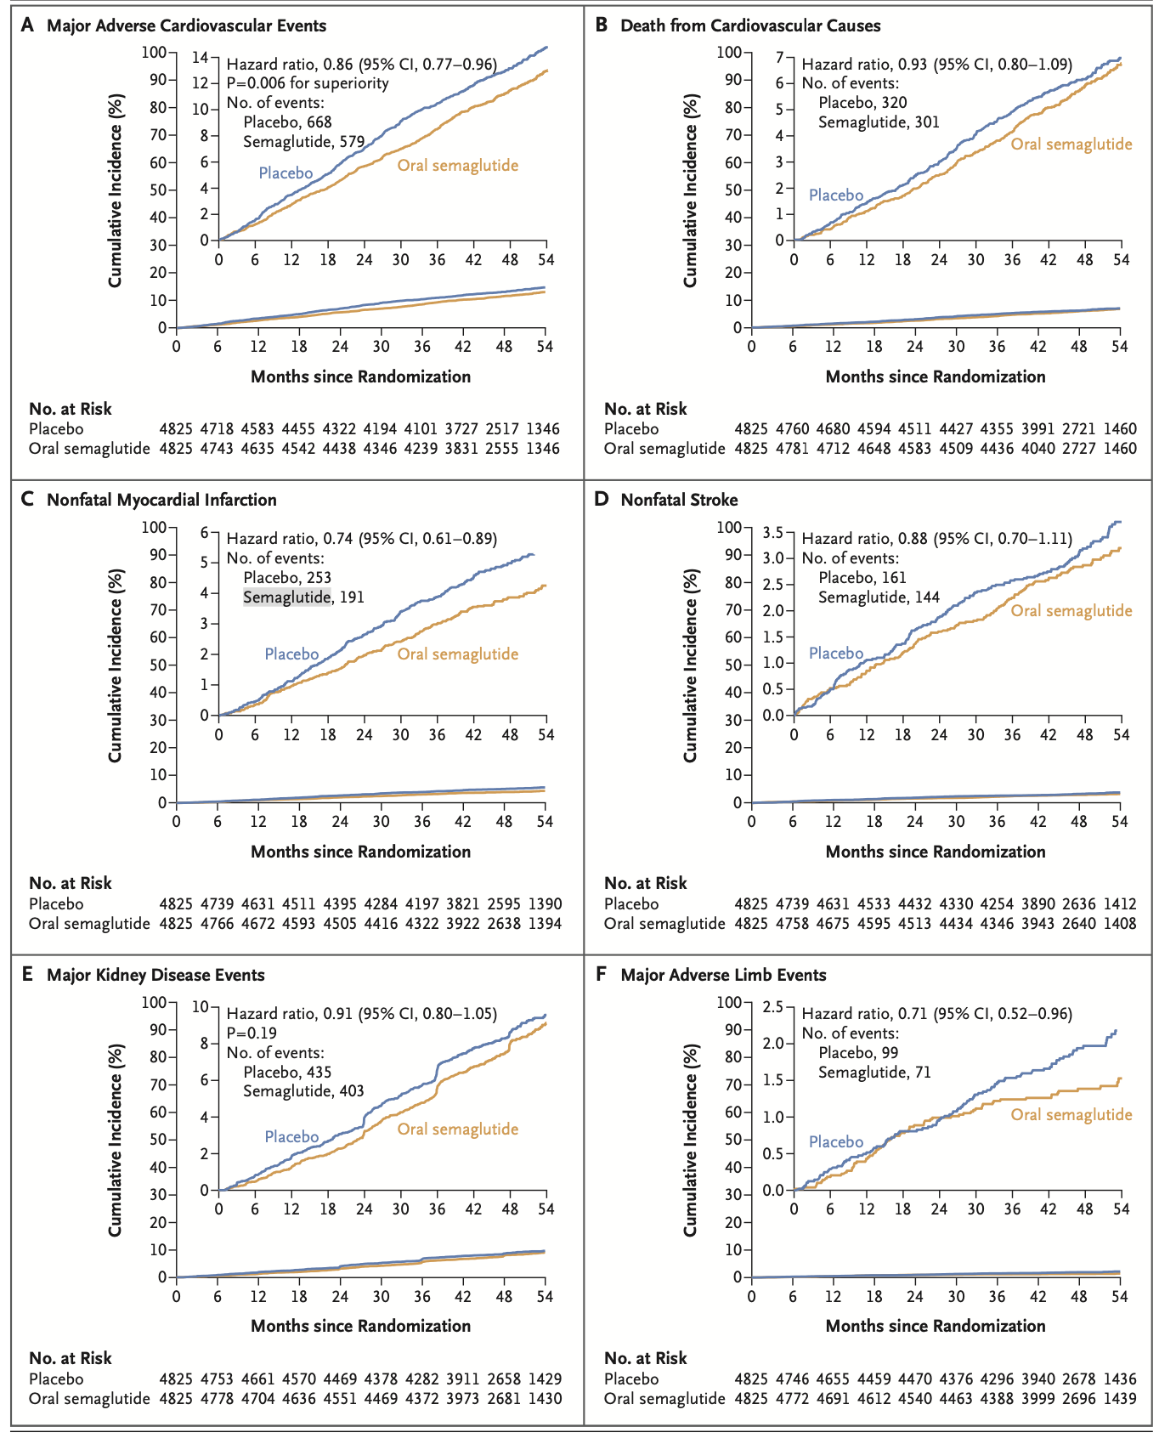
Results
Cumulative-incidence plots
Note on hazard ratios:
HR = 1 → No difference between groups in event risk
HR < 1 → Treatment group has lower hazard
HR > 1 → Treatment group has higher hazard.
Notes:
Key Findings Across Panels
Panel A. Major Adverse Cardiovascular Events (MACE)
Result: Reduction in MACE (composite of CV death, nonfatal MI, or nonfatal stroke) with oral semaglutide.
Hazard Ratio (HR): 0.86 (95% CI: 0.77–0.96), P = 0.006, indicating statistical superiority over placebo. (14% lower risk of experiencing a MACE event compared to those on placebo)
Events: Placebo had 668 events vs. semaglutide 579.
Interpretation: Oral semaglutide significantly lowers the long-term risk of major cardiovascular events.
Panel B. Death from Cardiovascular Causes
HR: 0.93 (95% CI: 0.80–1.09).
Events: Placebo 320 vs. semaglutide 301.
Interpretation: Slight trend toward fewer CV deaths with semaglutide, but this did not reach statistical significance.
Panel C. Nonfatal Myocardial Infarction (Heart Attack)
HR: 0.74 (95% CI: 0.61–0.89).
Events: Placebo 253 vs. semaglutide 191.
Interpretation: Substantial (~26%) and statistically significant reduction in the risk of nonfatal heart attacks with semaglutide.
Panel D. Nonfatal Stroke
HR: 0.88 (95% CI: 0.70–1.11).
Events: Placebo 161 vs. semaglutide 144.
Interpretation: Trend toward fewer strokes with semaglutide, but not statistically significant.
Panel E. Major Kidney Disease Events
HR: 0.91 (95% CI: 0.80–1.05), P = 0.19.
Events: Placebo 435 vs. semaglutide 403.
Interpretation: No significant effect on major kidney outcomes.
Panel F. Major Adverse Limb Events
HR: 0.71 (95% CI: 0.52–0.96).
Events: Placebo 99 vs. semaglutide 71.
Interpretation: Significant reduction (~29%) in serious limb events—such as ischemia or amputations—with semaglutide.
Interpretation of Key Findings:
Major Adverse Cardiovascular Events (MACE) (Graph A):
Oral semaglutide significantly reduced the risk of MACE compared to placebo (Hazard Ratio 0.86, P=0.006). This indicates a 14% reduction in MACE with oral semaglutide. The curves for semaglutide and placebo diverge relatively early, suggesting an early benefit.
Nonfatal Myocardial Infarction (Graph C):
Oral semaglutide significantly reduced the risk of nonfatal myocardial infarction (Hazard Ratio 0.74), indicating a substantial reduction in heart attack risk. The separation of curves for this endpoint is also early.
Major Adverse Limb Events (Graph F):
Oral semaglutide also showed a significant reduction in major adverse limb events (Hazard Ratio 0.71), demonstrating a benefit in this area.
Events with Less or No Significant Difference:
Death from Cardiovascular Causes (Graph B):
While there was a trend towards reduction, the hazard ratio for cardiovascular death was 0.93 (95% CI, 0.80-1.09), and the curves diverged later compared to non-fatal endpoints, indicating no statistically significant reduction in cardiovascular mortality in this trial.
Nonfatal Stroke (Graph D):
The hazard ratio for nonfatal stroke was 0.88, but the confidence interval crossed 1.0, suggesting no statistically significant reduction in stroke risk.
Major Kidney Disease Events (Graph E):
Similarly, the hazard ratio for major kidney disease events was 0.91, with a P-value of 0.19, indicating no statistically significant difference between the groups for this outcome.

Slide 19
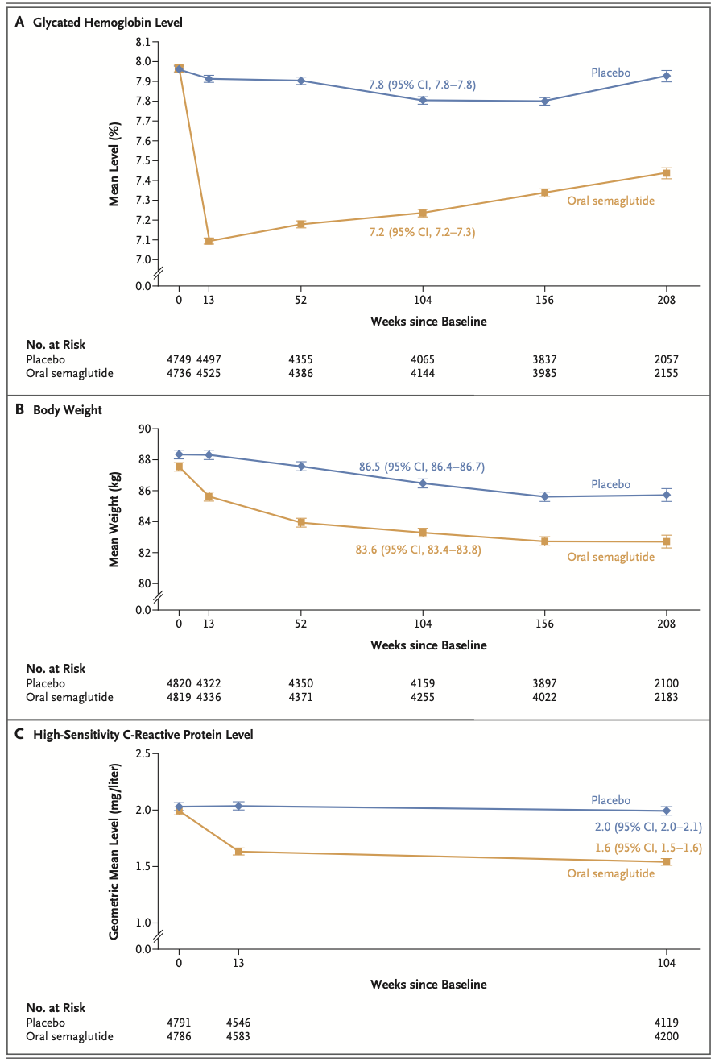
Results:
Measures of Metabolism and
Inflammation.
Notes:
A Glycated Hemoglobin Level: This panel shows that the mean glycated hemoglobin level, a measure of long-term blood sugar control, was notably lower in the oral semaglutide group compared to the placebo group throughout the trial, indicating improved glycemic control with semaglutide
B Body Weight: The graph clearly demonstrates a sustained reduction in mean body weight in the oral semaglutide group over the study period, while the placebo group's weight remained relatively stable or slightly decreased, highlighting semaglutide's significant effect on weight management.
C High-Sensitivity C-Reactive Protein Level: This panel indicates that the geometric mean level of high-sensitivity C-reactive protein, a marker of inflammation and cardiovascular risk, was lower in the oral semaglutide group compared to the placebo group, suggesting a potential anti-inflammatory effect of semaglutide.
Glycated hemoglobin levels, body weight, and high-sensitivity C-reactive protein levels were all improved with semaglutide. On average, patients treated with the oral GLP-1 receptor agonist lost 4.22 kg,

Slide 20
Results: SAEs
Serious adverse event (SAE) | Semaglutide group | Placebo group | P values
Total SAEs | 2312 participants (47.9%) | 2427 participants (50.3%) | P=0.02
Cardiac disorders (commonest) | 861 [17.8%] | 954 [19.8%] | P=0.02
Infections (commonest) | 726 [15.0%] | 797 [16.5%] | P=0.05
Gastrointestinal disorders | 239 [5.0%] | 210 [4.4%] | P=0.18
Gallbladder disorders, retinal disorders, or malignant neoplasms | 0.4 percentage points 22 events | 0.8 38 events
Acute pancreatitis | 0.4% | 0.4%
Notes:
June 2019 to March 2021 9650 patients randomised
Adverse events that led to permanent discontinuation of oral semaglutide or placebo occurred in 749 participants (15.5%) in the oral semaglutide group and in 559 participants (11.6%) in the placebo group. Such events were mainly gastrointestinal disorders (in 310 [6.4%] and 98 [2.0%], respectively), as well as infections or infestations
(in 63 [1.3%] and 96 [2.0%]).
(typically less than 0.05) calculated for serious adverse events (SAEs) in clinical trials or other studies suggests that the observed difference in SAE rates between groups (e.g., treatment group versus placebo group) is unlikely to be due to chance alone

Slide 21
Strengths
Robust design: RCT, double blind placebo controlled- gold standard, international and multicentre
First successful oral GLP‑1 RA showing cardiovascular benefits
High risk patients included
Large, diverse, event-driven trial with long follow-up
Well-tolerated safety profile
Very specific instructions on administration (enhanced absorption?)
SAEs were lower in the semaglutide group
Additional benefits beyond MACE: Significant reductions in nonfatal myocardial infarction and adverse limb events bolster the benefit profile
Notes:
Oral semaglutide effectively lowers the risk of major cardiovascular events in high-risk individuals with type 2 diabetes.
While promising, the trial was not specifically designed to assess kidney outcomes, and the study population had limited representation of women and Black individuals, warranting further investigation.

Slide 22
Limitations
Underrepresentation of some demographic groups: Only ~29% of participants were female; Black patients comprised just ~2.6% of the study population, potentially limiting generalizability.
Limited benefits for renal outcomes: Kidney endpoints did not reach statistical significance in the full trial population.
CKD defined only by one eGFR<60
Funding and potential bias: The trial was industry-funded (by Novo Nordisk), a common practice but one worth noting as a potential source of bias in interpretation

Slide 23
Implications on clinical practice
Adherence and Practicality
Less waste with tablet vs needles, needle disposal methods etc
Less time taken up by clinicians or nurses as do not need to teach subcutaneous injections/ disposal etc
Costs ?
Streamlined Multidisciplinary Care: SOUL’s results bridge cardiology, nephrology, and endocrinology practice, supporting integrated care for "the malignant triad"—diabetes, CVD, and CKD.
Joined diabetes/ vascular clinic for semaglutide, 3 months post MI
Improving metabolic syndrome, helping cardiology service burden (prevention)
Notes:
alternative to injectables, may improve treatment compliance by those hesitant about injections.
Adherence and Practicality alternative to injectables, may improve treatment compliance as surveys suggest needles are a significant barrier to starting GLP‑1 RA therapy
Less waste with tablet vs needles, needle disposal methods etc
Less time taken up by clinicians or nurses as do not need to teach subcutaneous injections/ disposal etc
Costs ?
Streamlined Multidisciplinary Care: SOUL’s results bridge cardiology, nephrology, and endocrinology practice, supporting integrated care for "the malignant triad"—diabetes, CVD, and CKD.
Effectiveness in Routine Care
A narrative review of 19 observational studies showed typical real-world reductions in HbA₁c (~1 %) and body weight (2–3 kg) at 6 months, aligning with clinical trial outcomes

Slide 24
Conclusions
Oral semaglutide significantly reduced MACE
Supportive secondary outcomes indicating improvements in peripheral artery disease (reduced hospitalizations for limb ischemia), and key cardiometabolic parameters like blood sugar, weight, and inflammation.
Favourable safety profile
Future directions: head to head trial of s.c vs oral semaglutide
Notes:
14% relative risk reduction in MACE (absolute reduction ~2% over 3 years) with oral semaglutide—consistent with previous injectable GLP‑1 results.
Oral semaglutide as an effective, safe, and practical option to reduce major cardiovascular events in patients with high-risk type 2 diabetes—matching the efficacy of injectables and offering flexibility for broader patient uptake

Slide 25
Discussion…
Barriers to starting semaglutide in hospital:
Who should be prescribing?
Increasing access to semaglutide?
Costs still high (secondary patent ongoing)
Notes:
alternative to injectables, may improve treatment compliance by those hesitant about injections.
Adherence and Practicality alternative to injectables, may improve treatment compliance as surveys suggest needles are a significant barrier to starting GLP‑1 RA therapy
Less waste with tablet vs needles, needle disposal methods etc
Less time taken up by clinicians or nurses as do not need to teach subcutaneous injections/ disposal etc
Costs ?
Streamlined Multidisciplinary Care: SOUL’s results bridge cardiology, nephrology, and endocrinology practice, supporting integrated care for "the malignant triad"—diabetes, CVD, and CKD.
Effectiveness in Routine Care
A narrative review of 19 observational studies showed typical real-world reductions in HbA₁c (~1 %) and body weight (2–3 kg) at 6 months, aligning with clinical trial outcomes

Slide 26
References
Drucker DJ, Holst JJ. The expanding incretin universe: from basic biology to clinical translation. Diabetologia. 2023 Oct;66(10):1765-1779. doi: 10.1007/s00125-023-05906-7. Epub 2023 Mar 28. PMID: 36976349.
MSA. University of Southhampton. https://www.msatrust.org.uk/cause-and-cure/get-involved-in-research/what-is-research/
Novo Nordisk. https://sciencehub.novonordisk.com/content/dam/sciencehub/global/en/congresses-and-scientific-publications/congresses/era2025/Mann/documents/ERA2025_SOUL_Kidney_outcomes_slides.pdf

