Slide 1
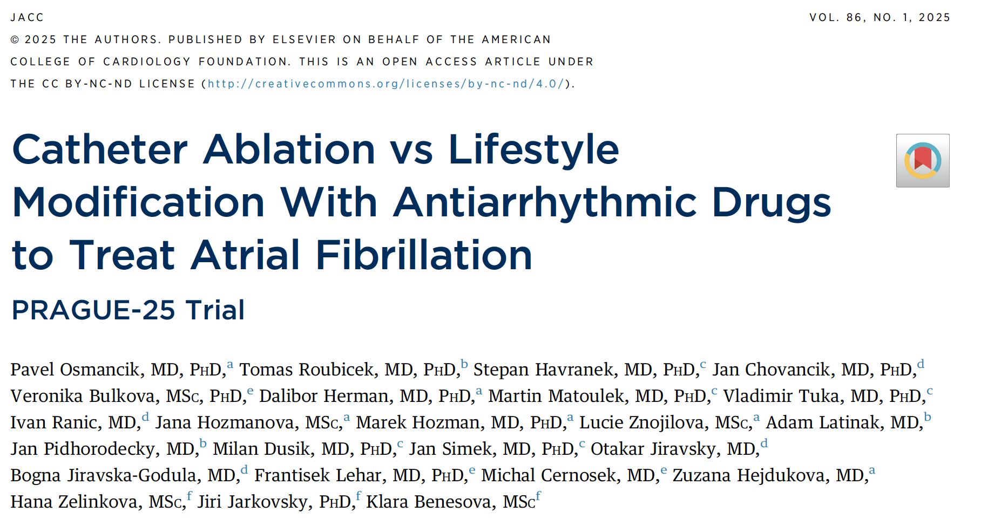
Dr Nicholas Pitto IMT3

Slide 2
Background
AF & obesity - Obesity one of biggest risk factors
Prior evidence:
CABANA (catheter ablation vs anti arrhythmic drug therapy for AF), 36.4% of ablation patients vs 59.2% drug therapy patients had recurrence of AF in 12 months
Nonrandomised LEGACY (Long-Term Effect of Goal-Directed Weight Management in an Atrial Fibrillation, weight losses >10% and 3% to 9% of body weight resulted in AF freedom without AADs or CA in 45.5% and 22.2%
  ARREST-AF (Aggressive Risk Factor Reduction Study for Atrial Fibrillation and Implications for the Outcome of Ablation) study. AF freedom higher in 61 patients who accepted the LFM program vs the 88 who declined (32.9% vs 9.7% of patients).

Slide 3
Background
But;
No prior RCT comparing catheter ablation vs lifestyle modification plus anti arrhythmic drugs
Aim: To test non inferiority of LFM + AAD vs CA in obese patients with AF

Slide 4
Study Design
Randomised control trial, multi centre - 5 centres in Czech Republic
Population : Symptomatic AF, BMI 30-40
Exclusion criteria included : Permanent AF, BMI > 40, LVEF < 40%, untreated CAD, contraindication for AADs, limitations that could affect physical activity
Sample size : 212 patients randomised, ~ 1: 1 ratio for CA vs LFM + AAD
Follow up : Mean 23.5months

Slide 5
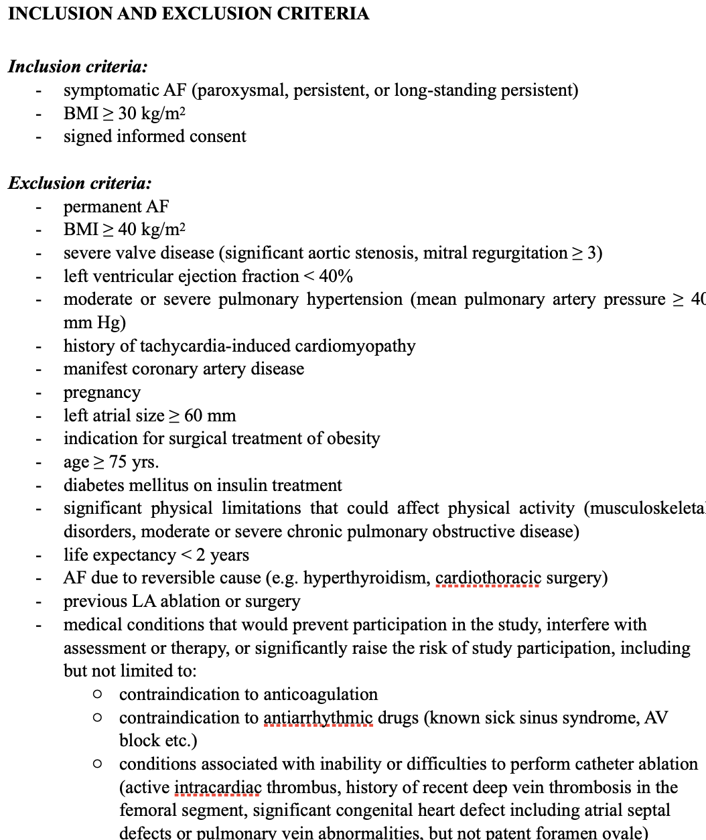

Slide 6

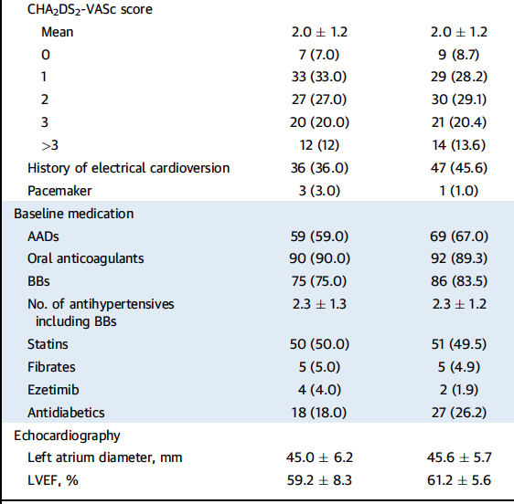
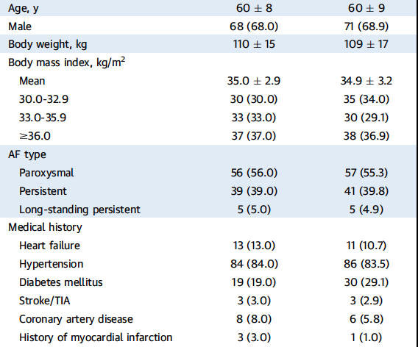
Baseline Characteristics

Slide 7
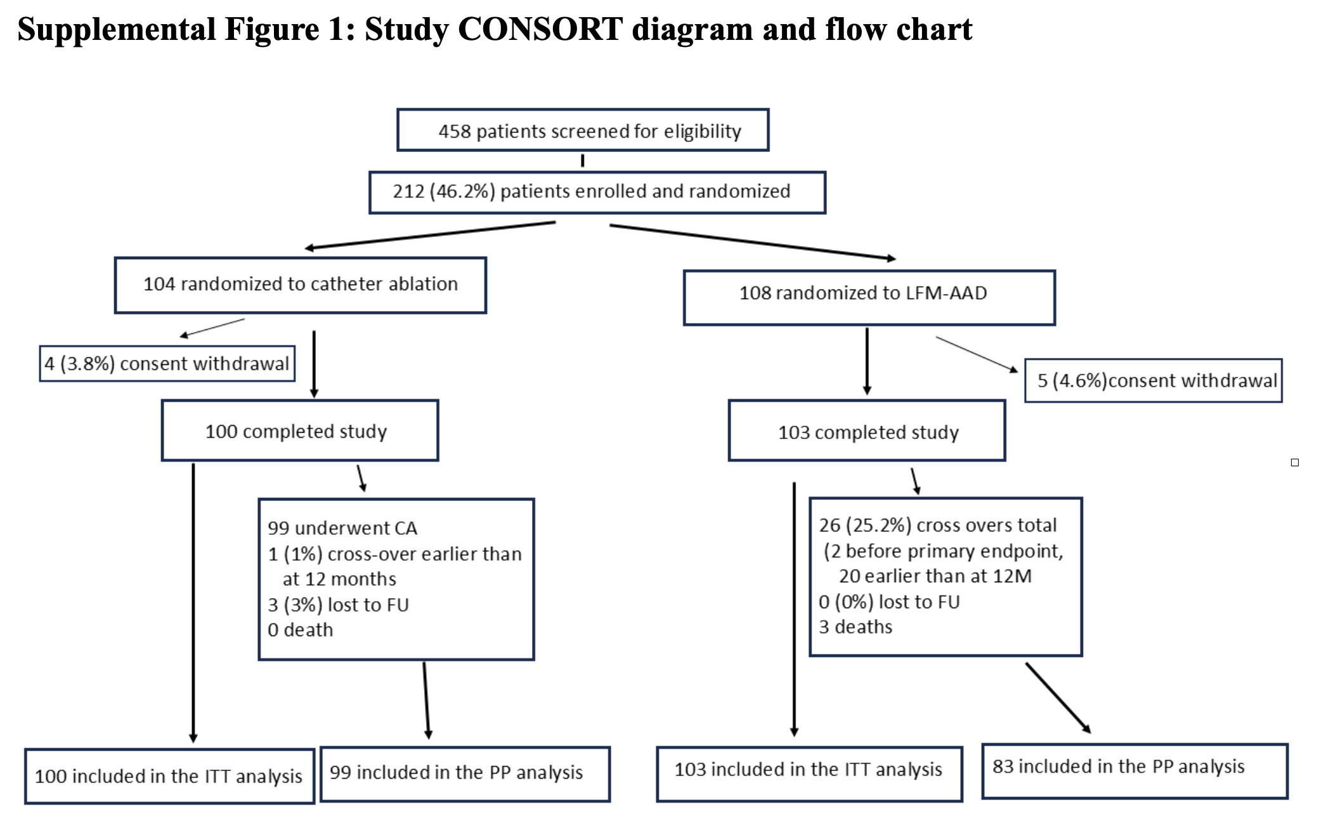
Patients

Slide 8
Study Design
Primary endpoint - Absence of any atrial tachycardia lasting > 30 seconds during the 1 year following blanking period (3 months)
  Evaluated with 7 day Holter, and any ECGs during OP visits or emergency visits
Secondly endpoints - Changes in AF burden %, peak VO2 max during CPET, AFEQT (atrial fibrillation effect on quality of life) questionnaire, body weight, lipids, HbA1C

Slide 9
Interventions
CA - Catheter ablation within 6 weeks of randomisation.
  3 month blanking period within which cardio version & AADs were allowed. Drugs had to be stopped after this
LFM + AAD - Programme started with 4 weeks post randomisation.
  Meet with dieticians & physiotherapists, encouraged to record calories & exercise activity, decrease alcohol consumption
Drugs - Started within 4 weeks, up titrated within 3 months
  Mostly class IC AADs. Amiodarone only used as 3rd line

Slide 10
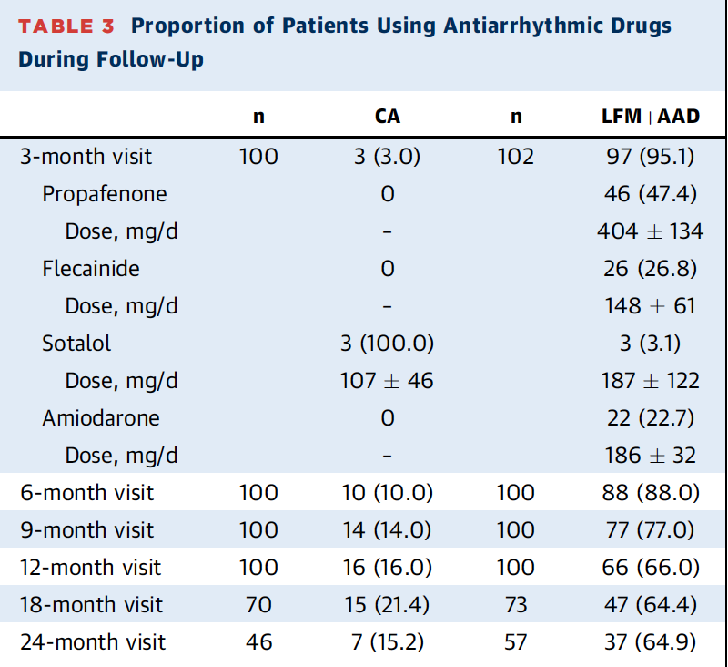

Slide 11
Follow Up
Done at 3, 6, 9 and 12 months, then 6 monthly
At 3 months, all those in AF had DCCV
7 day Holters done every 3 months for first year, and then 6 monthly thereafter
Holter evaluations were blinded

Slide 12
Statistical Considerations
From previous data from meta-analysis, CABANA, STOP AF trials, LEGACY, ARREST AF 12 month AF freedom rates were:
AADs : 45% - 52%
CA - 57-63%.
Authors anticipated AF freedom to be
CA group 60%
LFM + AAD 65% - Includes an additional 20% expected for weight loss & physical exercise

Slide 13
Statistical Considerations
Non-inferiority
In studies comparing AAD vs placebo, success of treatment in placebo arms 24.9% (95% CI, 15-34%))
12% chosen as non inferiority margin, less than assumed minimum effect of placebo

Slide 14
Results
Overall, treatment strategy for obese patients with AF based on AAD & lifestyle modifications, was inferior to catheter ablation in terms of sinus rhythm maintenance at 1 year

Slide 15
Results
Primary Outcome
Intention to treat analysis (ITT)
  Arrhythmia free survival at 12 months present in 73% (95% CI: 64.3%-81.7%) of patients in CA group vs 34.6 (95% CI: 25.3%-43.9%) in LFM + AAD group
Similar results for per protocol analysis
Criteria for non-interiority of LFM & AAD to CA was not met
Subsequent analysis showed CA superior to LFM & AAD
P noninferiority . 0.99, P superiority <0.001

Slide 16
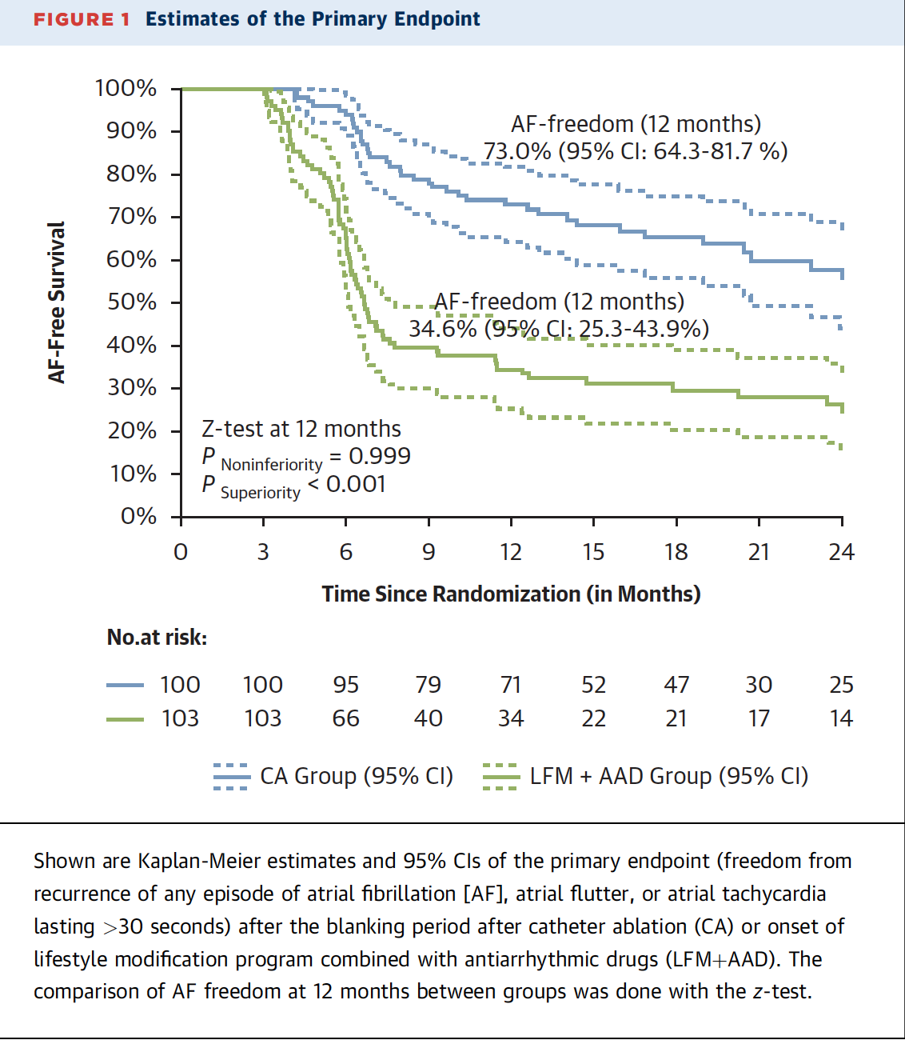
Primary endpoint
PRIMARY

Slide 17
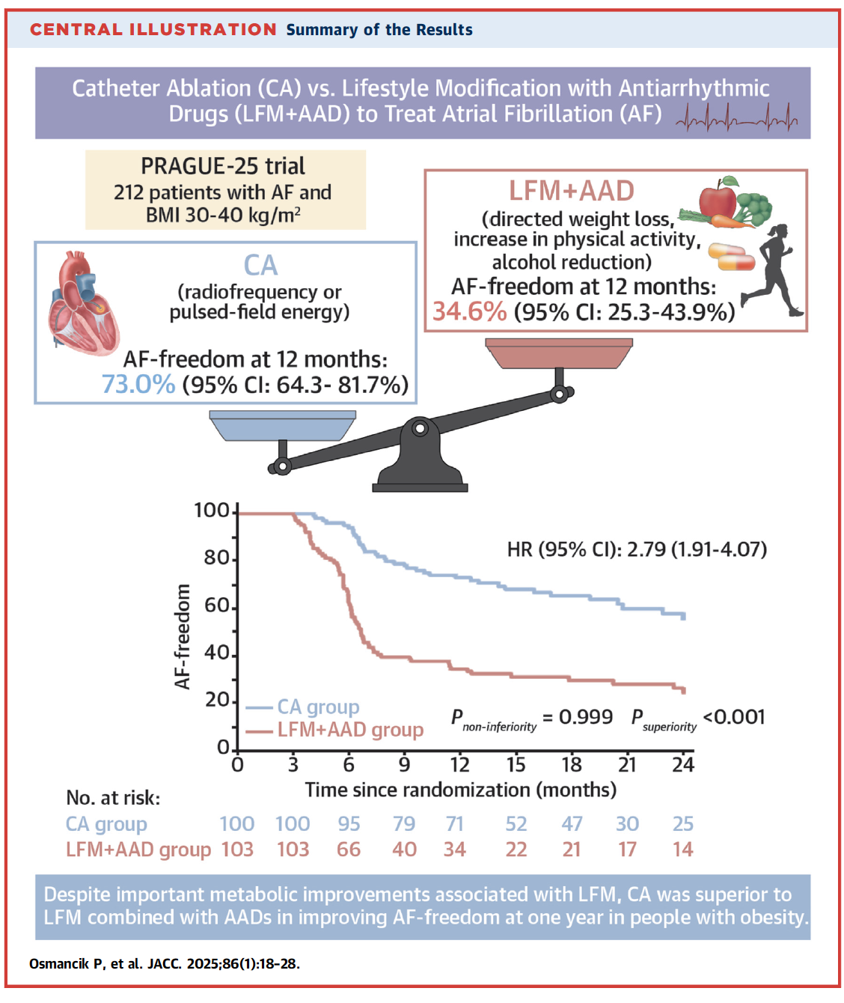

Slide 18
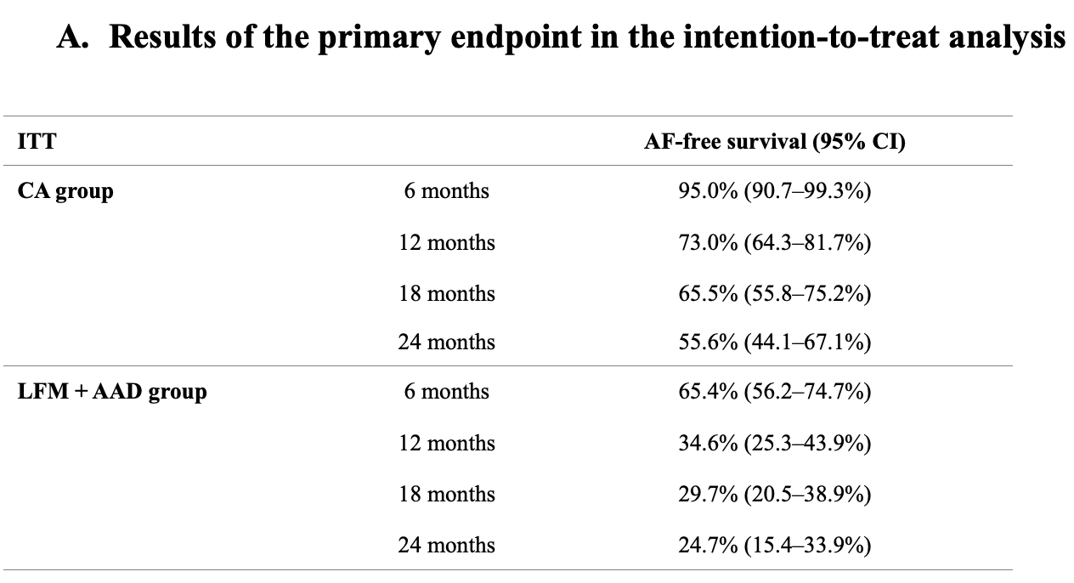
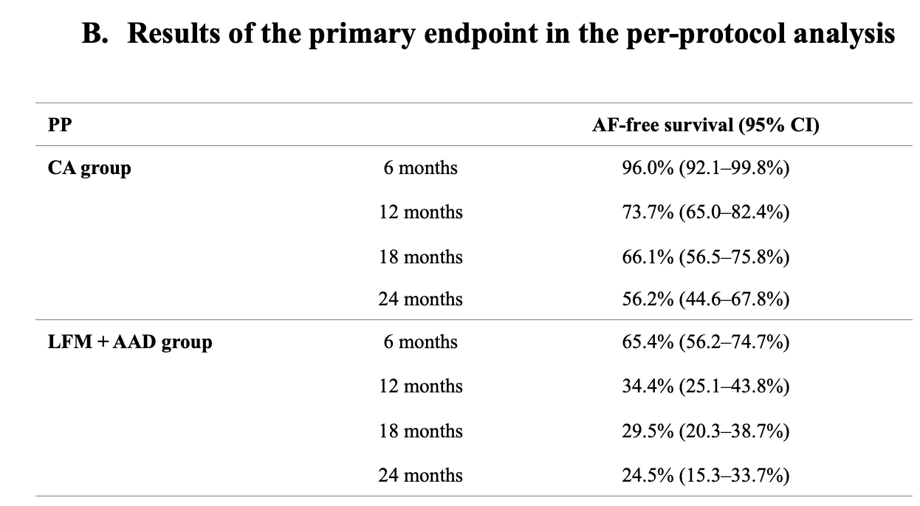
Results
Primary endpoint

Slide 19
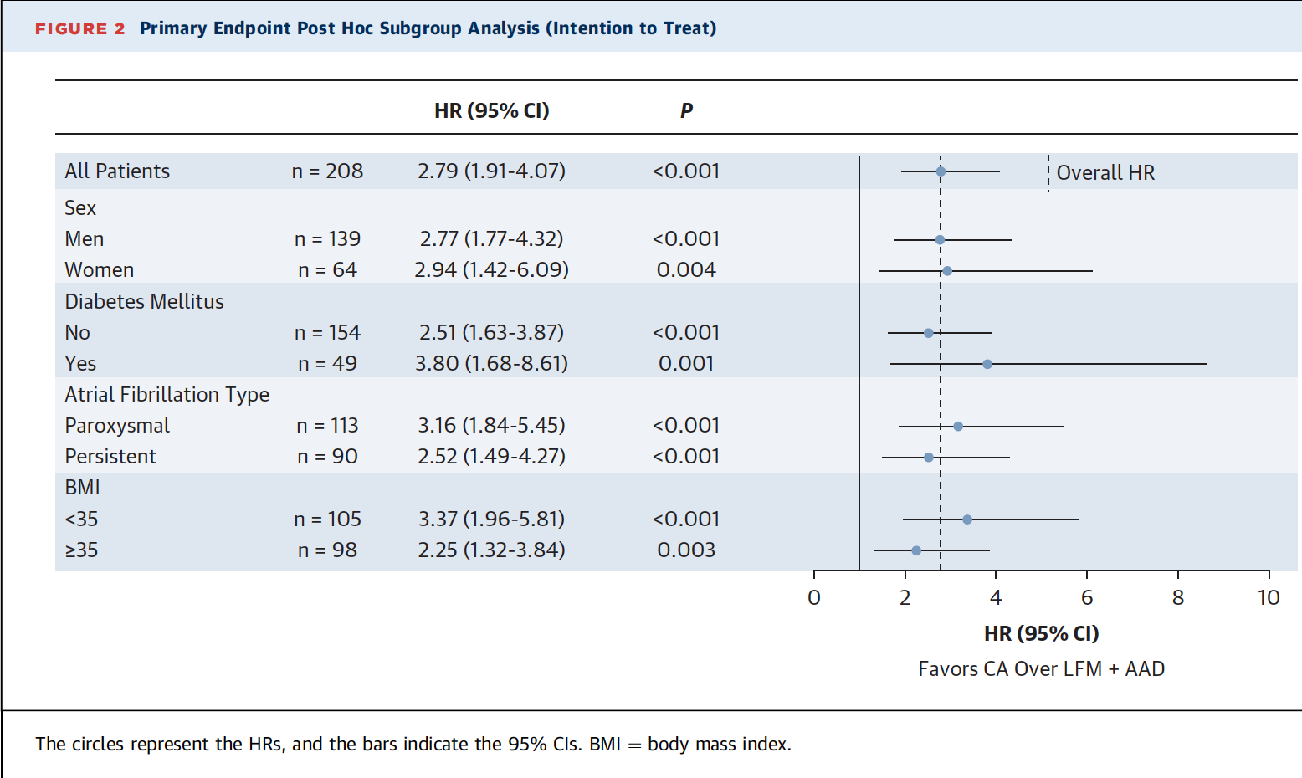
Results
Post hoc analysis
Across all groups, CA significantly more effective than LFM & AAD at achieving AF freedom

Slide 20
Results
Secondary Endpoints
AF burden decreased in both groups
Peak VO2 increased in LFM + AAD group
NT pro BNP significantly decreased both groups
Quality of life - Both groups reported improvements
HbA1c significantly decreased in LFM + AAD group, & increased in CA group
Weight loss - LFM & AAD achieved significant weight loss, sustained over 24 months
}
But no in between group
statistically significant
difference

Slide 21
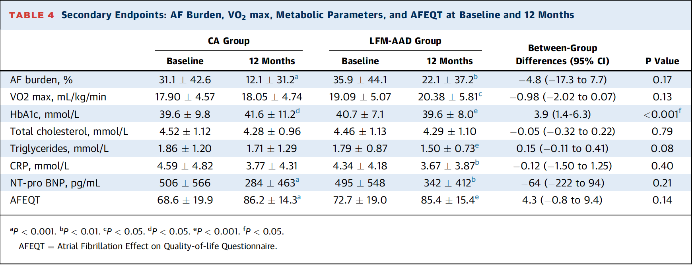
Results
Secondary Endpoint

Slide 22
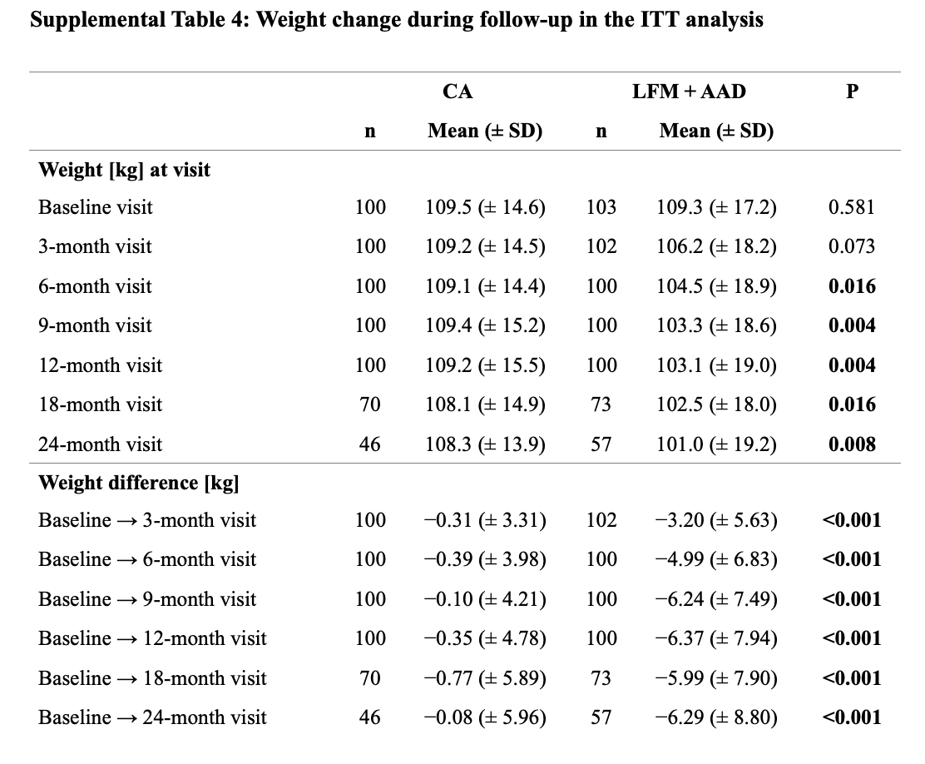

Slide 23
COMPLICATIONS
4 major complications
CA - 1 patient had TIA
LFM & AAD
  3 patients had syncope
  1 patient died suddenly, classified as sudden cardiac death

Slide 24
Strengths
RCT - Gold standard for clinical medicine
Well defined patient group, symptomatic AF with BMI 30-40
Blinded results evaluation - Holters reviewed independently
Multi disciplinary lifestyle interventions, not left to cardiologists alone
In addition to arrhythmia study also assessed other parameters, gives insight into broader health benefits

Slide 25
Weaknesses
Weight Loss
Underachievement of weight loss goal of 10%
Positive effect weight loss on AF seen in LEGACY study (non-randomised), weight losses >10%, 3% to 9%, and <3% were achieved in about 1/3 each
    AF freedom without AADs or ablation was present in 45.5%, 22.2%, and 13.4%, respectively
    ARREST AF - AF freedom 32.9& vs 9.7% between those accepting LFM vs not
    Average weight loss PRAGUE-25 was modest, 6.37kg, similar to middle group of LEGACY Study.
    ARREST AF & LEGACY both non randomised
GLP - 1 agonists not systematically used
Better weight reduction may have improved SR maintenance

Slide 26
Weaknessess
Drug Choice
AF freedom in LFM + AAD lower than expected at 34.6% compared to 40.8% in CABANA (CA vs AAD)
Class 1C AADs used in 74% of patients
Non response to class 1c & III AADs in obsese patients, BMI > 30, higher than in non-obese - Reported by Ornelas-Lorendo et al
Results could be lower than expected due to obesity related reduced efficacy of AADs used

Slide 27
Other weaknesses
Arrhythmia recurrence monitored by 7 day Holters, loop recorders not used, could have under detected AF recurrence
Anticipated AF freedom in 60% CA and 65% LFM & AAD, study not powered adequately to consider other values for non inferiority e.g. 55% vs 60%

Slide 28
Conclusions
Overall benefits of LFM, however CA was superior to LFM with AADs in terms of AF freedom at 1 year
Referrals to CA in this population should not be delayed until patient loses weight

