Slide 1
Biventricular vs. right ventricular pacing devices in patients anticipated to require frequent ventricular pacing (BioPace)
Dr Martin Fung

Slide 2
Introduction
Biventricular Pacing for Atrioventricular Block to Prevent Cardiac Desynchronization
Objective: Assess efficacy of biventricular (BiV) pacing versus right ventricular (RV) pacing in patients with atrioventricular block (AVB)

Slide 3
Rationale
AVB often necessitates permanent ventricular pacing​
Traditional RV pacing may lead to ventricular desynchronisation with or without LV dysfunction​
BiV pacing could potentially mitigate desynchronisation effects
Unknown whether BiV stimulation exerts benefit in patients who require frequent ventricular pacing and who do not have heart failure, LV dysfunction, or prolonged QRS duration

Slide 4
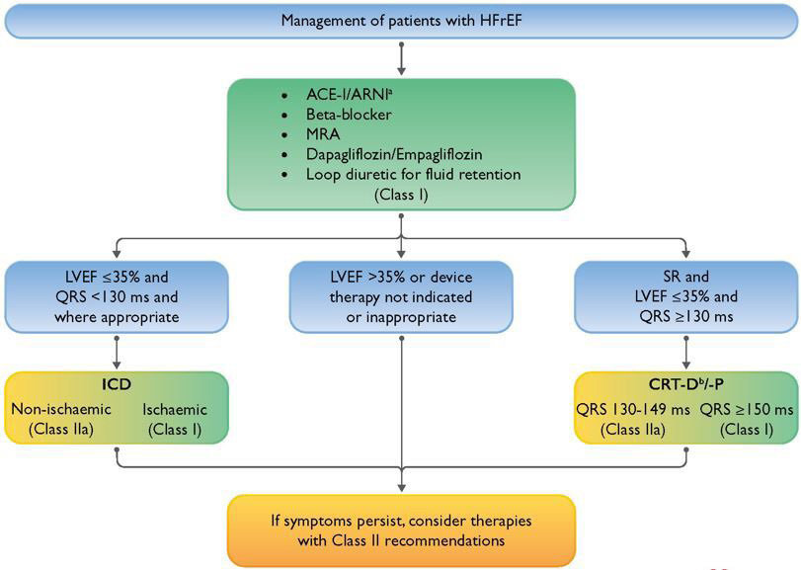

Slide 5
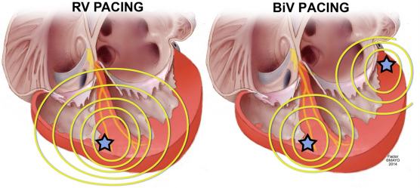
RV apex + anterolateral or posterolateral coronary vein
RV apex

Slide 6
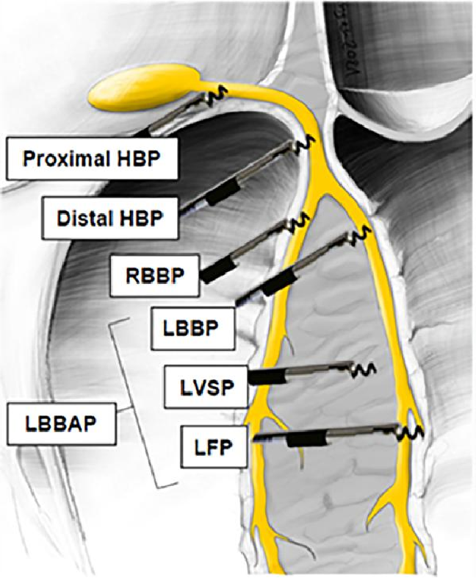
Notes:
Outline of capture types obtainable at various levels of the conduction system. HBP, His bundle pacing; LBBAP, left bundle branch area pacing; LBPP, left bundle branch pacing; LFP, left fascicular pacing; LVSP, left ventricular septal pacing; RBBP, right bundle branch pacing; LAFP, left anterior fascicle pacing; LPFP, left posterior fascicle pacing; LSFP, left septal fascicle pacing. Modified with permission from Burri et al. 46

Slide 7
Methods
Multicenter, single-blinded, randomised, controlled trial​
Participants: Patients who have Class I indication for permanent pacing​ and a need for frequent ventricular pacing
Exclusions: implanted or planned ICD, status 1 for cardiac transplant, implanted prosthetic tricuspid valve, age <18, life expectancy <6 months
Intervention: Random assignment to BiV or RV pacing​
Primary Endpoint: Composite of all-cause mortality or first hospitalisation due to heart failure

Slide 8
Evolution of the trial protocol
Initial trial protocol only included those with LVEF ≤45%, but due to slow recruitment, patients with normal LVEF were included
Emerging data at the time showed deterioration of initially normal LV function due to frequent RV pacing
Further, ICD implantation was allowed in patients with heart failure
Because of inclusion of patients with preserved LV function, heart failure-specific functional outcomes including functional capacity and quality of life were eliminated as primary endpoints
The composite of death or first heart failure-induced hospitalisation was added as a co-primary endpoint to enable the detection of manifest heart failure.

Slide 9
Procedures
LV leads were implanted in lateral and posterolateral veins. RV leads were allowed in the apex and in alternative positions
Atrial lead implantation as per guidelines
Crossover from RV to BiV pacing: if either a) three hospitalisations due to deterioration of heart failure into NYHA Class IV or b) the need for intravenous inotropic support
Follow-up after device implantation consisted of in-clinic visits at Months 1, 3, 6, and 12 and every 12 months thereafter, and telephone follow-up every 6 months between the in-clinic visits to explore patients’ vital status and to collect information about hospitalisations and adverse events

Slide 10
Endpoints
Co-primary endpoints: (i) composite of time to death or heart failure hospitalisation and (ii) survival time
Secondary endpoints included
  time to cardiovascular death or first heart failure hospitalisation,
  time to cardiovascular death,
  success of LV lead implantation,
  functional capacity at 12 and 24 months assessed by 6-min walk test,
  quality of life at 12 and 24 months assessed by the Minnesota Living with Heart Failure Questionnaire,
  number, incidence, and duration of hospitalisations for heart failure, for cardiovascular events, and for any reason,
  number and incidence of deaths for heart failure, for cardiovascular events, and for any reason,
  conversion to permanent atrial fibrillation,
  adverse events of the implantation procedure, the LV lead, and all leads.

Slide 11
Patient characteristics
From May 2003 to September 2007, 1833 patients were randomised in 94 hospitals in 15 countries: 915 to BiV and 918 to RV pacing.
Among baseline characteristics, we observed advanced age (73.5 ± 9.2 years), 31.7% females, preserved LVEF (55.4 ± 12.2%), and mostly a narrow QRS complex (118.4 ± 30.5 ms).

Slide 12
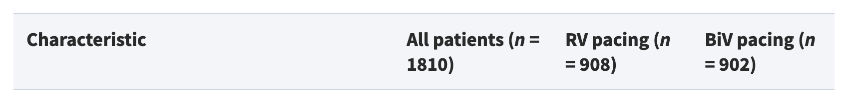
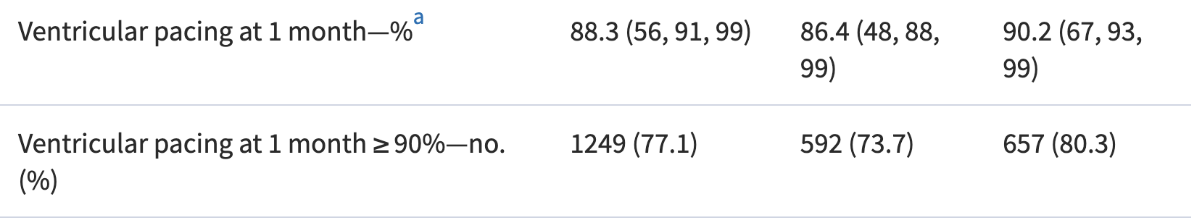
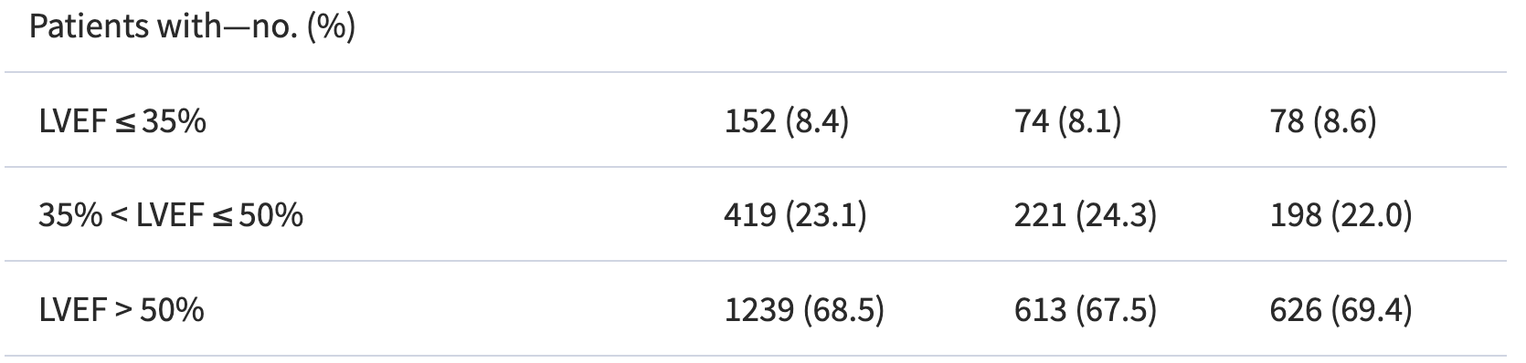

Slide 13
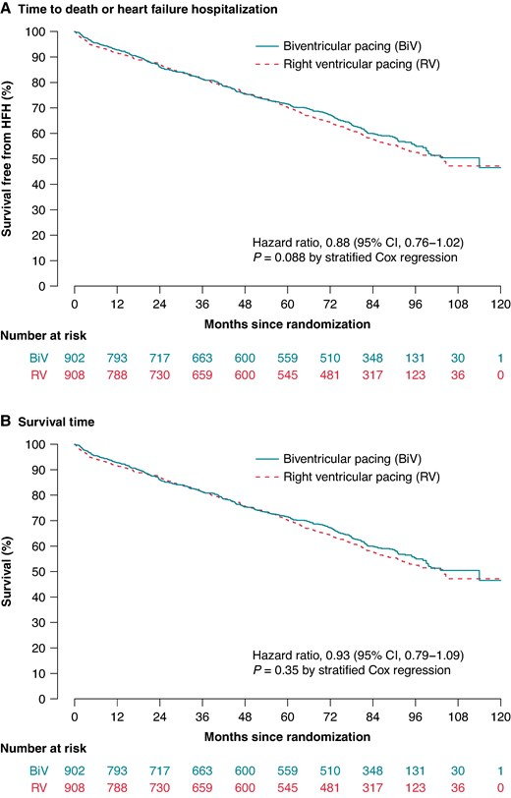
Co-primary composite endpoint events occurred in 346 of 902 patients (38.4%) assigned to the BiV pacing arm (death in 226 patients and first heart failure hospitalization in 120 patients) and in 363 of 908 patients (40.0%) assigned to RV pacing (death in 223 patients and first heart failure hospitalization in 140 patients).
The HR was 0.878 (95% CI 0.756–1.020) without statistical significance between both study arms (P = 0.0882)

Slide 14
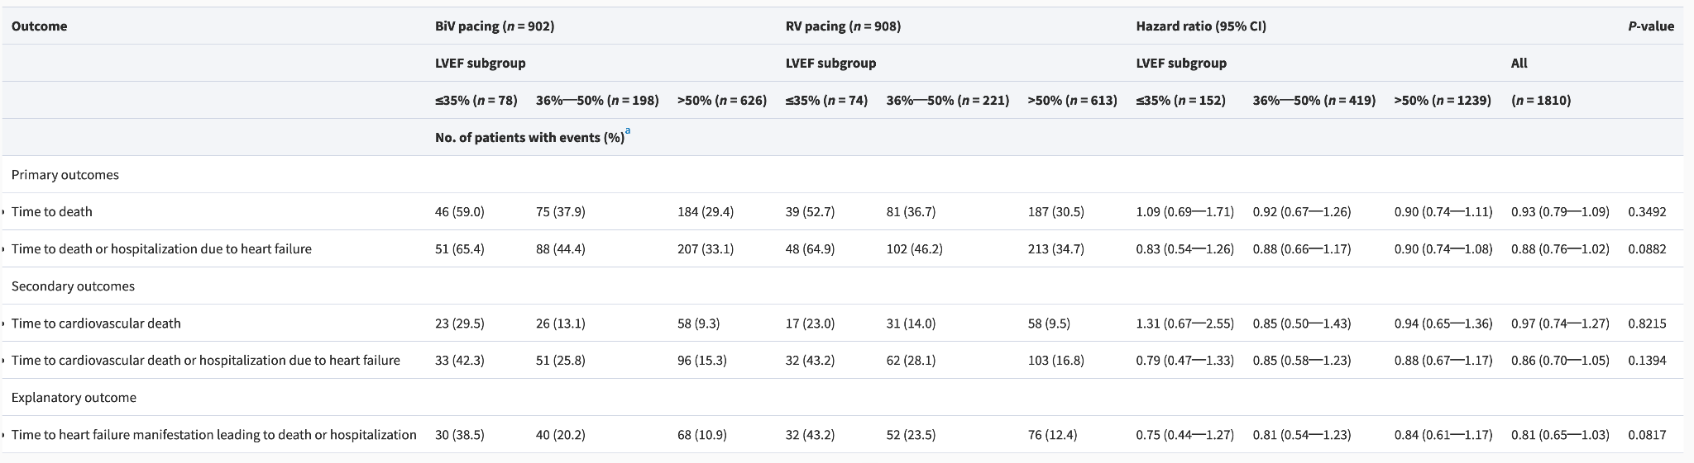
Also no significant difference in primary or secondary outcomes regardless of LVEF

Slide 15
Secondary endpoints
Regarding time to cardiovascular death, HR was 0.969 (95% CI 0.737–1.274)
Regarding the combined endpoint cardiovascular death or heart failure hospitalisation, HR was 0.857 (95% CI 0.697–1.052)
There were almost no differences between both study arms in the distances covered in the 6-min walk test and in the results of the Minnesota Living with Heart Failure Questionnaire
Time spent in hospital and mortality due to cardiovascular events were also almost the same in both study arms

Slide 16
Adverse events
A total of 4050 serious adverse events occurred, 2111 in the BiV pacing arm and 1939 in the RV pacing arm, and they appeared more often in patients with an LV lead
Most of the serious adverse events were hospitalisations
The rate of patients with serious device-related infection was 1.66% (30 of 1810 patients), 1.43% in the RV group (13 patients and 1.88% in the BiV group (17 patients); the absolute risk increased by 0.45% (95% CI −0.72 to 1.63%; P = 0.47)
Most LV lead-associated adverse events were non-serious

Slide 17
Discussion
Main takeaway message: this trial did not prove superiority of BiV over RV pacing in patients mostly without overt heart failure, with preserved LVEF, normal QRS duration, and high ventricular pacing burden
BLOCK-HF (Biventricular Pacing for Atrioventricular Block and Systolic Dysfunction) trial showed a reduction in the composite primary endpoint that consisted of time to death of any cause, an urgent care visit for heart failure that required intravenous therapy, or an at least 15% increase of LV end-systolic volume index, as compared with the value at randomisation. This was primarily driven by a reduction of events related to heart failure.

Slide 18
Discussion
There are only very limited data about the potential impact of BiV pacing compared with RV pacing in patients with preserved LV function
The PREVENT-HF (preventing ventricular dysfunction in pacemaker) trial and the PACE (Pacing to Avoid Cardiac Enlargement) trial compared BiV with RV stimulation in patients with preserved ejection fraction with regard to LV volume and function but not for clinical endpoints.
In PREVENT-HF, there was no difference of LV end-diastolic volume between BiV and RV pacing.
PACE reported a deterioration of LV function in patients receiving RV stimulation, while ventricular function was mainly preserved in patients with BiV pacing.

Slide 19
Limitations
The trial began recruitment in 2003. Since then, BiV pacing has come a long way. In BioPace, LV lead implantation failed in 13%.
Registry data showed a 3.6% failure rate of LV lead implantation (Friedman et al., 2023)
Death perhaps should not have been included as an endpoint. These were patients with preserved LV function, so death rates were expected to be very low. CV death or HF hospitalisation may be more suitable.

Slide 20
Current guidelines
ESC: BiVP has not been recommended as an alternative to RVP in patients with AV block and LVEF >40% in the 2021 guidelines.
According to these guidelines, HBP may be considered for treating these patients, who were anticipated to have >20% ventricular pacing, without giving any recommendation for LBBAP due to the limited amount of data available at that time.
More recently, the 2023 HRS/APHRS/LAHRS guidelines on physiological pacing stated that LBBAP may be useful (along with CRT) in AV block patients with LVEF 36–50% and that it may be considered in those with LVEF >50%.
Current ESC pacing guidelines state, based on several RCTs, that BiV-CRT rather than RVP is recommended for patients with HF with reduced EF (HFrEF, LVEF ≤40%) who have AV block and an indication for ventricular pacing.

Slide 21
Future direction
STAY (2024): small (n=75) trial comparing RVAP and CSP in patients with LVEF >40% and high-grade AVB. Most patients had broad QRS (138.2±21.5ms in RVAP arm).
  The LVEF showed a significant decrease in the RVAP group at 6 months versus baseline compared with the CSP group (mean difference, −5.8 [95% CI, −9.6 to −2; P<0.01)
  HF-related admissions were higher in the RVAP group compared with the CSP group (intention-to-treat analyses: 7 versus 2; 22.6% versus 5.1%; P=0.03; representing a 17.5% absolute risk reduction with CSP).
HOT-CRT (2023): n=100 trial comparing CSP and RVP in patients with LVEF <40% with indication for CRT.
  Change in LVEF at 6 months was greater in HOT-CRT than in BVP (12.4% ± 7.3% vs 8.0% ± 10.1%, P = 0.02)
But need for larger RCTs with clinical endpoints (CV death, major adverse cardiovascular event, all-cause death, HF hospitalisation)

Slide 22
PROTECT-HF
Ongoing RCT estimated 2600 patients with indication for permanent pacing and LVEF >35%, randomised to RVP vs CSP
Primary endpoints: all-cause death and unplanned HF acute care
Secondary endpoints: device upgrade to CRT, quality of life, safety endpoints, LVESV, LVEF
Follow-up of 78 months (6 years 6 months)

Slide 23

Thank you
Time for discussion…

