Slide 1

Arrhythmia Recurrence and Rhythm Control Strategies After Catheter Ablation of Newly Diagnosed Atrial Fibrillation (ARRC-AF )
JACC: Clinical Electrophysiology, 2025
Subramonian Ashwin, MD

Slide 2
Background & Rationale
Catheter Ablation in AF:
Effective Rhythm Control Strategy
Improves cardiovascular outcomes, especially with early intervention
Guideline Recommendations:
US Guidelines: Catheter ablation as first- or second-line therapy vs antiarrhythmic drugs (AADs).
International Guidelines: Focus on managing recurrence post-ablation; both ablation and AADs are considered effective, but based on limited RCT evidence.

Slide 3
Background & Rationale
Current Knowledge Gaps:
Lack of systematic, large-scale data on:
Repeat ablations or AAD use after initial ablation.
The necessity and adoption of rhythm-control strategies post-index ablation.
Real-world clinical practice trends are poorly described.
Why ARRC-AF Matters:
Fills a major evidence gap in the real-world management of patients post-catheter ablation.
Aims to assess the need, frequency, and predictors of repeat procedures and AAD use in routine practice.

Slide 4
Study Objectives
Assess rhythm control strategies used after index AF ablation
Evaluate repeat ablation rates over a 14-year follow-up period
Determine recurrence rates of AF, atrial flutter (AFL), and other tachyarrhythmias
Examine AAD use (type and incidence) following ablation
Identify predictors of repeat ablation including:
AF subtype (e.g., persistent, long-standing persistent)
Comorbidities (e.g., OSA, CAD, BMI)
All-cause mortality associations

Slide 5
Methodology

Slide 6
Ethics & Data Source
Ethical Approval
Data used were deidentified and HIPAA-compliant
Exempt from IRB review under the U.S. Common Rule (1991, revised 2018)
Study Database
Optum Market Clarity Dataset
Links medical, pharmacy claims & EHRs
Covers >80 million insured individuals in the U.S.
Includes:
Commercially insured
Medicare Advantage members
Representative in age and sex
Predominantly from Midwest, East, and South U.S

Slide 7
Inclusion Criteria
Population:
Adults ≥18 years
With newly diagnosed atrial fibrillation (AF)
No prior AF diagnosis in the 12 months before diagnosis
Data Requirements:
At least 12 months of baseline data available
Minimum 1 healthcare system interaction in the 12 months before AF diagnosis
≥12 months of continuous enrollment prior to the index catheter ablation
Intervention:
Underwent index catheter ablation for AF

Slide 8
Exclusion Criteria
History of permanent AF
AV nodal ablation at or before index procedure
Surgical (maze) or hybrid ablation procedures

Slide 9
Study Design & Data Collection – ARRC-AF Study
Follow-Up Protocol
Patients followed from index ablation until:
Death, database disenrollment, or study end
No minimum follow-up required
3-month blanking period post-ablation: Events during this period were not considered treatment failures
Data Collected
Diagnosis codes (AF, AFL, other arrhythmias)
Subsequent ablations
Antiarrhythmic drug (AAD) use – Class I & III
Comorbidities and event rates
Baseline variables:
Demographics & vital signs
Comorbidities
Charlson Comorbidity Index (CCI): scored as 0, 1, or ≥2

Slide 10
Statistical Design & Analysis
Study Period & Definitions
Index ablation: First AF ablation between Jan 2007 – Sep 2021
Arrhythmia recurrence: Assessed using ICD codes (each recorded once/patient)
AAD use: Analyzed pre- and post-ablation
Analytical Methods
Repeat ablation rate = Total ablations ÷ Follow-up duration
Multivariate Poisson regression to identify predictors of repeat ablation
Reported as IRRs with 95% CIs
P < 0.05 considered significant

Slide 11
Statistical Design & Analysis
Covariates Included
Age, sex, BMI (<30, 30–35, ≥35 kg/m²)
AF phenotype (paroxysmal, persistent, long-standing persistent, chronic)
AF duration
AAD use
Comorbidities: OSA, CAD, valvular disease, diabetes
History of prior ablation
Sensitivity Analyses
Blanking period: 3 months vs 0 months
Subgroup: AAD-naive patients
Tools Used
Python 3.6, R 3.5, executed on Databricks

Slide 12
RESULTS

Slide 13
STUDY POPULATION
Cohort Selection
2.43 million patients with newly diagnosed AF identified
Final study population: 23,323 patients (0.96%) after applying criteria
Baseline Characteristics
Mean age: 63.0 ± 10.2 years
Male: 67.2%
≥1 comorbidity: Majority of patients
Charlson Comorbidity Index: Mean 3.93 ± 2.74

Slide 14
STUDY POPULATION
Common Comorbidities
Hypertension: 51.8%
Coronary artery disease (CAD): 17.9%
Obstructive sleep apnoea (OSA): 14.4%
Diabetes: 11.7%
Heart failure (HF): 10.5%
Baseline Therapy
Antiarrhythmic drugs (AADs): 44.6%
Rate-control medications: 61.1%
Follow-up & Mortality
Median follow-up: 3.2 years
All-cause mortality: 5.5% (post-blanking period)
AAD-Naive Subgroup (n = 12,933)
Similar characteristics
Common comorbidities: HTN (50.8%), CAD (18.5%), OSA (13.2%), Diabetes (11.4%), HF (10.0%)

Slide 15
ABLATION PROCEDURE
Timing of Index Ablation
Mean time from AF diagnosis to index ablation: ~400 days
Median time: 147 days (IQR: 482 days)
Repeat Ablations
Total patients with ≥2 ablations: 3,862 (16.6%)
2 ablations: 14.2%
3 ablations: 2.0%
≥4 ablations: 0.4%
Repeat ablation more likely in patients with baseline heart failure:
HF prevalence: 10.1% (1 ablation) → 26.7% (≥4 ablations)

Slide 16
ABLATION PROCEDURE
<1% had index ablation before 2011
90% of ablations occurred between 2014–2021
41% between 2019–2021
AAD-Naive Subgroup (n = 12,933)
Repeat ablations in 15.9%:
2 ablations: 13.7%
3 ablations: 1.9%
≥4 ablations: 0.4%
HF prevalence rose from 9.5% (1 ablation) to 23.9% (≥4 ablations)

Slide 17
REPEAT ABLATION
Patient Numbers
3,862 patients (16.6%) underwent ≥2 ablations
Timing
From AF diagnosis to index ablation (≥2 ablation group):
Mean: 379.5 ± 516.3 days
Median: 147 days (IQR: 466)
From index to second ablation:
Mean: 539.0 ± 555.4 days
Median: 341 days (IQR: 597)
Skewed data distribution — some patients had very long intervals between procedures

Slide 18
REPEAT ABLATION
📊 Repeat Ablation Rates (per 100 person-years)
Total Ablations | All Patients | AAD-Naive Subgroup
2 Ablations | 58 | 59
3 Ablations | 33 | 31
≥4 Ablations | 20 | 18

Slide 19
AAD Therapy Before & After Ablation
Baseline AAD Use
Most common agents:
Amiodarone – 15.1%
Flecainide – 13.6%
Sotalol – 9.4%
Dronedarone – 6.2%
AAD Use After Index Ablation
46.9% of all patients were prescribed AADs post-ablation (includes continuation from pre-ablation)
Among AAD-naive patients:
27.6% initiated AADs during follow-up
AAD use increased with the number of ablations
AAD Use by Repeat Ablation Status
Only 15.1% of patients with 2 ablations stopped pre-ablation AADs
Suggests a combined strategy of:
Catheter ablation + AAD therapy for rhythm control

Slide 20
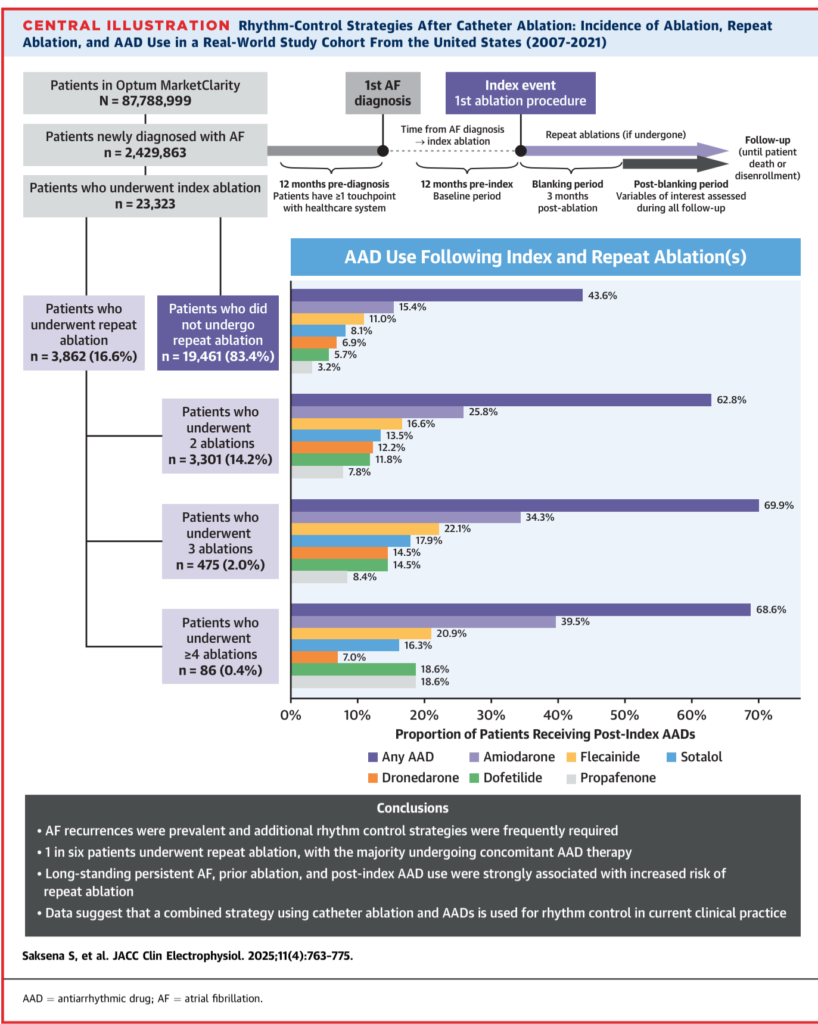

Slide 21
Predictors of Repeat Ablation
Predictor | IRR (95% CI) | Significance
Prior nonindex ablation | 3.38 (3.22–3.55) | P < 0.001
Long-standing persistent AF | 2.26 (1.27–3.68) | P = 0.002
AAD use post-index ablation | 1.42 (1.30–1.56) | P < 0.001
Obstructive sleep apnoea (OSA) | 1.26 (1.20–1.33) | P < 0.001
Chronic AF | 1.34 (1.11–1.60) | P = 0.002
Persistent AF | 1.25 (1.13–1.39) | P = 0.002
Valvular heart disease | 1.12 (1.07–1.18) | P < 0.001
Coronary artery disease (CAD) | 1.13 (1.07–1.19) | P < 0.001
BMI >35 vs <30 kg/m² | 1.14 (1.07–1.21) | P < 0.001
🔍 Strongest Predictors (↑ Repeat Ablation Risk)

Slide 22
Predictors of Repeat Ablation
Inverse Predictors (↓ Repeat Ablation Risk)
Younger age: IRR = 0.99 (per year); P < 0.001
Shorter time from AF diagnosis to index ablation: IRR < 1.00; P < 0.001
Interpretation: Non-paroxysmal AF types, AAD use, comorbidities (OSA, CAD, valvular disease), and metabolic burden (BMI >35) all significantly increased the likelihood of repeat ablation.

Slide 23
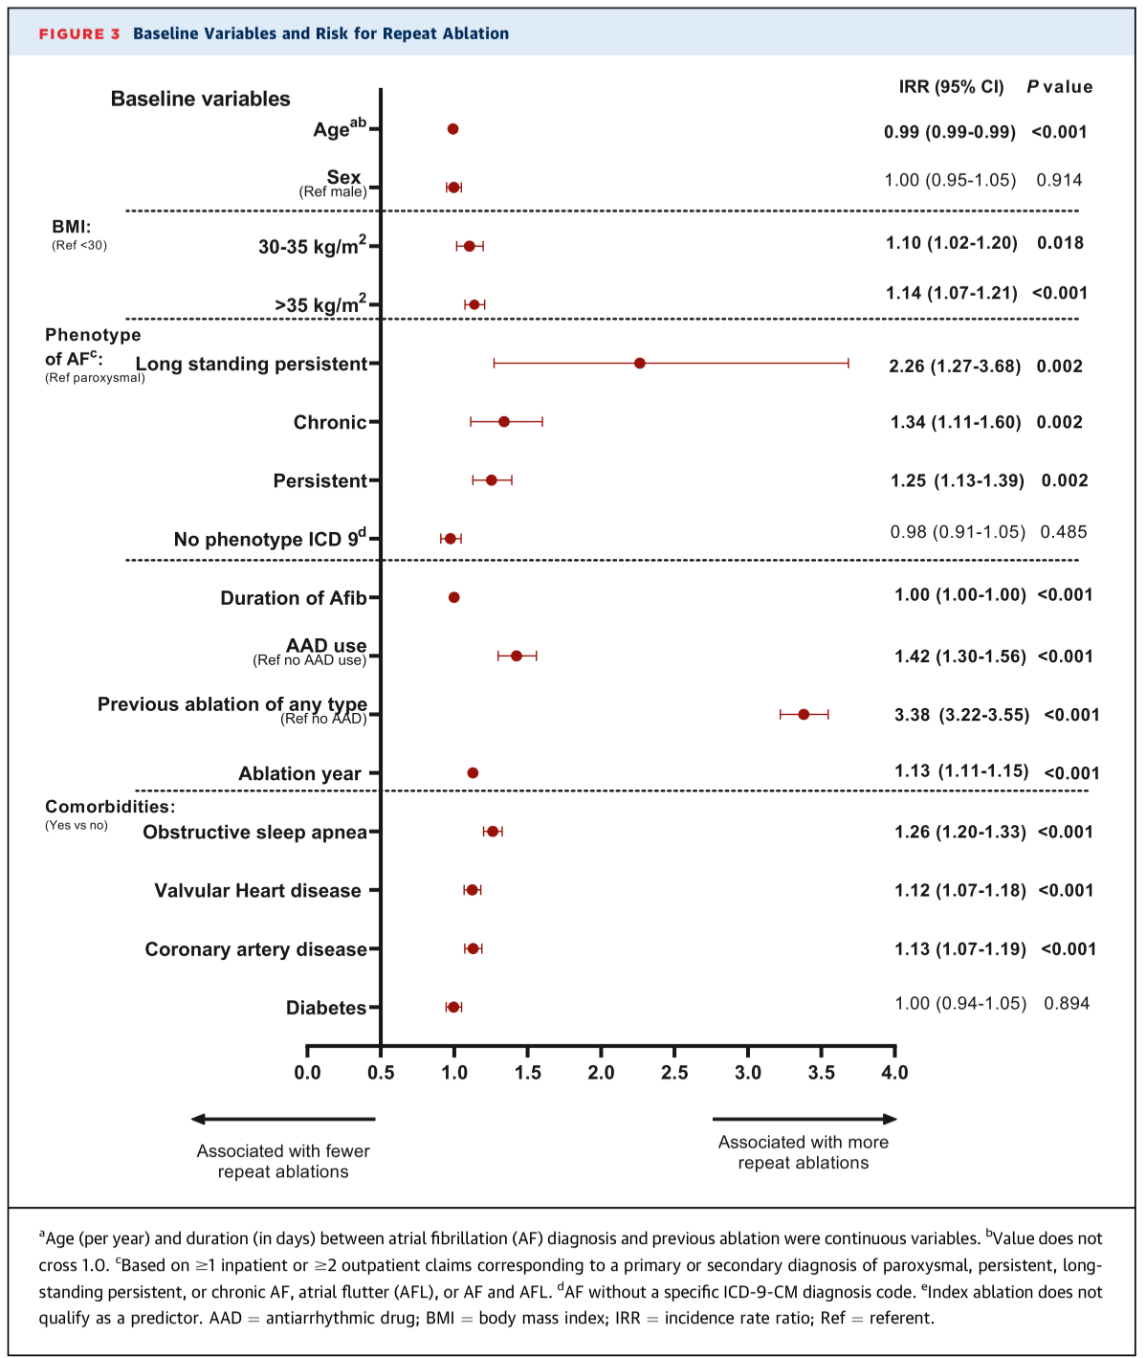

Slide 24
Mortality & Comorbidities After Ablation
All-Cause Mortality
Overall cohort (≥1 ablation):
Mortality rate: 17.7 per 100 person-years
Mean age at death: 68.4 ± 9.3 years
AAD-naive subgroup:
Mortality rate: 19.0 per 100 person-years
Mean age at death: 68.8 ± 9.3 years

Slide 25
Mortality & Comorbidities After Ablation
Top Comorbidities – Post-Blanking Period (Repeat Ablation Group)
Condition | Rate (per 100 person-years)
OSA | 17.8
Depression | 16.3
Hypertension | 16.2
Valvular heart disease | 15.4
Heart failure (HF) | 13.0

Slide 26
Mortality & Comorbidities After Ablation
Top Comorbidities – All Follow-Up (Repeat Ablation Group)
Condition | Rate (per 100 person-years)
Chronic kidney disease (CKD) | 17.2
OSA | 16.8
Hypertension | 15.7
Diabetes | 15.3
HF | 13.8

Slide 27
Mortality & Comorbidities After Ablation
AAD-Naive Subgroup (Repeat Ablation Patients)
Condition | Rate (per 100 person-years)
CKD | 24.6
OSA | 18.2
Hypertension | 16.1
Diabetes | 16.0
HF | 11.8
Patients who needed repeat ablations are:
Medically complex
At higher risk of developing serious comorbidities like kidney disease, OSA, and heart failure
Especially vulnerable if they were AAD-naive to start

Slide 28
DISCUSSION
Key Context
AF recurrence after first ablation: 30–40% (per 2023 US guidelines)
Rehospitalization in 40% within 1 year, often due to recurrent AF or AT
Repeat ablation offers benefit but adds risk: PV stenosis, stiff LA syndrome
AAD Use: Practice vs Trials
High real-world AAD use: 47% after ≥1 ablation
Lower discontinuation rates than previous studies
28% of AAD-naive patients initiated AADs post-ablation
Higher AAD use in patients with repeat ablations (up to 70%)

Slide 29
DISCUSSION
Repeat Ablation Findings
16.6% of patients had ≥1 repeat ablation
Most had >1 year between ablations → interim pharmacologic therapy likely
Only 2.4% had ≥3 ablations (vs 5–17% in single-center studies)
Risk Factors for Repeat Ablation
Prior ablation, non-paroxysmal AF phenotype
AAD use, OSA, valvular disease, CAD, obesity
Younger age and early ablation post-diagnosis
Implications
Combination therapy (AAD + ablation) is common and may be more pragmatic than single-modality approaches
ARRC-AF provides long-term real-world evidence that complements trial data and highlights evolving rhythm control practices

Slide 30
STUDY LIMITATIONS
Data Quality & Coding
Based on claims data → risk of incomplete or inaccurate coding
ICD-9-CM, ICD-10-CM, and CPT coding changed over time, introducing variability
AAD data based on prescription fills, not confirmed intake
Population & Generalisability
Overrepresented U.S. Midwest; only insured patients included
Underrepresentation of older adults, Black patients (4%), and non-U.S. populations
Mean study age = 63 years, limiting relevance to older AF populations

Slide 31
STUDY LIMITATIONS
Selection & Treatment Bias
Possible bias: healthier or more willing patients may have been more likely to undergo repeat ablation
Excludes those preferring AAD-only treatment
Physician confidence may have influenced repeat ablation decisions
Methodological Limitations
No data on ablation type, energy source, or technique
Cause of death not recorded; death date imprecise (only month/year)
Variable follow-up durations across cohorts
Some predictors of repeat ablation may have been missed
Statistical Considerations
Poisson regression appropriate: mean and variance aligned
IRRs used, but not HRs, to avoid survival bias complications

Slide 32
CONCLUSIONS
Rhythm-control strategy via ablation is frequently supplemented with long-term AAD use
Similar to ongoing anticoagulation
Complete AAD discontinuation is uncommon
Clinical Relevance
Findings help clinicians counsel patients with newly diagnosed AF on:
Expected outcomes after ablation
Realistic rhythm control strategies
Risk profiling is possible:
Identify patients at higher risk for repeat ablations
Guide personalised rhythm-control planning
Practice Impact
Provides a real-world framework for:
Patient selection
Long-term rhythm management
Shared decision-making in AF care

Slide 33
Critical appraisal
CASP COHORT Checklist

Slide 34
Section A: Are the results of the study valid?
1. Did the study address a clearly focused issue?
Yes. The study clearly examined the long-term rhythm control strategies in patients undergoing index catheter ablation for newly diagnosed atrial fibrillation (AF), focusing on repeat ablation, AAD use, and associated predictors.
2. Was the cohort recruited in an acceptable way?
Partially.
Large initial cohort (>2.4 million) was filtered using clear inclusion/exclusion criteria.
However, recruitment relied on claims data, which may exclude uninsured patients and lacks clinical granularity.
Population overrepresented by Midwestern US and insured individuals.
3. Was the exposure accurately measured to minimize bias?
Moderate.
Exposure (index ablation) was identified via CPT codes, which are reasonably reliable but prone to coding errors or variability over the 14-year span.
No data on ablation technique, energy type, or procedural success.

Slide 35
Section A: Are the results of the study valid?
4. Was the outcome accurately measured to minimize bias?
Partially.
Outcomes (repeat ablation, AAD use, AF/AFL recurrence) were based on ICD-9/10 codes and prescription records.
Potential for misclassification, especially for arrhythmia recurrence or AAD adherence (i.e. prescriptions filled ≠ drugs taken).
5. Have the authors identified all important confounding factors?
Yes.
The study considered major confounders: age, sex, BMI, AF phenotype, OSA, CAD, valvular disease, etc.
These were adjusted for in Poisson regression models.
6. Have they taken account of the confounding factors in the design/analysis?
Yes.
Multivariate Poisson regression was used with pre-defined covariates.
They appropriately adjusted for immortal time bias and accounted for follow-up variability.

Slide 36
Section B : What are the results?
7. What are the results?
16.6% underwent repeat ablation
AAD use post-ablation: 47% overall; higher with repeat ablation
Risk factors for repeat ablation: prior ablation, long-standing persistent AF, AAD use, OSA, obesity, etc.
8. How precise are the results?
Precise.
Results presented with Incidence Rate Ratios (IRRs) and 95% Confidence Intervals, with statistically significant P-values < 0.001 for most predictors.
9. Do you believe the results?
Yes, with caveats. The large sample size, sound statistical analysis, and sensitivity testing support the results. However, limitations in coding accuracy and generalisability temper absolute confidence.

Slide 37
Section C : Will the result help locally?
10. Can the results be applied to the local population?
Partially.
UK clinicians should interpret with care due to:
Different healthcare systems and ablation access
Different prescribing practices (e.g., amiodarone use)
11. Do the results fit with other available evidence?
YES (Findings align with real-world trends and prior AF rhythm-control trials (e.g., AFFIRM, EAST-AFNET 4).
12. What are the implications for practice?
Realistic post-ablation counselling: continued AAD use often needed
Risk stratification for repeat ablation can guide follow-up intensity
Validates combined rhythm-control strategies in actual practice

Slide 38
Funding and conflict of interest
Funding Source
Study funded by Sanofi, a pharmaceutical company with AAD interests.
Disclosures
Multiple authors employed by or consulting for Sanofi, Axtria, or device companies.
Some hold shares or stock options.
Implications
Introduces potential for sponsorship bias in interpretation of AAD use.
Findings should be evaluated with transparency and independent validation in mind.

Slide 39
Summary
The ARRC-AF study found that in real-world practice, catheter ablation for newly diagnosed atrial fibrillation is rarely a one-off solution.
The study highlights the importance of realistic patient counselling, risk stratification, and the widespread use of combined rhythm control strategies in contemporary AF management.

Slide 40

Thank you
Any Questions?

