Slide 1
Coronary sinus reducer for the treatment of refractory angina (ORBITA-COSMIC)
Medway cardiology department journal club July 2024
By Younan Samuel
ST4 Cardiology registrar
Medway NHS Foundation trust
Notes:
The reason why I chose this trial is because it was published very recently just 3 months ago and it was done here in the UK. But more imprtantly, I found the results so intriguing that they help elucidate how CSR works as we will see at the end.

Slide 2
Outline
History of CSR and where does it sit in the current guidelines?
ORBITA – COSMIC trial: data presentation.
Critical appraisal – Audience discussion.
Future considerations/thoughts.

Slide 3
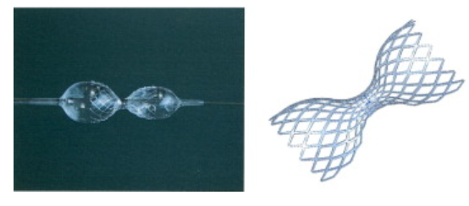
History of augmentation of CS pressure
Claude Beck
Werner Mohl
Y. Paz and A. Shinfeld
The Beck operation 1938 - 1964
PICSO concept 1984 - present
Cornary sinus reducer
2004 - present
Notes:
Professor Claude Beck. He was the first American professor of cardiovascular surgery and nobel prize winner in the middle of last century. While famous for his Beck’s triad of cardiac tamponade, he is actually the 1st person to introduce the idea of increasing the CS pressure to improve myocardial blood flow.
1- The Beck operation: While their experiments on dogs, they found increase in myocardial blood flow following partial ligation of the CS. Later, this was introduced to humans and it did show improvement in angina, reduce infarct size and improved mortality.
2- PISCO: pressure controlled intermittent coronary sinus occlusion (PICSO).
In the 1980s, Dr. Werner Mohl took another approach by intermittently occluding the coronary sinus (CS): It intermittently increases the pressure in the cardiac venous outflow tract using a balloon-tipped catheter introduced percutaneously into the CS. The proposed mechanisms of PICSO are to redistribute venous blood to the border zone of the ischaemic myocardium, to enhance washout of deleterious agents from the microcirculation, to prevent myocardial reperfusion injury and to induce release of vascular growth factors from the venous endothelium, thereby limiting the extent of myocardial necrosis and enhancing infarct healing
3- CS reducer device. The CSRS is a balloon-expandable stent, implanted by percutaneous transvenous approach through the right internal jugular vein or any other large peripheral vein. It has a unique shape that reduces the coronary sinus diameter to 3mm; therefore, instead of increasing the coronary circulation input it reduces its output.
Pivotal COSIRA-II multicenter U.S. clinical trial is underway

Slide 4
CSR Timeline
2007
2015
2021
2024
Future
1st in-man
COSIRA I
Reducer I
ORBITA COSMIC
COSIRA II
2018
2019
2021
Notes:
2007: First in human: Coroanry sinus reducer stent for the treatment of chronic refractory angina: Germany. 15 patients. There was improvement in agina and ischamia at 6 months. Benal et al 2007. The first human study began in 2004.² This was a prospective, open-label, safety feasibility study. The CSRS was implanted in 15 patients with angina pectoris refractory to medical treatment.
2015:1st RCT. Efficacy of a device to Narrow the coronary sinus in ref angina ( COSIRA I 2015): We randomly assigned 104 patients with Canadian Cardiovascular Society (CCS) class III or IV angina (on a scale from I to IV, with higher classes indicating greater limitations on physical activity owing to angina) and myocardial ischemia, who were not candidates for revascularization, to implantation of the device (treatment group) or to a sham procedure (control group). The primary end point was the proportion of patients with an improvement of at least two CCS angina classes at 6 months.In this small clinical trial, implantation of the coronary-sinus reducing device was associated with significant improvement in symptoms and quality of life in patients with refractory angina who were not candidates for revascularization.
2021: REDUCER –I Enrollement is complete. REDUCER-I is a multicentre, non-randomised observational study. Enrolled patients had refractory angina pectoris Canadian Cardiovascular Society (CCS) class II-IV and were treated with Reducer implantation. Interim results from the ongoing REDUCER-I study confirm the high safety profile of this therapy in patients suffering from refractory angina. The results also demonstrate sustained improvement in angina severity and in quality of life up to two years.
COSIRA II is enrolling patients in 30 centers in the US; 190

Slide 5
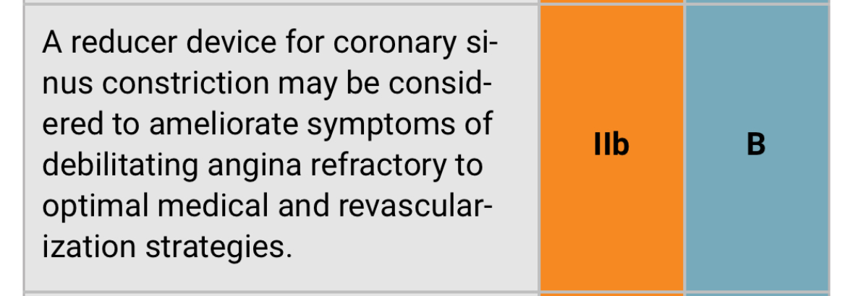
Notes:
ESC 2019 Guidelines: Level of evidence B > Single randomized controlled trial (COSIRA trial 2015)
NICE: Evidence on the safety of coronary sinus narrowing device implantation for refractory angina shows well-recognised complications. Evidence on efficacy is limited in quantity and quality. Therefore, this procedure should only be used with special arrangements for clinical governance, consent, and audit or research.

Slide 6
ORBITA – COSMIC
Double-blind
6 UK hospitals
N = 51 M: 44 F:7
6 Months Follow up
Notes:
Randomised
double-blind
placebo-controlled trial
conducted at six hospitals in the UK: Imperial College London Michael Foley, Christopher Rajkumar, Fiyyaz Ahmed-Jushuf, Florentina Simader, Sashiananthan Ganesananthan, Danqi Wang, Muhammad Mohsin, Ahmed Salih, Prithvi Dixit, Rachel Pathimagaraj, Graham Cole, Ricardo Petraco, James Howard, Jamil Mayet, Darrel Francis, Matthew Shun-Shin, Rasha Al-Lamee Imperial College London Healthcare NHS Trust Ramzi Khamis, Rodney Foale, Jonathan Anderson, Ghada Mikhail, Henry Seligman, Sukhjinder Nijjer, Sayan Sen, Raffi Kaprielian, Iqbal Malik, Michael Bellamy Mid and South Essex NHS Foundation Trust Thomas Keeble, John Davies, Gerald Clesham, St George’s University Hospitals NHS Foundation Trust James Spratt, Claudia Cosgrove Royal Free London NHS Foundation Trust Tushar Kotecha University Hospitals Bristol NHS Foundation Trust Tom Johnson The Royal Brompton and Harefield Hospitals, Guys and St Thomas’ NHS Foundation Trust Ranil De Silva, Jonathan Hill, Kevin Cheng University Hospitals of Dorset NHS Foundation Trust

Slide 7
Exclusion criteria
Recent acute coronary syndrome (<3 months)
Recent Revascularization (<6 weeks)
Indication for cardiac resynchronisation therapy.
Severe LVSD (LVEF<25%)
Right atrial pressure of 15 mm Hg or higher (COSIRA I)
Ischaemia isolated to the inferior wall (RCA).
contraindication to cardiac magnetic resonance or adenosine.
Pregnancy , children ( < 18), inability to consent.
Notes:
If the mean pressure is above 15 mmHg, the procedure is abandoned as the effect of the Reducer (aiming to increase the cardiac venous system pressure) is unlikely to be beneficial.
Contra-indication by the manufacturer Neovasc: : ischaemia related exclusively to the right coronary artery, the presence of a pacemaker lead in the coronary sinus, recent acute coronary syndrome (within 3 months), recent coronary revascularisation (within 6 months) or a mean right atrial pressure higher than 15 mmHg.

Slide 8
Study design
All patients underwent adenosine-stress perfusion cMR to quantify regional myocardial blood flow in all 16 myocardial segments, with further stratification into endocardial and epicardial layers during stress and at rest.
Patients were instructed in the use of a dedicated smartphone symptom application (ORBITA-app) to record the number of daily angina episodes throughout the trial.
Patients then entered the 2-week, pre-randomisation, symptom assessment phase. Patients were only eligible to progress to randomisation if they reported symptoms during this period.
Notes:
All patients underwent adenosine-stress cardiac magnetic resonance with fully automated quantitative perfusion mapping.
This cardiac magnetic resonance sequence quantifies regional blood flow in all 16 myocardial segments, with further stratification into endocardial and epicardial layers.
Myocardial blood flow was measured during adenosine stress and at rest. Patients without ischaemia or with ischaemia only in the inferior wall were withdrawn. Three imaging consultant cardiologists with expertise in cardiac magnetic resonance independently double-reported all scans (GDC, JPH, and TK). All three experts were masked to clinical data, randomised treatment allocation, timepoint of the scan, and their own previous opinion. They designated each segment as ischaemic or not ischaemic.
Patients completed the following symptom and quality-of-life questionnaires: the Seattle Angina Questionnaire (SAQ),¹⁰
EQ-5D-5L including the visual analogue scale (EQ VAS),¹¹
and MacNew Heart Disease Health-Related Quality of Life Questionnaire.¹²
Investigators graded participants’ angina severity with the Canadian Cardiovascular Society (CCS) angina class. Patients performed a treadmill exercise test with the modified Bruce protocol

Slide 10
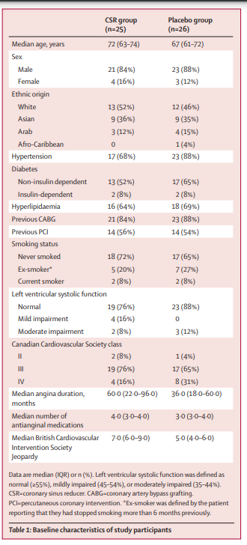

Slide 11
Primary outcomes
The primary symptom outcome was the number of daily episodes of angina recorded on the ORBITA-app.
Myocardial blood flow on adenosine-stress cardiac magnetic resonance in myocardial segments designated as ischaemic at enrolment (excluding transmurally infarcted segments).

Slide 12
At 6-month follow-up, patients in the CSR group were more likely to have a lower number of daily episodes of angina recorded on the ORBITA-app (OR 1·40 [95% CrI 1·08 to 1·83];
Notes:
The odds ratio is the ratio of the odds of the event happening in an exposed group versus a non-exposed group. The odds ratio is commonly used to report the strength of association between exposure and an event. The larger the odds ratio, the more likely the event is to be found with exposure.

Slide 13
No benefit of CSR over placebo was detected in stress myocardial blood flow in segments designated ischaemic at enrolment (0·06 mL/min per g [95% CrI –0·09 to 0·20];

Slide 14
Secondary imaging outcomes
In ischaemic segments, the endocardial to epicardial ratio of stress myocardial blood flow improved in the CSR group (0·09 [95% CrI 0·00 to 0·17])
No difference in the other secondary imaging outcomes

Slide 15
Mechanism of CSR INORD Tebaldi et al 2024
Notes:
C, Mechanisms of coronary sinus reducer (CSR) device. Increase in coronary venous pressure. Increased capillary and arteriolar dilatation. Lower resistance to flow. Restoration of the normal endocardial/epicardial blood flow ratio. LVEDP indicates left ventricular end-diastolic pressure.
INORD study:
The key distinction from prior studies is mechanistic evaluation of coronary microvascular function testing at baseline and 4-month follow-up. The study is consistent with recent in vivo data among patients with microvascular angina (without obstructive coronary artery disease), whereby an acute iatrogenic increase in coronary sinus pressure leads to a reduction in invasive measures of microvascular resistance.5 Tebaldi et al6 should be congratulated for providing a mechanistic prospective single cohort evaluation of patients with RA who underwent coronary sinus reducer implantation. Invasive coronary physiological testing was performed at baseline and 4 months out from the procedure. The primary study end point was the change in the index of microcirculatory resistance (IMR) value from baseline to 4-month follow-up with a reduction in IMR >20% being deemed significantThe key study finding was that IMR reduced in the cohort mean difference (−17.9 units [95% CI, −26.1 to −9.6]) from baseline to 4-month follow-up. Over 70% of patients responded with a significant reduction in IMR value from baseline (IMR reduction ≥20%). These physiological responders had significant improvement in patient-reported outcome measurements of Seattle Angina Questionnaire (SAQ) frequency (≈6 units), stability (≈10 units), and quality of life (≈6 units) relative to nonresponders

Slide 16
Critical appraisal:
Is the basic study design valid for a randomised controlled trial?
Was the study methodologically sound?
Did it add to the available evidence?
Do the benefits of the CSR outweigh the harms and costs?
Notes:
Is the basic study design valid for a randomised controlled trial?
the study address a clearly focused research question?
Was the assignment of participants to interventions randomised?
Were all participants who entered the study accounted for at its conclusion?
==============================================
Was the study methodologically sound?
Were the participants ‘blind’ to intervention they were given? • Were the investigators ‘blind’ to the intervention they were giving to participants?
• Were the people assessing/analysing outcome/s ‘blinded’?
Were the study groups similar at the start of the randomised controlled trial?

Slide 17
Future Considerations/ thoughts!
Next NICE guidelines updates Nov 2024?
Would ESC upgrade the class of recommendation for CSR in the next CCS guidelines update?
Collaboration between EP and interventional consultants?
Can Medway Hospital provide CSR locally?

Slide 18
References:
Thomas J. Ford, Eleanor Redwood,Eunice Chuah,Coronary Sinus Reduction: Can Device-Based Therapy Improve Coronary Microvascular Function?, Circulation: Cardiovascular Interventions, 17, 1, (e013831), (2024).
Banai S, Ben Muvhar S, Parikh KH, Medina A, Sievert H, Seth A, Tsehori J, Paz Y, Sheinfeld A, Keren G. Coronary sinus reducer stent for the treatment of chronic refractory angina pectoris: a prospective, open-label, multicenter, safety feasibility first-in-man study. J Am Coll Cardiol. 2007 May 1;49(17):1783-9. doi: 10.1016/j.jacc.2007.01.061. PMID: 17466229.
Paz Y, Shinfeld A. The coronary sinus reducer for the treatment of refractory angina. Neth Heart J. 2016 Dec;24(12):763-764. doi: 10.1007/s12471-016-0903-x. PMID: 27785619; PMCID: PMC5120012.
Sandler G, Slesser BV, Lawson CW
The Beck operation in the treatment of angina pectoris.Thorax 1967;22:34-37.

